Slide 1
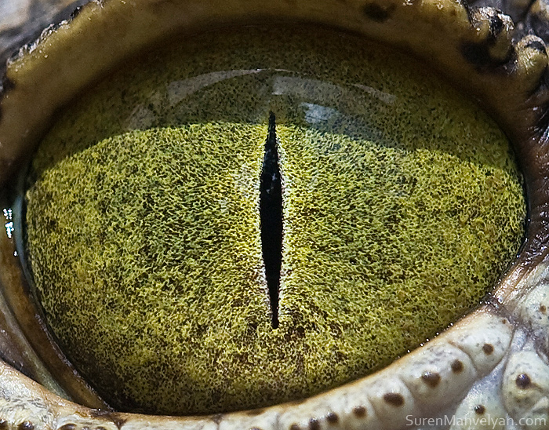
By Suren Manvelyan, http://www.surenmanvelyan.com/gallery/7116
Notes:
http://www.surenmanvelyan.com/gallery/7116
Crocodile (nile crocodile?)

Slide 2
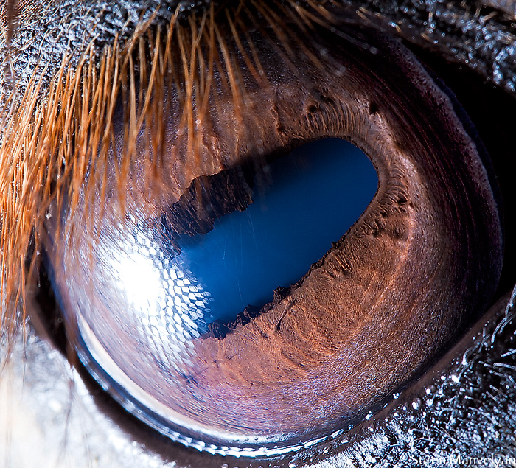
By Suren Manvelyan, http://www.surenmanvelyan.com/gallery/7116
Notes:
http://www.surenmanvelyan.com/gallery/7116
horse

Slide 3
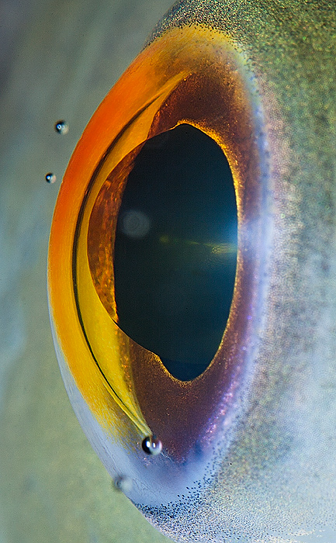
By Suren Manvelyan, http://www.surenmanvelyan.com/gallery/7116
Notes:
http://www.surenmanvelyan.com/gallery/7116
fish

Slide 4
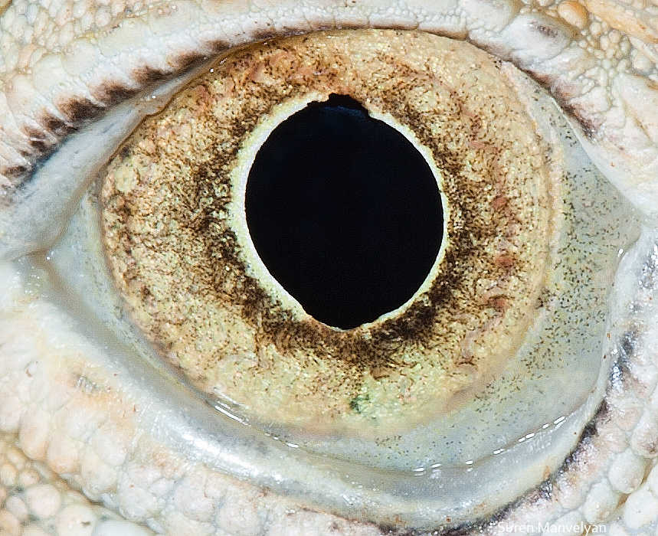
By Suren Manvelyan, http://www.surenmanvelyan.com/gallery/7116
Notes:
http://www.surenmanvelyan.com/gallery/7116
iguana

Slide 5
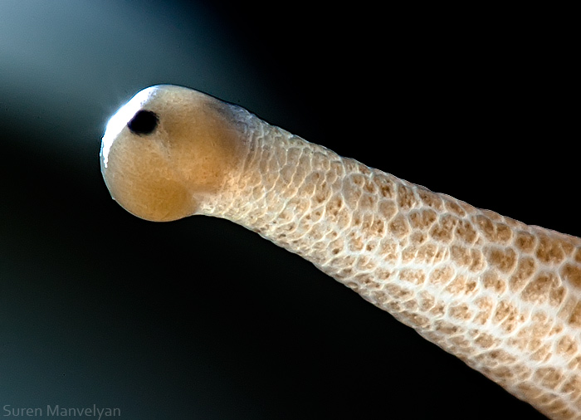
By Suren Manvelyan, http://www.surenmanvelyan.com/gallery/7116
Notes:
http://www.surenmanvelyan.com/gallery/7116
snail

Slide 6
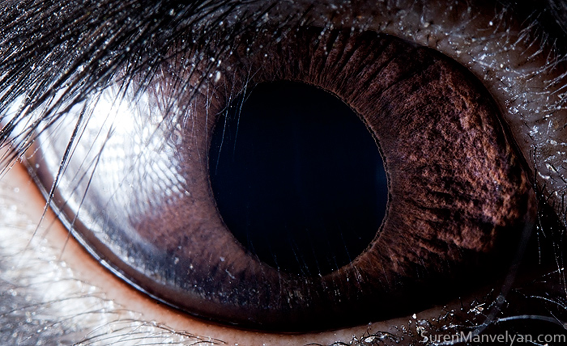
By Suren Manvelyan, http://www.surenmanvelyan.com/gallery/7116
Notes:
http://www.surenmanvelyan.com/gallery/7116
rabbit

Slide 7
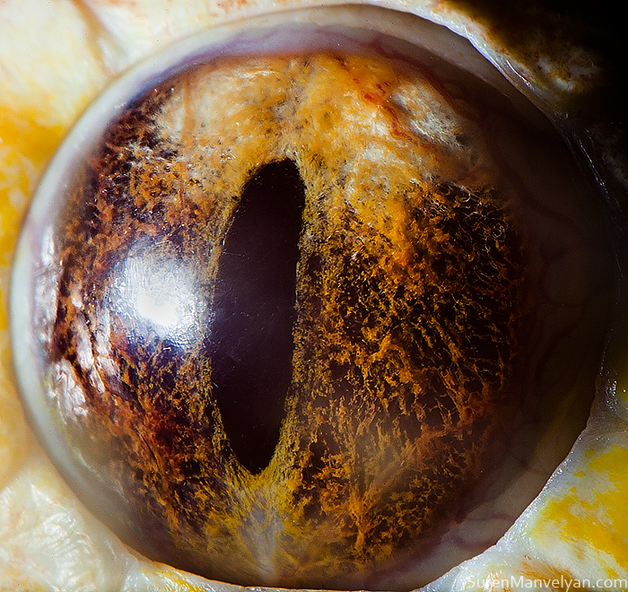
By Suren Manvelyan, http://www.surenmanvelyan.com/gallery/7116
Notes:
http://www.surenmanvelyan.com/gallery/7116
Tiger python

Slide 8
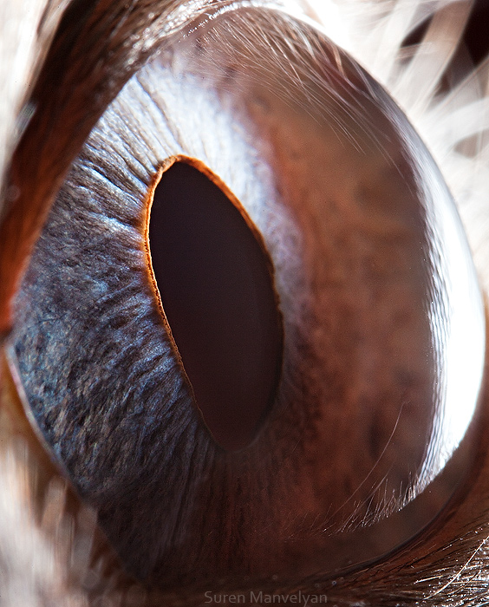
By Suren Manvelyan, http://www.surenmanvelyan.com/gallery/7116
Notes:
http://www.surenmanvelyan.com/gallery/7116
Siam cat

Slide 9
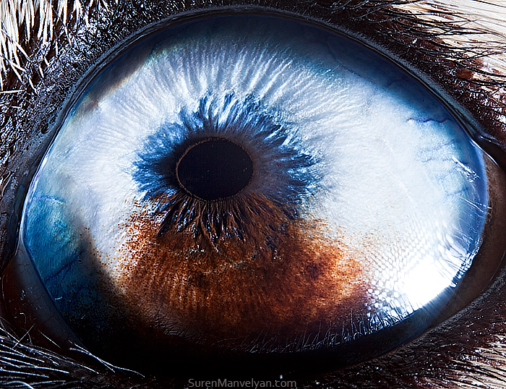
By Suren Manvelyan, http://www.surenmanvelyan.com/gallery/7116
Notes:
http://www.surenmanvelyan.com/gallery/7116
Husky with heterochromia

Slide 10
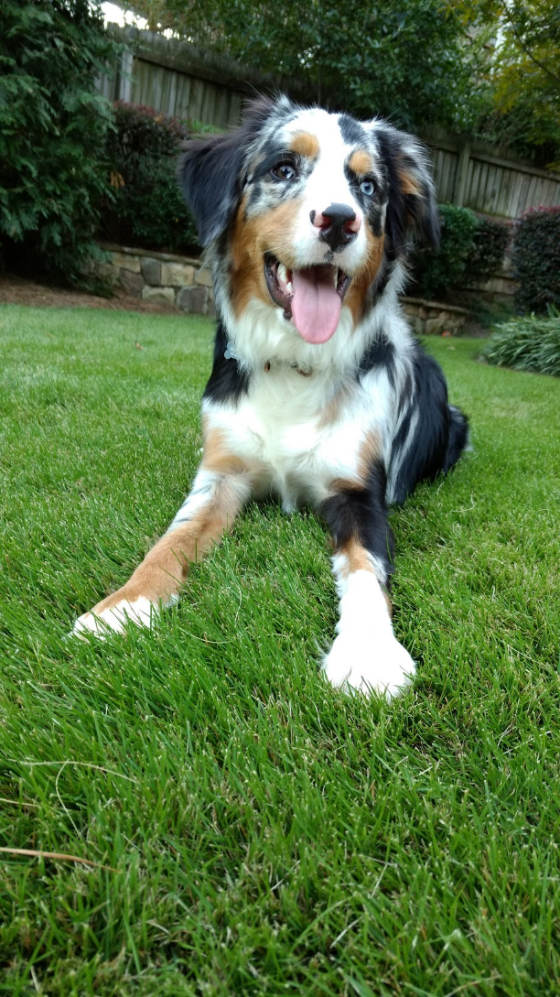
Indy
Notes:
http://www.surenmanvelyan.com/gallery/7116
Crocodile (nile crocodile?)

Slide 11

Indy
Notes:
http://www.surenmanvelyan.com/gallery/7116
Crocodile (nile crocodile?)

Slide 12
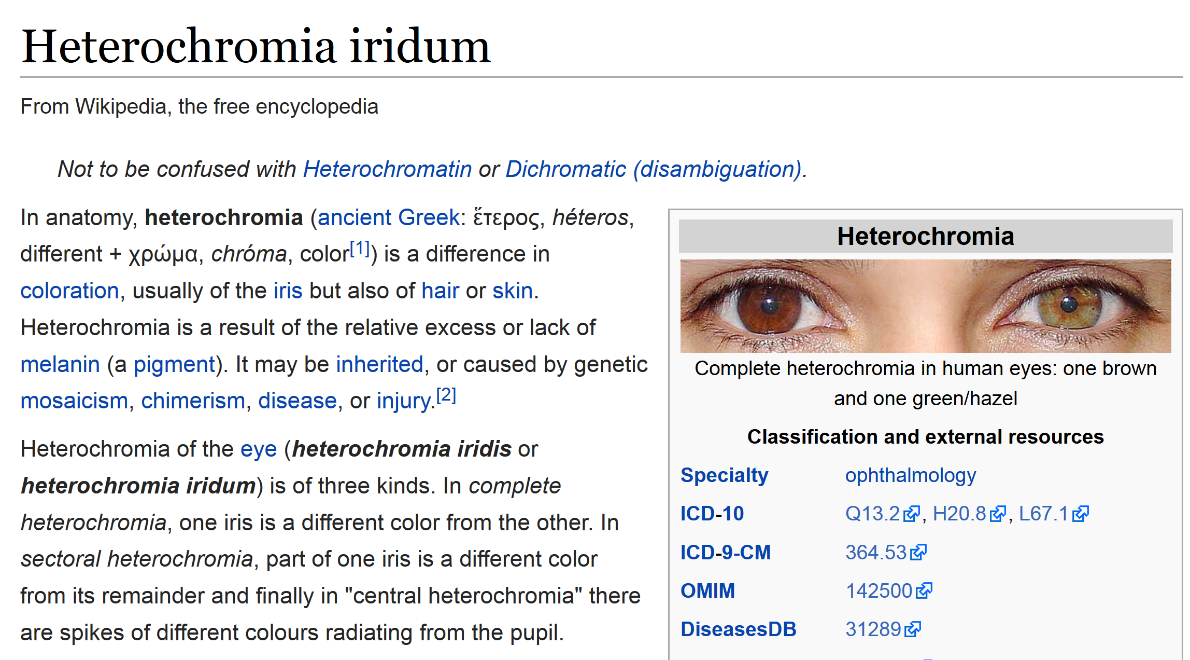

Slide 13
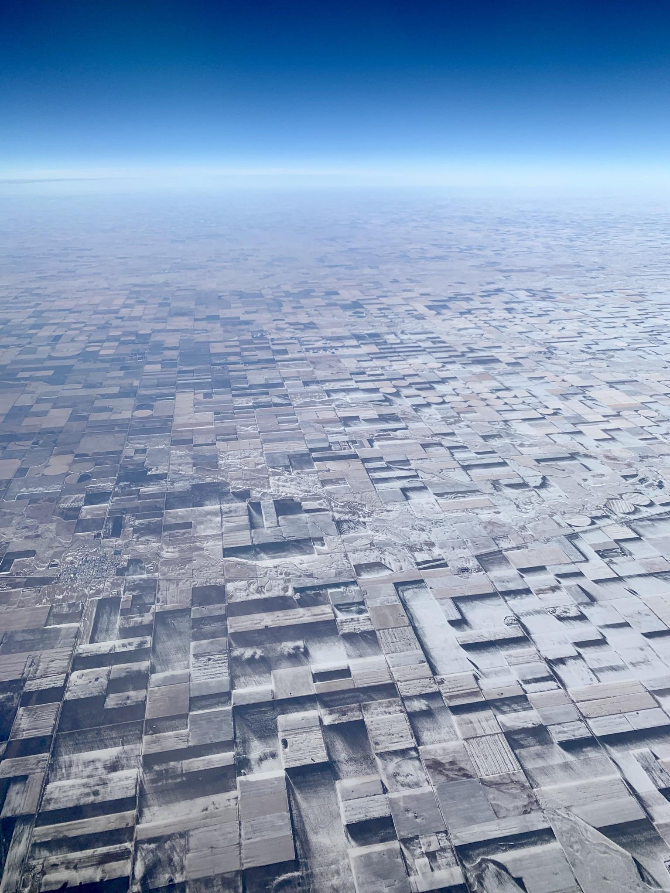
Notes:
https://www.reddit.com/r/oddlysatisfying/comments/1i8hqyk/this_is_100_flat_farmland_several_years_ago_i/

Slide 15
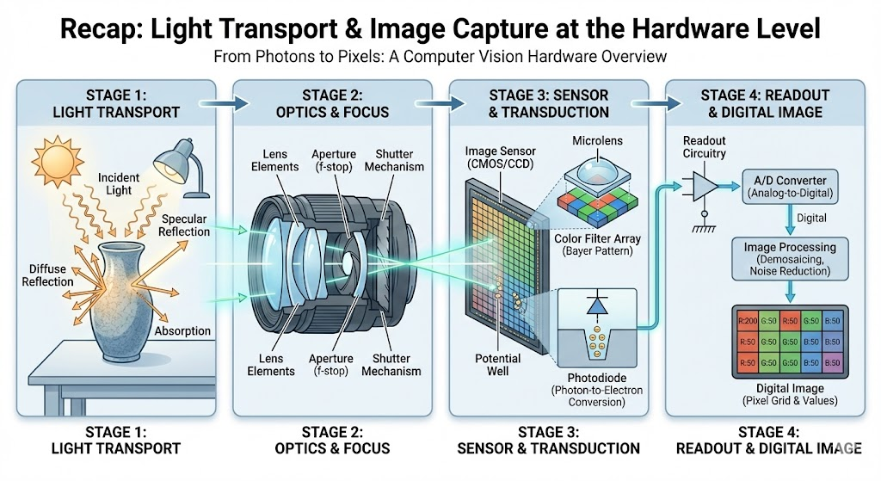

Slide 16
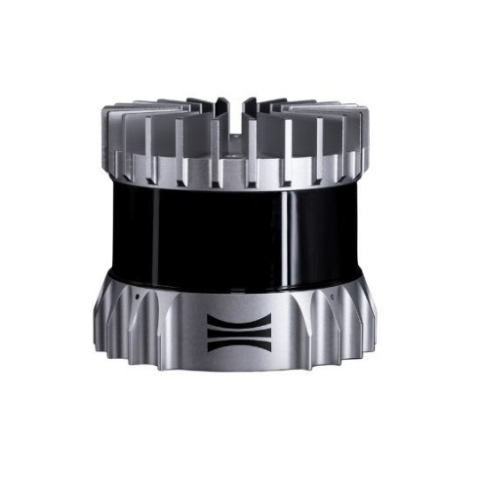
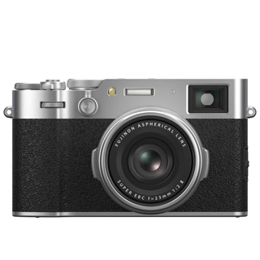
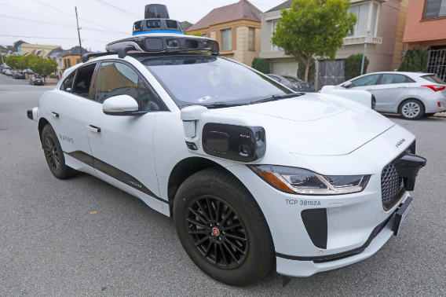
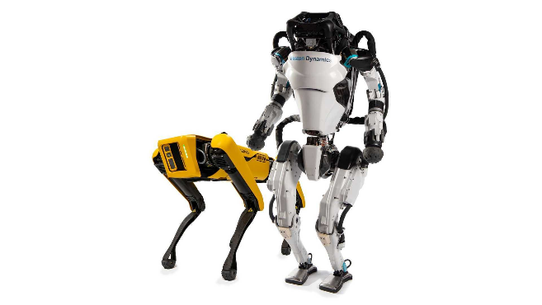
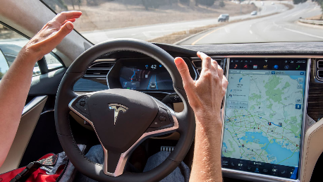
The Spectrum of Biological Inspiration
Radar
Lidar
Traditional cameras
Tesla autopilot
Humanoid and Quadruped robots
Less biologically inspired
More biologically inspired

Slide 17
Interest Points and Corners
Computer Vision
James Hays
Read Szeliski 7.1.1 and 7.1.2
Slides from Rick Szeliski, Svetlana Lazebnik, Derek Hoiem and Grauman&Leibe 2008 AAAI Tutorial

Slide 18
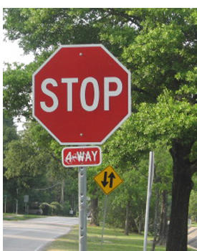


Correspondence across views
Correspondence: matching points, patches, edges, or regions across images
≈

Slide 19
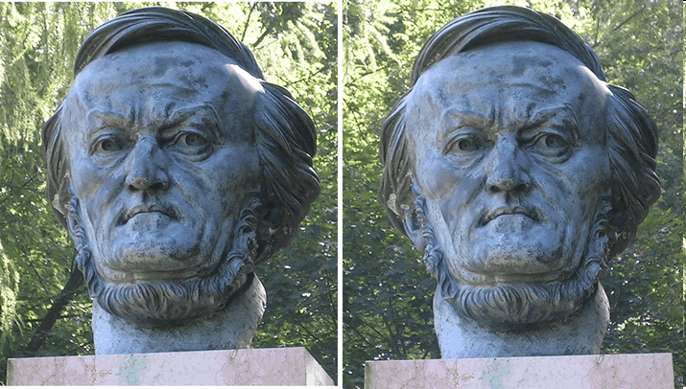
Example: estimating “fundamental matrix” that corresponds two views
Slide from Silvio Savarese

Slide 20
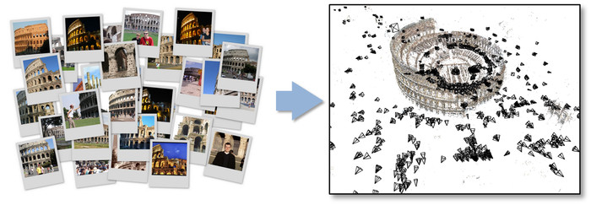
Application: structure from motion

Slide 21
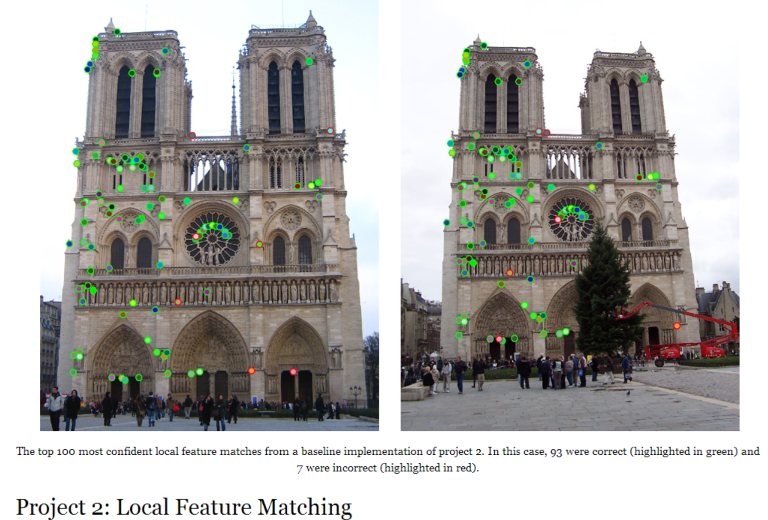
Project 2

Slide 22
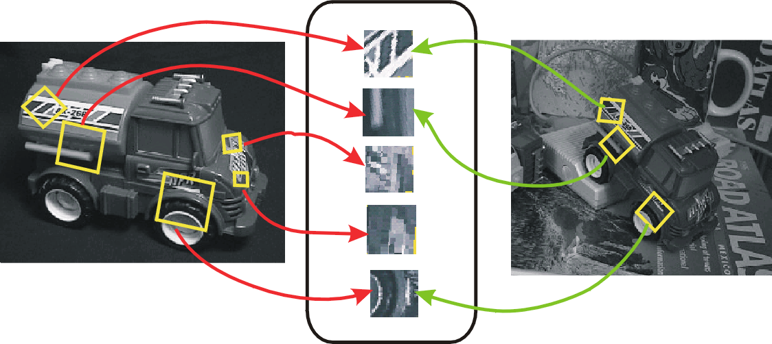
Invariant Local Features
Image content is transformed into local feature coordinates that are invariant to translation, rotation, scale, and other imaging parameters
Features Descriptors

Slide 23
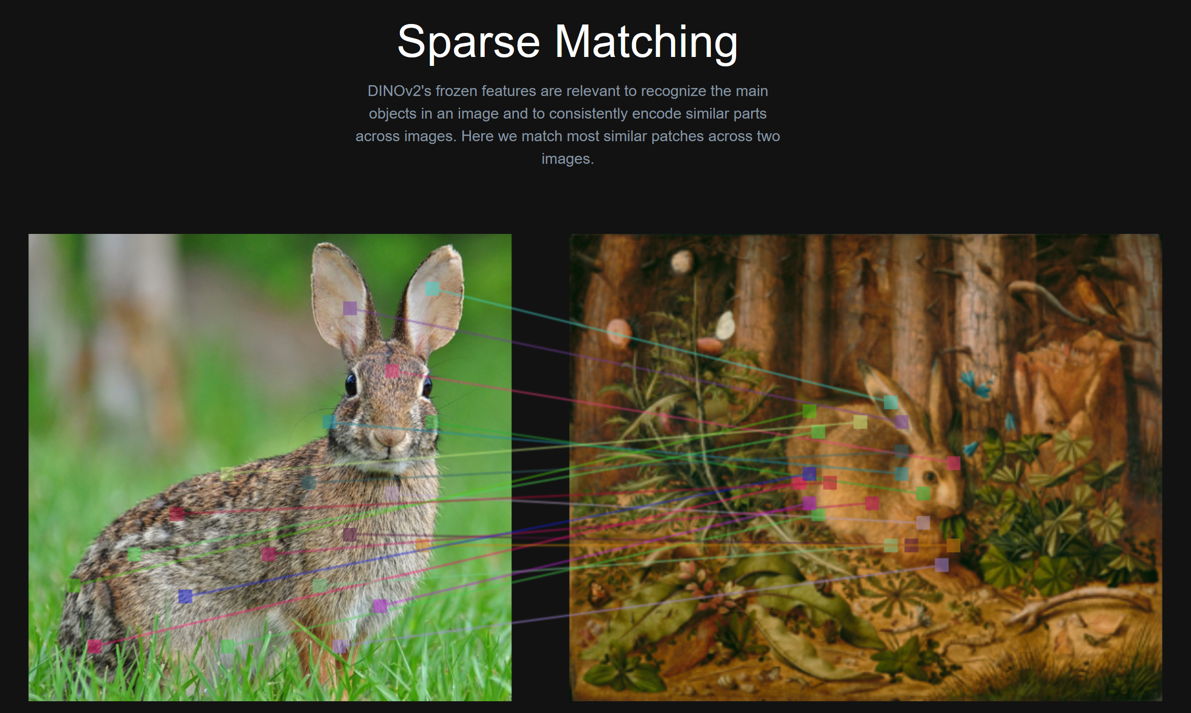
Notes:
Sparse matching is still a challenging task. Dino V2 features are good at it, but they’re not doing especially well in this case

Slide 24
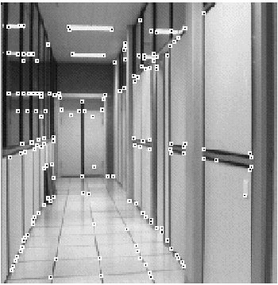
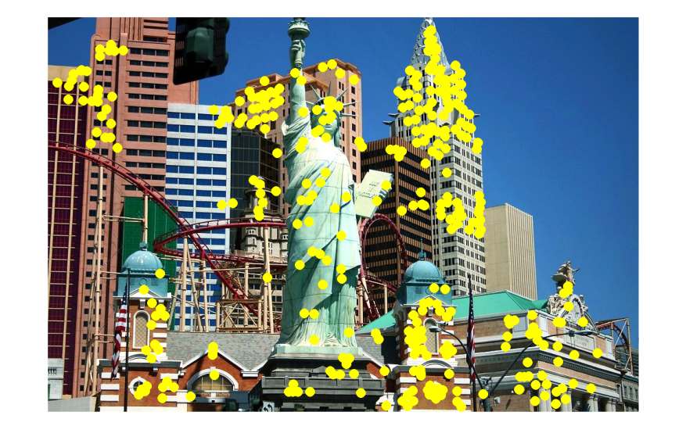
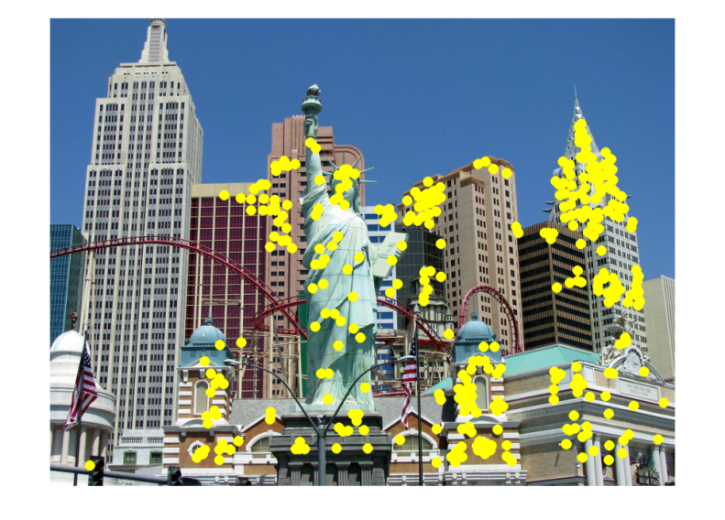
Applications
Feature points are used for:
  Image alignment
  3D reconstruction
  Motion tracking
  Robot navigation
  Indexing and database retrieval
  Object recognition

Slide 25
Project 2: interest points and local features
I use “interest points” and “keypoints” and “SIFT features” interchangeably

Slide 26
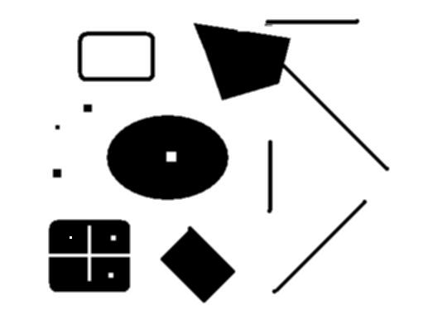
This class: interest points
original
Suppose you have to click on some point, go away and come back after I deform the image, and click on the same points again.
  Which points would you choose?
deformed

Slide 27




Overview of Keypoint Matching
1. Find a set of distinctive keypoints
A₁
B₃
A₂
A₃
2. Compute a local descriptor from the region around each keypoint
B₁
B₂
3. Match local descriptors

Slide 28
Goals for Keypoints
Detect points that are repeatable and distinctive

Slide 29
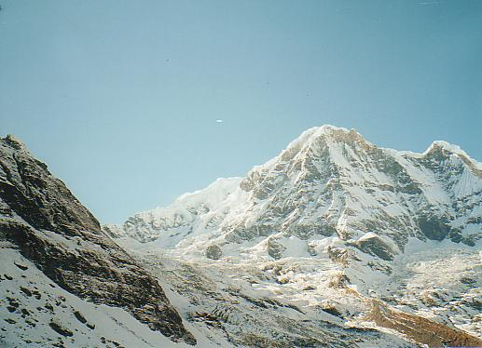
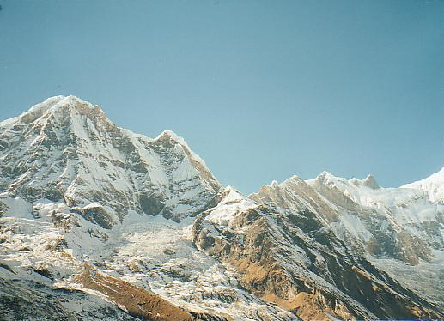
Why extract features?
Motivation: panorama stitching
  We have two images – how do we combine them?

Slide 30
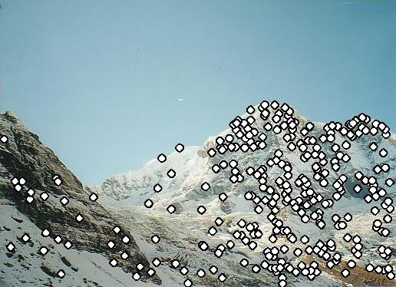
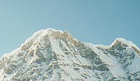

Local features: main components
Detection: Identify the interest points
Description: Extract vector feature descriptor surrounding each interest point.
Matching: Determine correspondence between descriptors in two views
Kristen Grauman

Slide 31
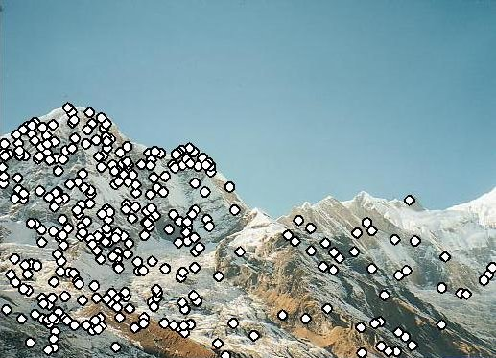
Characteristics of good interest points
Repeatability
  The same feature can be found in several images despite geometric and photometric transformations
Saliency
  Each feature is distinctive
Compactness and efficiency
  Many fewer features than image pixels
Locality
  A feature occupies a relatively small area of the image; robust to clutter and occlusion

Slide 32
Goal: interest operator repeatability
We want to detect (at least some of) the same points in both images.
Yet we have to be able to run the detection procedure independently per image.
No chance to find true matches!
Kristen Grauman
Notes:
32

Slide 33
Goal: descriptor distinctiveness
We want to be able to reliably determine which point goes with which.
Must provide some invariance to geometric and photometric differences between the two views.
?
Kristen Grauman

Slide 34
Local features: main components
Detection: Identify the interest points
Description:Extract vector feature descriptor surrounding each interest point.
Matching: Determine correspondence between descriptors in two views

Slide 35
Many Existing Detectors Available
Hessian & Harris [Beaudet ‘78], [Harris ‘88]
Laplacian, DoG [Lindeberg ‘98], [Lowe 1999]
Harris-/Hessian-Laplace [Mikolajczyk & Schmid ‘01]
Harris-/Hessian-Affine [Mikolajczyk & Schmid ‘04]
EBR and IBR [Tuytelaars & Van Gool ‘04]
MSER [Matas ‘02]
Salient Regions [Kadir & Brady ‘01]
Others…

Slide 36
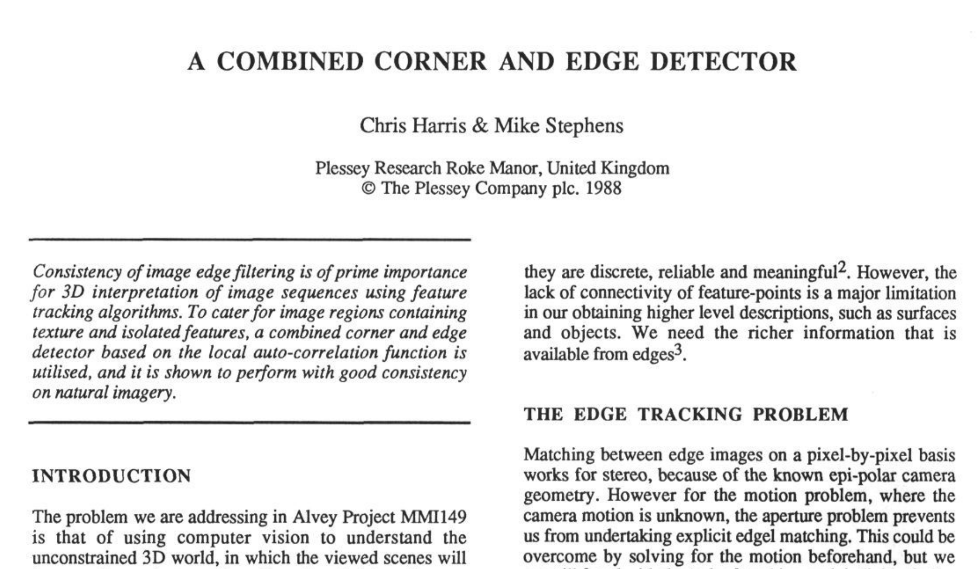

Slide 37
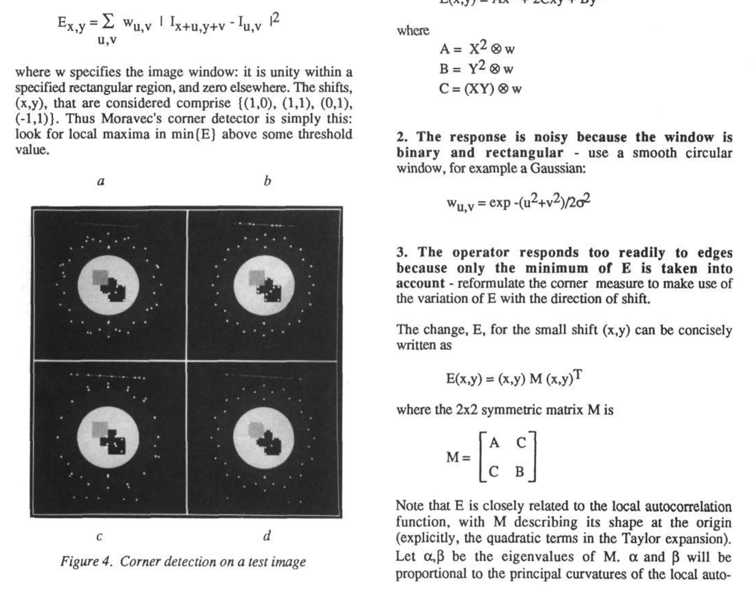

Slide 38

Corner Detection: Basic Idea
We should easily recognize the point by looking through a small window
Shifting a window in any direction should give a large change in intensity
“flat” region:
no change in all directions
“edge”:
no change along the edge direction
“corner”:
significant change in all directions
Source: A. Efros

Slide 39
Corner Detection: Baseline strategies
First, cornerness is a property of a “patch”, not a single pixel
Let’s look for patches that have high gradients in the x and y directions.
“flat” region:
no gradients
“edge”:
gradients in one direction
“corner”:
gradients in both directions
Source: James Hays

Slide 40
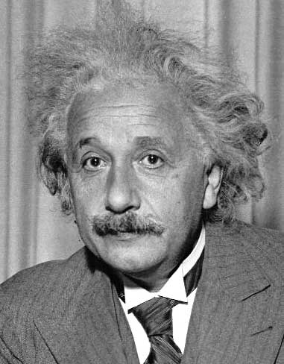
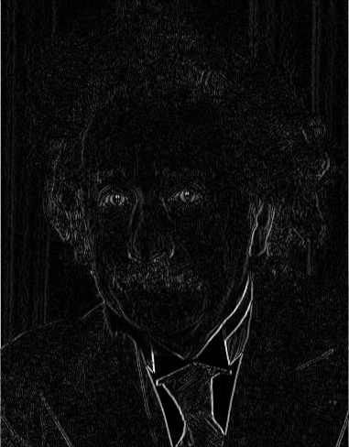
Reminder: gradients measured with filtering
1
0
-1
2
0
-2
1
0
-1
Sobel
Vertical Edge
(absolute value)

Slide 41
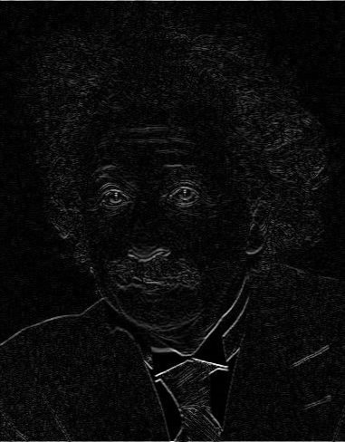
Reminder: gradients measured with filtering
1
2
1
0
0
0
-1
-2
-1
Sobel
Horizontal Edge
(absolute value)
Notes:
Questions at this point?

Slide 42
Corner Detection: Baseline strategies
First, cornerness is a property of a “patch”, not a single pixel
Let’s look for patches that have high gradients in the x and y directions.
“flat” region:
no gradients
“edge”:
gradients in one direction
“corner”:
gradients in both directions
“edge”:
gradients in both directions
Source: James Hays

Slide 43
Corner Detection: Baseline strategies
Let’s look for patches that have high gradients in the x and y directions.
Not a sufficient strategy
“flat” region:
no gradients
“edge”:
gradients in one direction
“corner”:
gradients in both directions
“edge”:
gradients in both directions
Source: James Hays

Slide 44
Corner Detection: Baseline strategies
Let’s write down what the gradients actually look like in different scenarios
“flat” region:
no gradients
“edge”:
gradients in one direction
“corner”:
gradients in both directions
“edge”:
gradients in both directions
Source: James Hays

Slide 45
Corner Detection: Baseline strategies
For a patch to be a corner, the gradient distribution needs to be full rank
We should check more than 2 pixels
How do we measure this rank?
“flat” region:
no gradients
“edge”:
gradients in one direction
“corner”:
gradients in both directions
“edge”:
gradients in both directions
Source: James Hays

Slide 46
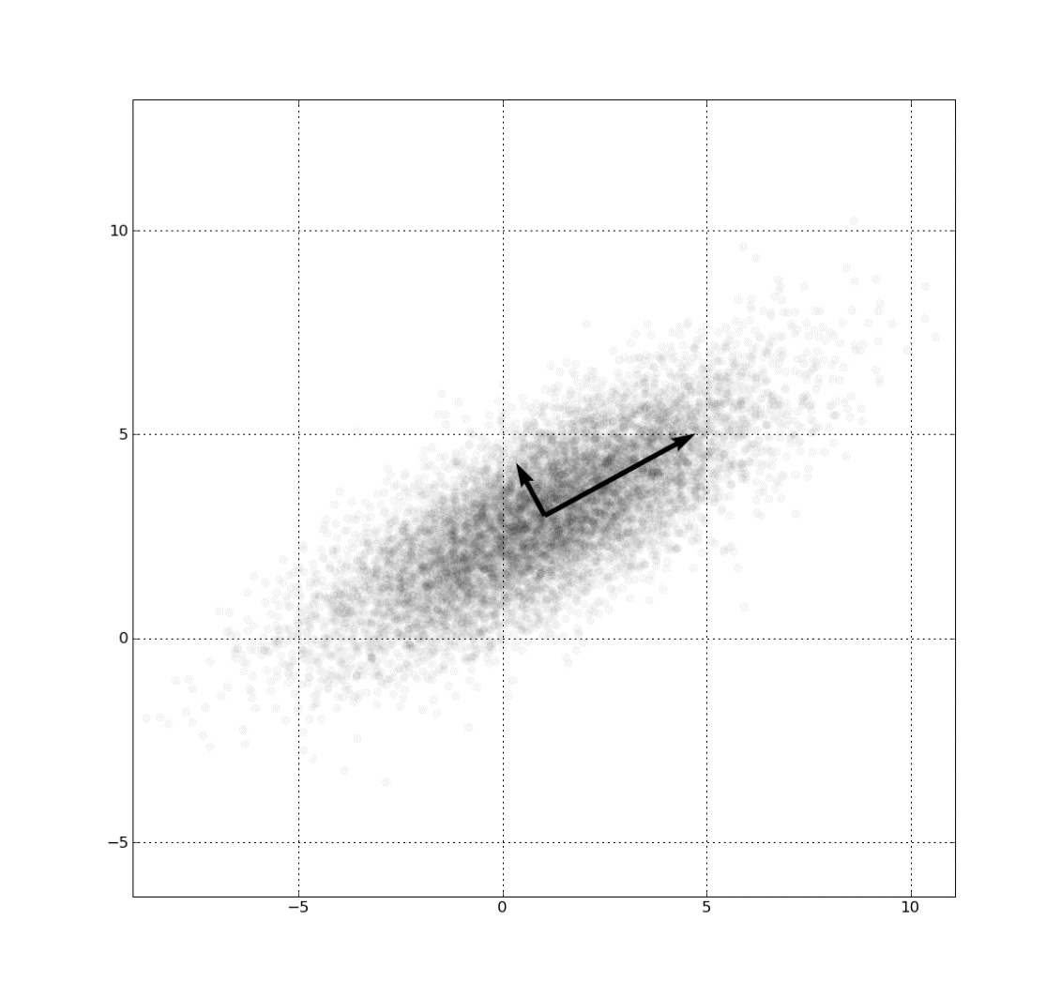
Eigenvalues tell us the rank
I = [-5, 0
0, 3
-3, 0
5, 5
…
...]
https://en.wikipedia.org/wiki/Eigenvalues_and_eigenvectors

Slide 47
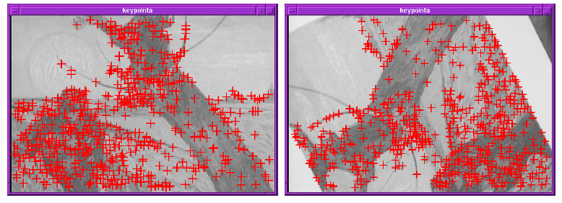
Finding Corners
Key property: in the region around a corner, image gradient has two or more dominant directions
Corners are repeatable and distinctive
C.Harris and M.Stephens. "A Combined Corner and Edge Detector.“ Proceedings of the 4th Alvey Vision Conference: pages 147--151.

Slide 48
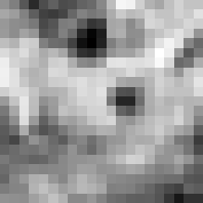

Corner Detection: Mathematics
Change in appearance of window w(x,y)
for the shift [u,v]:
I(x, y)
E(u, v)
E(3,2)
w(x, y)

Slide 49
Corner Detection: Mathematics
Change in appearance of window w(x,y)
for the shift [u,v]:
I(x, y)
E(u, v)
E(0,0)
w(x, y)

Slide 50
Corner Detection: Mathematics
Change in appearance of window w(x,y)
for the shift [u,v]:
Window function
Shifted intensity
Intensity
Window function w(x,y) =
or
1 in window, 0 outside
Gaussian
Source: R. Szeliski

Slide 51
Corner Detection: Mathematics
Change in appearance of window w(x,y)
for the shift [u,v]:
We want to find out how this function behaves for small shifts
E(u, v)

Slide 52
Corner Detection: Mathematics
Change in appearance of window w(x,y)
for the shift [u,v]:
We want to find out how this function behaves for small shifts
But this is very slow to compute naively.
O(window_width² * shift_range² * image_width²)
O( 11² * 11² * 600² ) = 5.2 billion of these
14.6 thousand per pixel in your image

Slide 53
Corner Detection: Mathematics
Change in appearance of window w(x,y)
for the shift [u,v]:
We want to find out how this function behaves for small shifts
Recall Taylor series expansion. A function f can be approximated around point a as

Slide 54
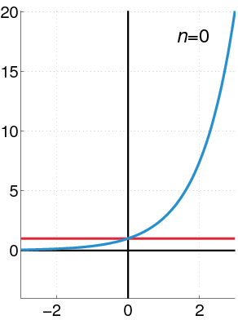
Recall: Taylor series expansion
A function f can be approximated as
Approximation of
f(x) = e^{x}
centered at f(0)

Slide 55
Corner Detection: Mathematics
Change in appearance of window w(x,y)
for the shift [u,v]:
We want to find out how this function behaves for small shifts
Local quadratic approximation of E(u,v) in the neighborhood of (0,0) is given by the second-order Taylor expansion:
Notes:
Technically a Maclaurin expansion, a special case of Taylor expansion centered at 0.
What is the point? Well, now we’re just extrapolating local measurements instead of doing 10s of thousands of computations.

Slide 56
Corner Detection: Mathematics
Local quadratic approximation of E(u,v) in the neighborhood of (0,0) is given by the second-order Taylor expansion:
E(u, v)
Always 0
First derivative is 0
Notes:
Technically a Maclaurin expansion, a special case of Taylor expansion centered at 0.

Slide 57
Corner Detection: Mathematics
Second-order Taylor expansion of E(u,v) about (0,0):

Slide 58
Corner Detection: Mathematics
Second-order Taylor expansion of E(u,v) about (0,0):

Slide 59
Corner Detection: Mathematics
Second-order Taylor expansion of E(u,v) about (0,0):

Slide 60
Corner Detection: Mathematics
The quadratic approximation simplifies to
where M is a second moment matrix computed from image derivatives:
M

Slide 61
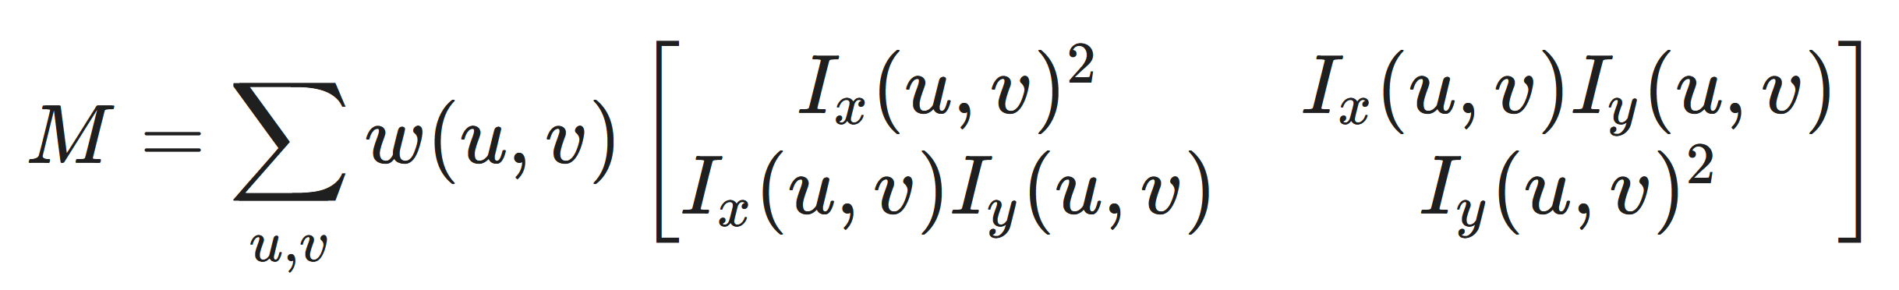
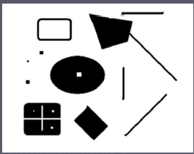
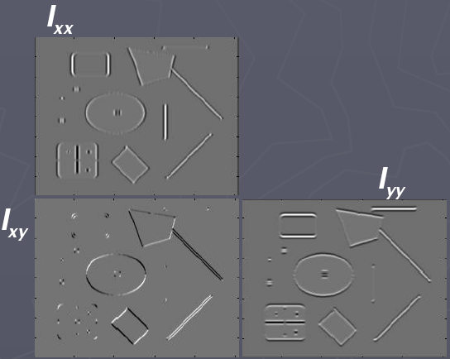
Corners as distinctive interest points
2 x 2 matrix of image derivatives (averaged in neighborhood of a point).
Notation:
M

Slide 62
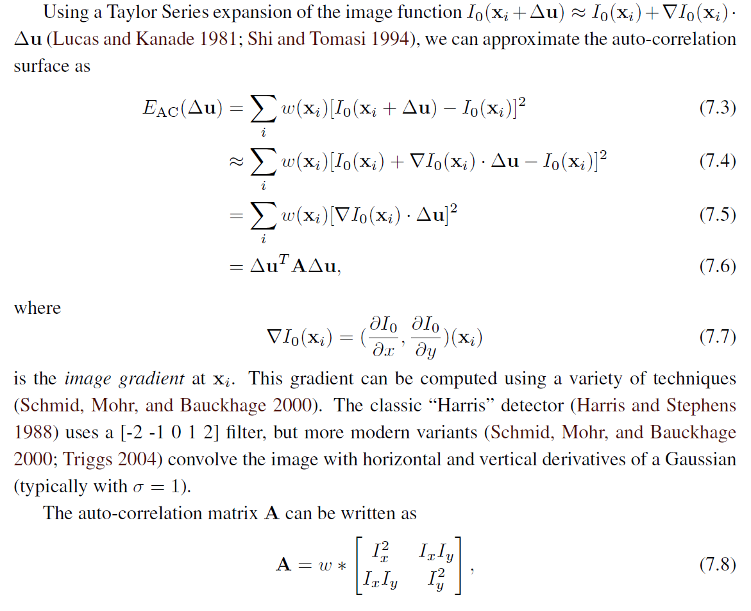
Different derivations exist.
This is the textbook version.

Slide 63
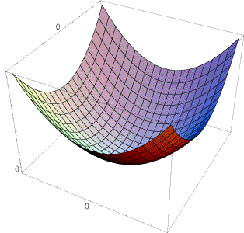
Interpreting the second moment matrix
The surface E(u,v) is locally approximated by a quadratic form. Let’s try to understand its shape.

Slide 64
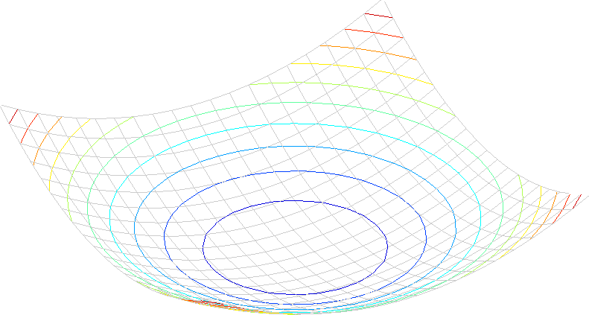
Interpreting the second moment matrix
Consider a horizontal “slice” of E(u, v):
This is the equation of an ellipse.

Slide 65
Interpreting the second moment matrix
First, consider the axis-aligned case (gradients are either horizontal or vertical)
If either λ is close to 0, then this is not a corner, so look for locations where both are large.

Slide 66
Interpreting the second moment matrix
Consider a horizontal “slice” of E(u, v):
This is the equation of an ellipse.
Diagonalization of M:
The axis lengths of the ellipse are determined by the eigenvalues and the orientation is determined by R
direction of the fastest change
direction of the slowest change
(λ_{max})^{-1/2}
(λ_{min})^{-1/2}

Slide 67
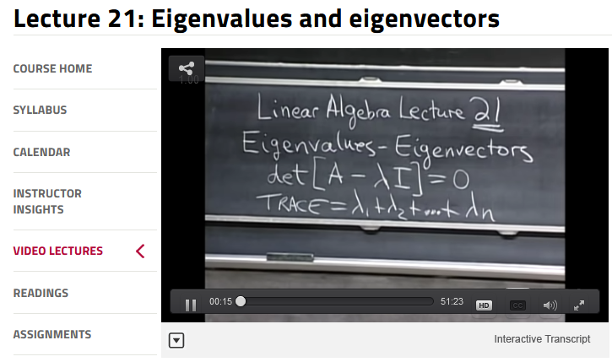
If you’re not comfortable with Eigenvalues and Eigenvectors, Gilbert Strang’s linear algebra lectures are linked from the course homepage

Slide 68
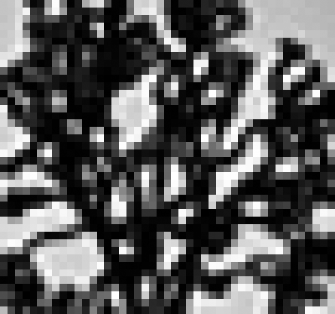
Visualization of second moment matrices

Slide 69

Visualization of second moment matrices

Slide 70
Interpreting the eigenvalues
Classification of image points using eigenvalues of M:
λ₂
“Edge”
λ₂ >> λ₁
“Corner”
λ₁ and λ₂ are large,
λ₁ ~ λ₂;
Patch differs from itself for shifts in all directions
λ₁ and λ₂ are small;
E is almost constant in all directions
“Flat” region
“Edge”
λ₁ >> λ₂
λ₁

Slide 71
Interpreting the eigenvalues
Classification of image points using eigenvalues of M:
λ₂
“Edge”
λ₂ >> λ₁
“Corner”
λ₁ and λ₂ are large,
λ₁ ~ λ₂;
Patch differs from itself for shifts in all directions
α: constant (0.04 to 0.06)
λ₁ and λ₂ are small;
E is almost constant in all directions
“Flat” region
“Edge”
λ₁ >> λ₂
λ₁

Slide 72
Harris corner detector
Compute M matrix for each image window to get their cornerness scores, R.
Find points whose surrounding window gave large corner response (f> threshold)
Take the points of local maxima, i.e., perform non-maximum suppression
C.Harris and M.Stephens. “A Combined Corner and Edge Detector.” Proceedings of the 4th Alvey Vision Conference: pages 147—151, 1988.
Notes:
72

Slide 73










Harris Detector [Harris88]
Second moment matrix
1. Image derivatives
I_{x}
I_{y}
(optionally, blur first)
I_{x}²
I_{y}²
I_{x}I_{y}
2. Square of derivatives
3. Gaussian
filtered derivatives g(σ_{I})
g(I_{x}²)
g(I_{y}²)
g(I_{x}I_{y})
4. Cornerness function – both eigenvalues are strong
5. Non-maxima suppression
har

Slide 74
Harris Corners – Why so complicated?
Can’t we just check for regions with lots of gradients in the x and y directions?
  No! A diagonal line would satisfy that criteria
Current Window

Slide 75
Harris Detector [Harris88]
Second moment matrix
1. Image derivatives
I_{x}
I_{y}
(optionally, blur first)
I_{x}²
I_{y}²
I_{x}I_{y}
2. Square of derivatives
3. Gaussian
filtered derivatives g(σ_{I})
g(I_{x}²)
g(I_{y}²)
g(I_{x}I_{y})
4. Cornerness function – both eigenvalues are strong
5. Non-maxima suppression
har

Slide 76
Harris Corners – Why so complicated?
Current Window
What does the structure matrix look here?

Slide 77
Harris Corners – Why so complicated?
Current Window
What does the structure matrix look here?

Slide 78
Harris Corners – Why so complicated?
Current Window
What does the structure matrix look here?

Slide 79
Harris Corners – Why so complicated?
0
-4
0
4
0
-1
0
1
0
-4
0
4
0
We will measure x gradients by filtering with:
-2
0
2
Current Window
0
-2
0
2
0
-1
0
1
0
-4
0
4
0
0
-4
0
4
0
-1
-2
-1
0
0
0
0
0
We will measure y gradients by filtering with:
0
0
0
-4
-4
-2
-4
-4
1
2
1
0
0
0
0
0
4
4
2
4
4
0
0
0
0
0

Slide 80
Harris Corners – Why so complicated?
0
-4
0
4
0
-1
0
1
0
-4
0
4
0
We will measure x gradients by filtering with:
-2
0
2
Current Window
0
-2
0
2
0
-1
0
1
0
-4
0
4
0
0
-4
0
4
0
-1
-2
-1
0
0
0
0
0
We will measure y gradients by filtering with:
0
0
0
-4
-4
-2
-4
-4
1
2
1
0
0
0
0
0
4
4
2
4
4
0
0
0
0
0
0
0
0
0
0
0
16
0
-16
0
0
0
0
0
0
0
-16
0
16
0
0
0
0
0
0

Slide 81
Harris Corners – Why so complicated?
0
-4
0
4
0
-1
0
1
0
-4
0
4
0
We will measure x gradients by filtering with:
-2
0
2
Current Window
0
-2
0
2
0
-1
0
1
0
-4
0
4
0
0
-4
0
4
0
-1
-2
-1
0
0
0
0
0
We will measure y gradients by filtering with:
0
0
0
-4
-4
-2
-4
-4
1
2
1
0
0
0
0
0
4
4
2
4
4
0
0
0
0
0
0
0
0
0
0
0
16
0
-16
0
0
0
0
0
0
0
-16
0
16
0
0
0
0
0
0

Slide 82
Harris Corners – Why so complicated?
Current Window
What does the structure matrix look here?

Slide 83
Harris Detector [Harris88]
Second moment matrix
1. Image derivatives
I_{x}
I_{y}
(optionally, blur first)
I_{x}²
I_{y}²
I_{x}I_{y}
2. Square of derivatives
3. Gaussian
filter g(σ_{I})
g(I_{x}²)
g(I_{y}²)
g(I_{x}I_{y})
4. Cornerness function – both eigenvalues are strong
5. Non-maxima suppression
har

Slide 84

Harris Detector: Steps

Slide 85

Harris Detector: Steps
Compute corner response R

Slide 86

Harris Detector: Steps
Find points with large corner response: R>threshold

Slide 87

Harris Detector: Steps
Take only the points of local maxima of R

Slide 88

Harris Detector: Steps

