Slide 1
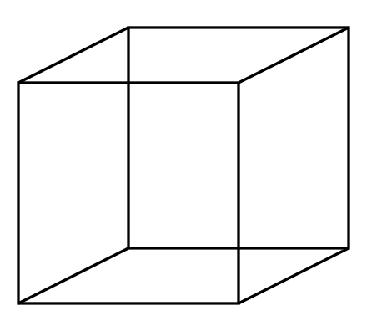
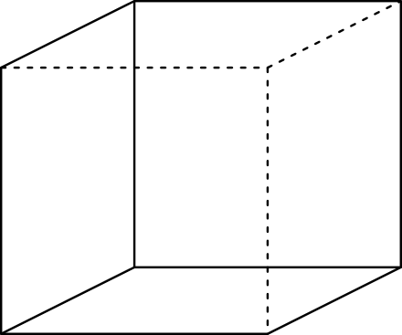
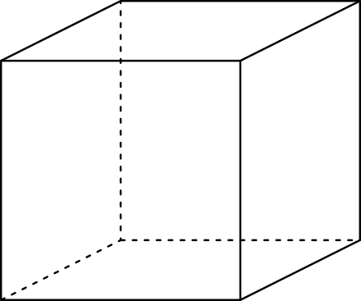
Multi-stable Perception
Necker Cube

Slide 2
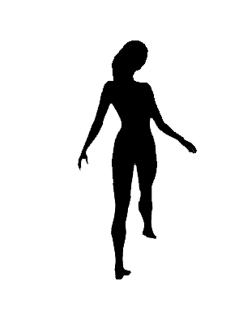
Spinning dancer illusion, Nobuyuki Kayahara
Notes:
2021 poll results
https://linkto.run/p/2VGXTJD3
Surprisingly many people could see it rotating either way, hypothesizing that the low framerate on Bluejeans made it easier

Slide 3
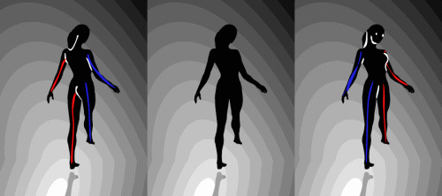

Slide 4
Feature Matching and Robust Fitting
Read Szeliski 7.4.2 and 2.1
Computer Vision
James Hays
Acknowledgment: Many slides from Derek Hoiem and Grauman&Leibe 2008 AAAI Tutorial

Slide 5
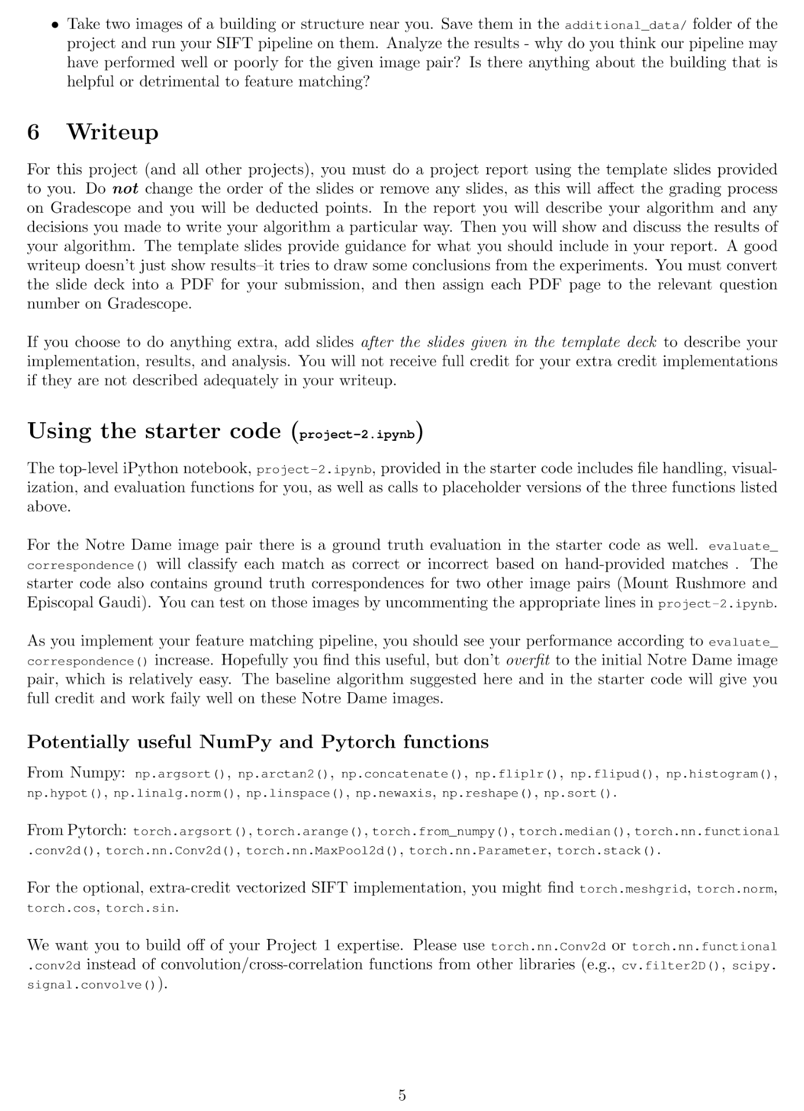
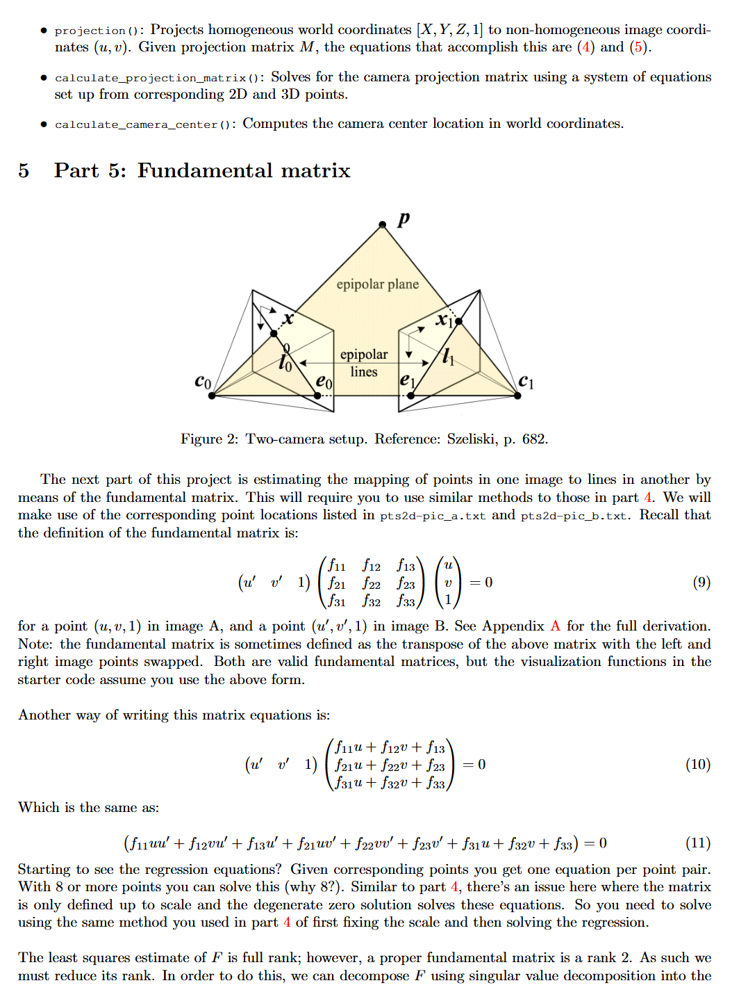
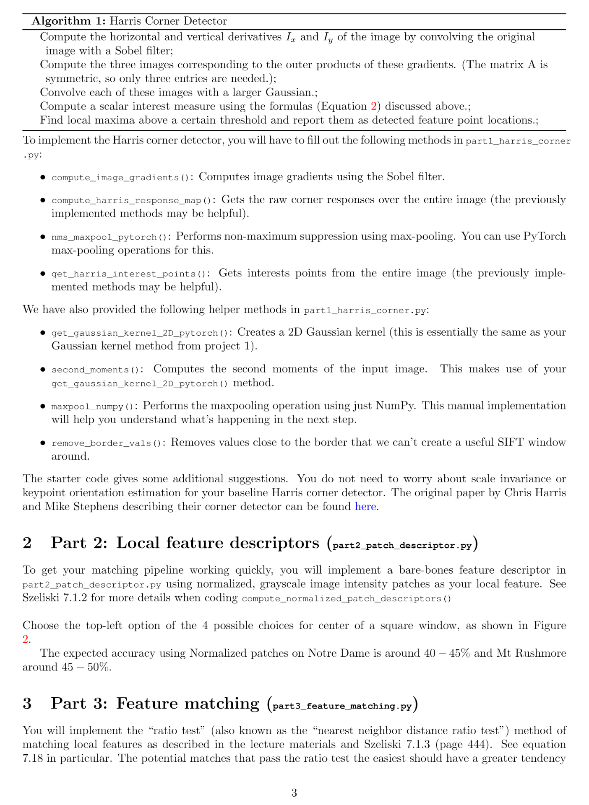
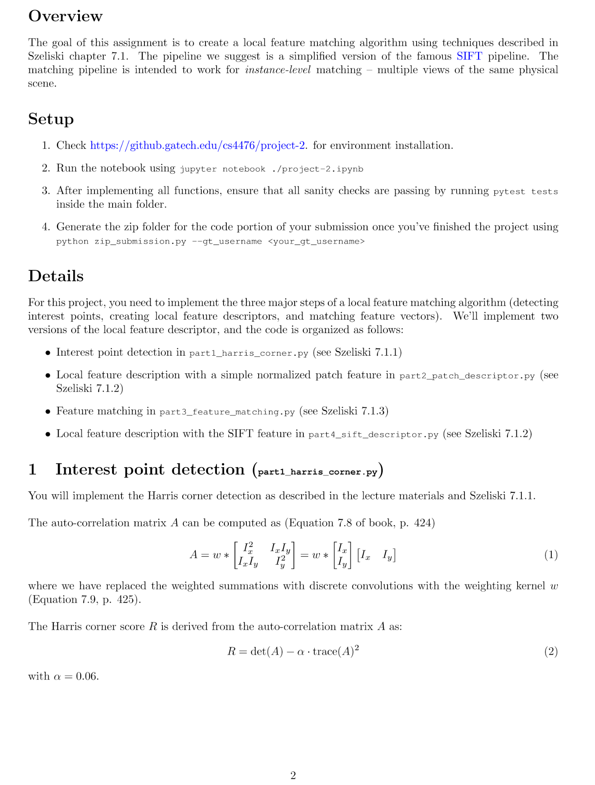
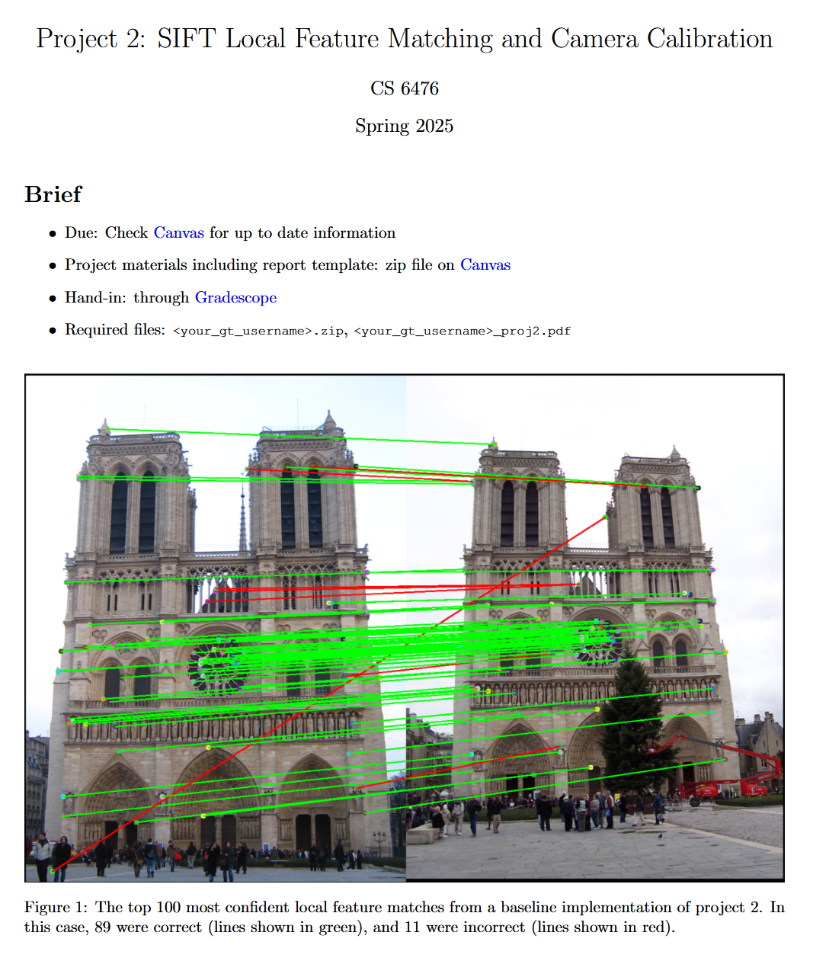
Project 2

Slide 6
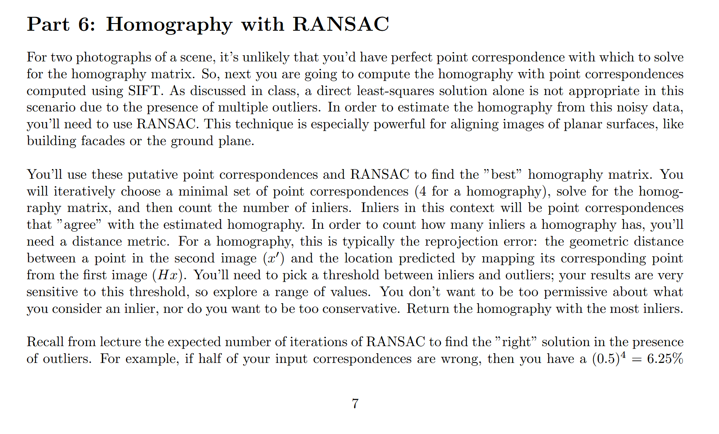

Slide 7
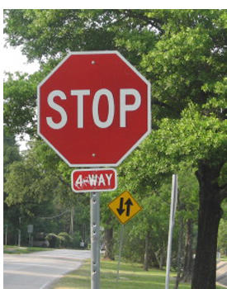
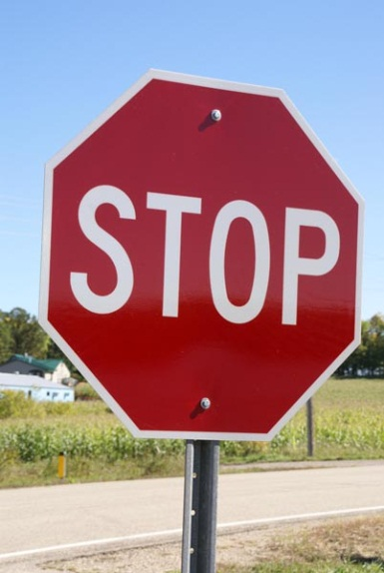
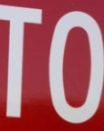
This section: correspondence and alignment
Correspondence: matching points, patches, edges, or regions across images
≈

Slide 8
Review: Local Descriptors
Most features can be thought of as templates, histograms (counts), or combinations
The ideal descriptor should be
  Robust and Distinctive
  Compact and Efficient
Most available descriptors focus on edge/gradient information
  Capture texture information
  Color rarely used

Slide 9
Matching
Simplest approach: Pick the nearest neighbor. Threshold on absolute distance
Problem: Lots of self similarity in many photos

Slide 10
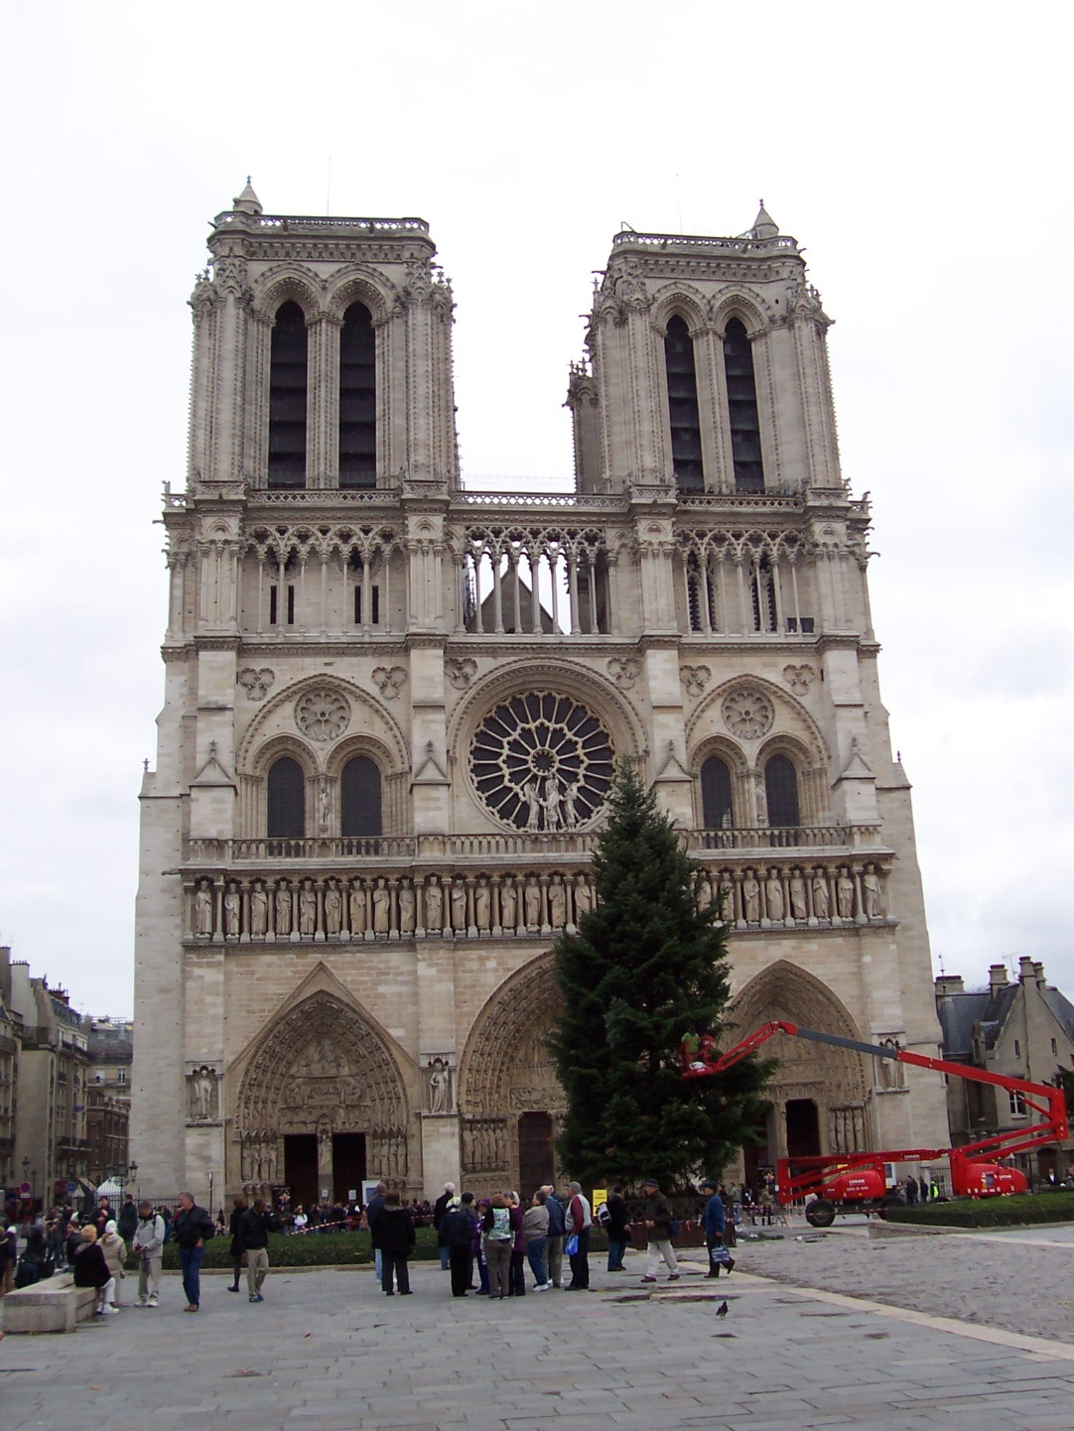
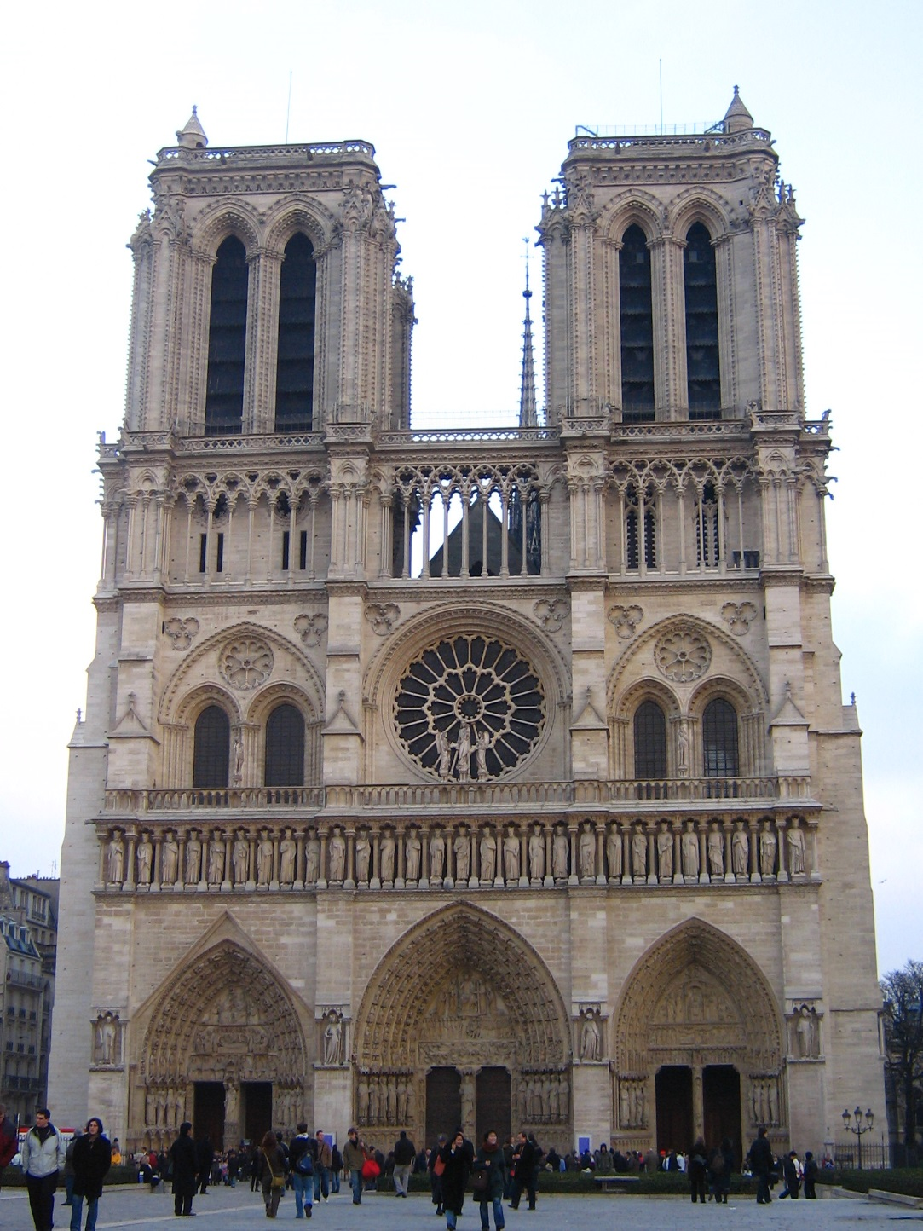
Distance: 1.22
Distance: 0.61
Distance: 0.34, 0.30, 0.40

Slide 11

Nearest Neighbor Distance Ratio
$\frac{NN1}{NN2}$ where NN1 is the distance to the first nearest neighbor and NN2 is the distance to the second nearest neighbor.
Sorting by this ratio (into ascending order) puts matches in order of confidence (in descending order of confidence).

Slide 12
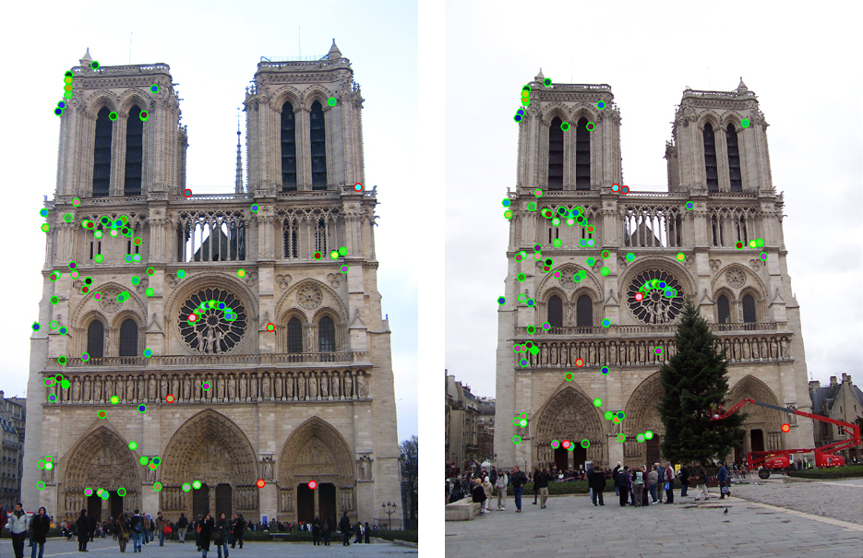
Can we refine this further?

Slide 13
Can we refine this further?

Slide 14
Can we refine this further?

Slide 15
Can we refine this further?

Slide 16
What is the space of allowable correspondences?
Notes:
If the scene is static
If we have a pinhole camera

Slide 17
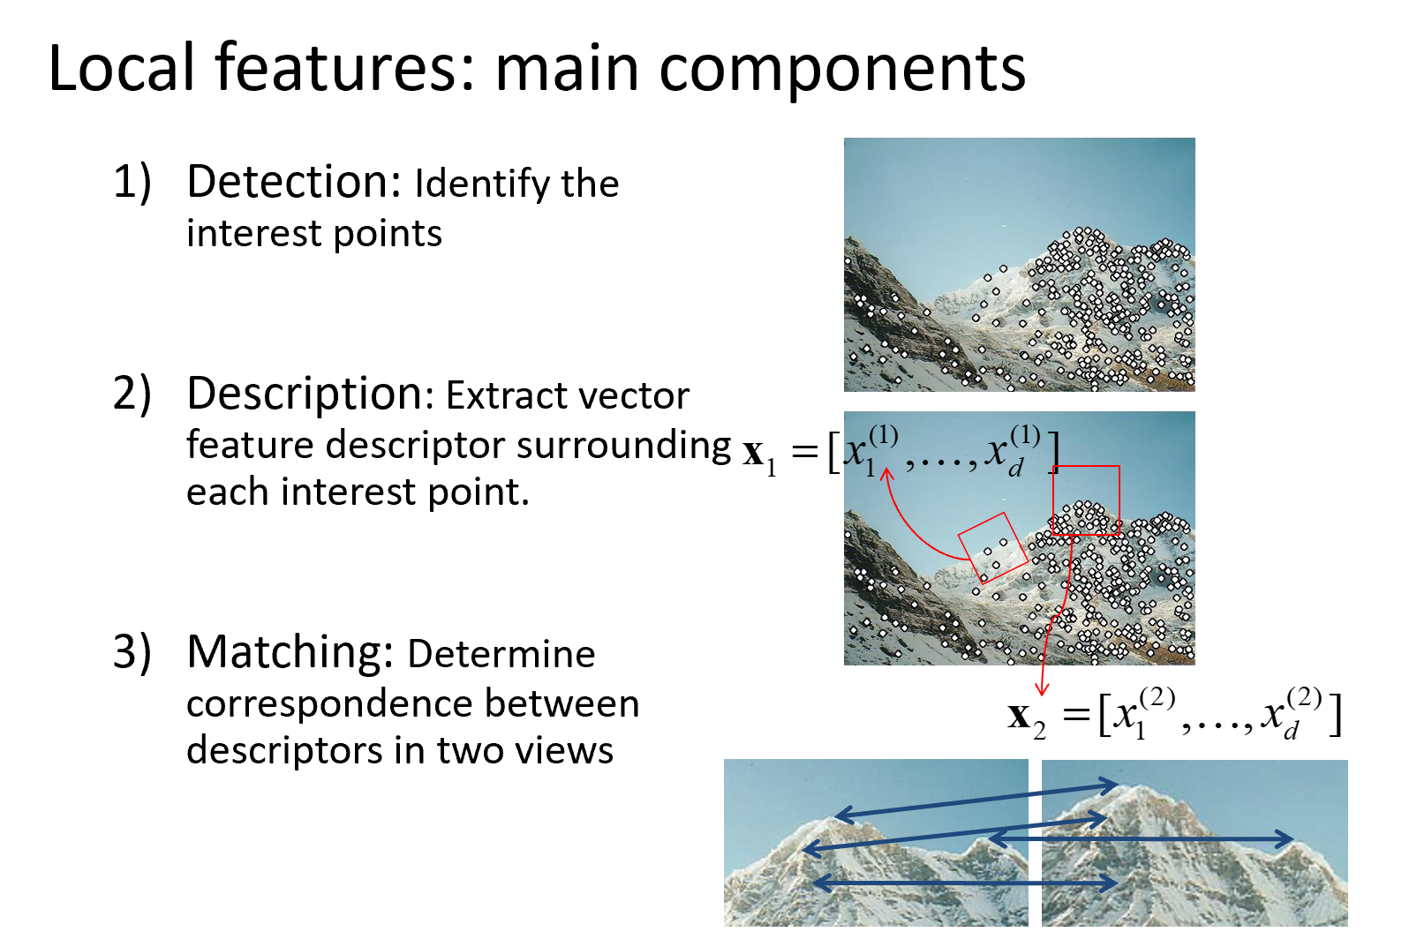
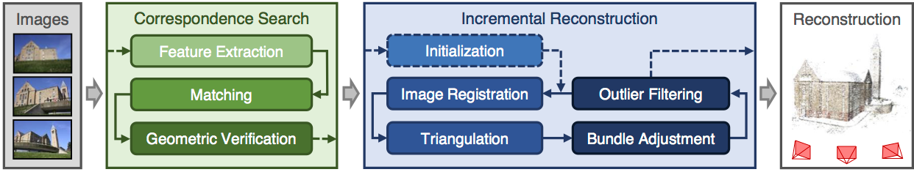
What is “Geometric Verification”?
COLMAP is the standard way to do structure from motion these days
“Structure-From-Motion Revisited”. Johannes L. Schonberger, Jan-Michael Frahm; CVPR 2016
5k+ citations
Notes:
Colmap

Slide 19
But first…
Let’s talk about how we even find the parameters for a model

Slide 20
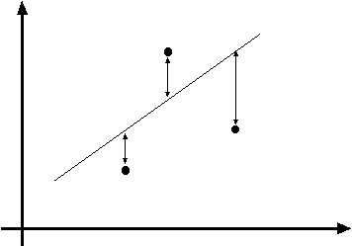
y=mx+b
(x_{i}, y_{i})
Fitting: find the parameters of a model that best fit the data
Alignment: find the parameters of the transformation that best align matched points

Slide 21
Fitting and Alignment
Design challenges
  Design a suitable goodness of fit measure
    Similarity should reflect application goals
    Encode robustness to outliers and noise
  Design an optimization method
    Avoid local optima
    Find best parameters quickly
y=mx+b
(x_{i}, y_{i})

Slide 22
Fitting and Alignment: Methods
Global optimization / Search for parameters
  Least squares fit
  Robust least squares
  Other parameter search methods
Hypothesize and test
  Generalized Hough transform
  RANSAC
Iterative Closest Points (ICP)

Slide 23
Fitting and Alignment: Methods
Global optimization / Search for parameters
  Least squares fit
  Robust least squares
  Other parameter search methods
Hypothesize and test
  Generalized Hough transform
  RANSAC
Iterative Closest Points (ICP)

Slide 24
Simple example: Fitting a line

Slide 25
Least squares line fitting
Data: (x₁, y₁), …, (x_{n}, y_{n})
Line equation: y_{i} = m x_{i} + b
Find (m, b) to minimize
y=mx+b
(x_{i}, y_{i})
Matlab: p = A \ y;
Python: p =
numpy.linalg.lstsq(A, y)
Modified from S. Lazebnik

Slide 26
Problem with “vertical” least squares
Not rotation-invariant
Fails completely for vertical lines
Slide from S. Lazebnik

Slide 27
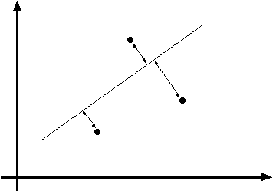
Total least squares
Slide modified from S. Lazebnik
If (a²+b²=1) then
Distance between point (x_{i}, y_{i}) is
|ax_{i} + by_{i} + c|
ax+by+c=0
Unit normal: N=(a, b)
(x_{i}, y_{i})
proof: http://mathworld.wolfram.com/Point-LineDistance2-Dimensional.html

Slide 28
Total least squares
Slide modified from S. Lazebnik
If (a²+b²=1) then
Distance between point (x_{i}, y_{i}) is
|ax_{i} + by_{i} + c|
Find (a, b, c) to minimize the sum of squared perpendicular distances
ax+by+c=0
Unit normal: N=(a, b)
(x_{i}, y_{i})

Slide 29
Total least squares
Slide modified from S. Lazebnik
Find (a, b, c) to minimize the sum of squared perpendicular distances
ax+by+c=0
Unit normal: N=(a, b)
(x_{i}, y_{i})
Solution is eigenvector corresponding to smallest eigenvalue of A^{T}A
See details on Raleigh Quotient: http://en.wikipedia.org/wiki/Rayleigh_quotient

Slide 30
Recap: Two Common Optimization Problems
Problem statement
Solution
(matlab)
Problem statement
Solution

Slide 31
Least squares (global) optimization
Good
Clearly specified objective
Optimization is easy
Bad
May not be what you want to optimize
Sensitive to outliers
  Bad matches, extra points
Doesn’t allow you to get multiple good fits
  Detecting multiple objects, lines, etc.

Slide 32
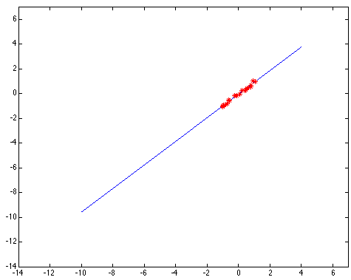
Least squares: Robustness to noise
Least squares fit to the red points:

Slide 33
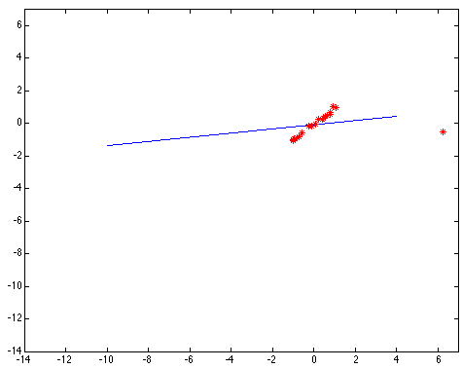
Least squares: Robustness to noise
Least squares fit with an outlier:
Problem: squared error heavily penalizes outliers

Slide 34
Fitting and Alignment: Methods
Global optimization / Search for parameters
  Least squares fit
  Robust least squares
  Other parameter search methods
Hypothesize and test
  Generalized Hough transform
  RANSAC
Iterative Closest Points (ICP)

Slide 35

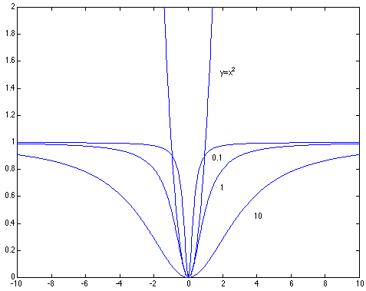
Robust least squares (to deal with outliers)
General approach:
minimize
u_{i} (x_{i}, θ) – residual of i^{th} point w.r.t. model parameters θ
ρ – robust function with scale parameter σ
The robust function ρ
Favors a configuration
with small residuals
Constant penalty for large residuals
Slide from S. Savarese

Slide 36

Choosing the scale: Just right
The effect of the outlier is minimized
Notes:
Fit to earlier data with an appropriate choice of s

Slide 37
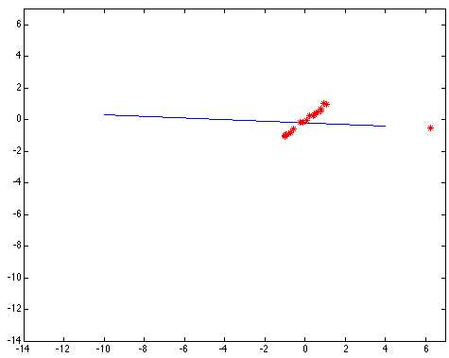
Choosing the scale: Too small
The error value is almost the same for every
point and the fit is very poor

Slide 38

Choosing the scale: Too large
Behaves much the same as least squares

Slide 39
Robust estimation: Details
Robust fitting is a nonlinear optimization problem that must be solved iteratively
Least squares solution can be used for initialization
Scale of robust function should be chosen adaptively based on median residual

Slide 40
Fitting and Alignment: Methods
Global optimization / Search for parameters
  Least squares fit
  Robust least squares
  Other parameter search methods
Hypothesize and test
  Generalized Hough transform
  RANSAC
Iterative Closest Points (ICP)

Slide 41
Other ways to search for parameters
(for when no closed form solution exists)
Line search (see also“coordinate descent”)
  For each parameter, step through values and choose value that gives best fit
  Repeat (1) until no parameter changes
Grid search
  Propose several sets of parameters, evenly sampled in the joint set
  Choose best (or top few) and sample joint parameters around the current best; repeat
Gradient descent
  Provide initial position (e.g., random)
  Locally search for better parameters by following gradient

Slide 42
Fitting and Alignment: Methods
Global optimization / Search for parameters
  Least squares fit
  Robust least squares
  Other parameter search methods
Hypothesize and test
  Generalized Hough transform
  RANSAC
Iterative Closest Points (ICP)

Slide 43
Hypothesize and test
Propose parameters
  Try all possible
  Each point votes for all consistent parameters
  Repeatedly sample enough points to solve for parameters
Score the given parameters
  Number of consistent points, possibly weighted by distance
Choose from among the set of parameters
  Global or local maximum of scores
Possibly refine parameters using inliers

Slide 44
Fitting and Alignment: Methods
Global optimization / Search for parameters
  Least squares fit
  Robust least squares
  Other parameter search methods
Hypothesize and test
  Generalized Hough transform
  RANSAC
Iterative Closest Points (ICP)

Slide 45
Hough Transform: Outline
Create a grid of parameter values
Each point (or observation of correspondence) votes for a set of parameters, incrementing those values in grid
Find maximum or local maxima in grid

Slide 46
Hough transform
P.V.C. Hough, Machine Analysis of Bubble Chamber Pictures, Proc. Int. Conf. High Energy Accelerators and Instrumentation, 1959
Given a set of points, find the line that explains the data points best
y
m
x
b
Hough space
y = m x + b
Slide from S. Savarese
Notes:
􀁑 Basic ideas
• A line is represented as . Every line in the image corresponds
to a point in the parameter space
• Every point in the image domain corresponds to a line in the parameter
space (why ? Fix (x,y), (m,n) can change on the line . In other
words, for all the lines passing through (x,y) in the image space, their
parameters form a line in the parameter space)
• Points along a line in the space correspond to lines passing through the
same point in the parameter space (why ?)

Slide 47
Hough transform
y
m
x
b
y
m
3
5
3
3
2
2
3
7
11
10
4
3
2
3
1
4
5
2
2
1
0
1
3
3
x
b
Slide from S. Savarese
Notes:
􀁑 Basic ideas
• A line is represented as . Every line in the image corresponds
to a point in the parameter space
• Every point in the image domain corresponds to a line in the parameter
space (why ? Fix (x,y), (m,n) can change on the line . In other
words, for all the lines passing through (x,y) in the image space, their
parameters form a line in the parameter space)
• Points along a line in the space correspond to lines passing through the
same point in the parameter space (why ?)

Slide 48
Hough transform
P.V.C. Hough, Machine Analysis of Bubble Chamber Pictures, Proc. Int. Conf. High Energy Accelerators and Instrumentation, 1959
Issue : parameter space [m,b] is unbounded…
Slide from S. Savarese
Notes:
􀁑 Basic ideas
• A line is represented as . Every line in the image corresponds
to a point in the parameter space
• Every point in the image domain corresponds to a line in the parameter
space (why ? Fix (x,y), (m,n) can change on the line . In other
words, for all the lines passing through (x,y) in the image space, their
parameters form a line in the parameter space)
• Points along a line in the space correspond to lines passing through the
same point in the parameter space (why ?)

Slide 49
Hough transform
P.V.C. Hough, Machine Analysis of Bubble Chamber Pictures, Proc. Int. Conf. High Energy Accelerators and Instrumentation, 1959
Issue : parameter space [m,b] is unbounded…
Use a polar representation for the parameter space
y
x
Hough space
Slide from S. Savarese
Notes:
􀁑 Basic ideas
• A line is represented as . Every line in the image corresponds
to a point in the parameter space
• Every point in the image domain corresponds to a line in the parameter
space (why ? Fix (x,y), (m,n) can change on the line . In other
words, for all the lines passing through (x,y) in the image space, their
parameters form a line in the parameter space)
• Points along a line in the space correspond to lines passing through the
same point in the parameter space (why ?)

Slide 50
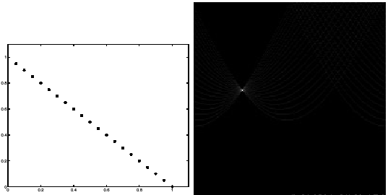
Hough transform - experiments
features
votes
Slide from S. Savarese
Notes:
Figure 15.1, top half. Note that most points in the vote array are very dark, because they
get only one vote.

Slide 51
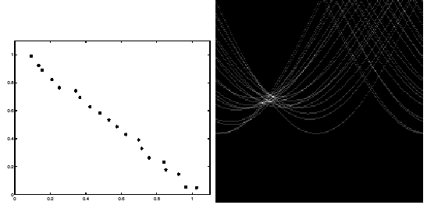
Hough transform - experiments
Noisy data
features
votes
Need to adjust grid size or smooth
Slide from S. Savarese
Notes:
This is 15.1 lower half

Slide 52
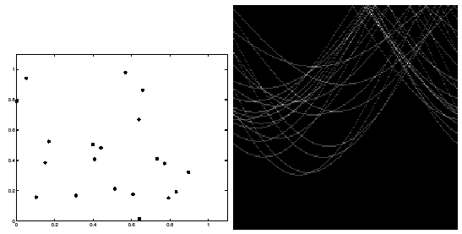
Hough transform - experiments
features
votes
Issue: spurious peaks due to uniform noise
Slide from S. Savarese
Notes:
15.2; main point is that lots of noise can lead to large peaks in the array

Slide 53
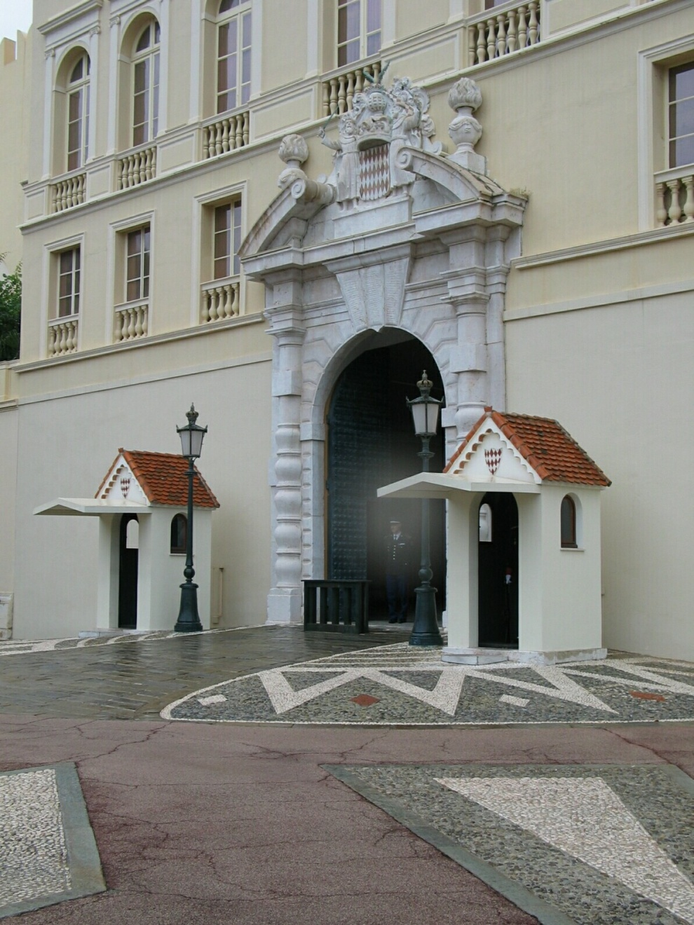
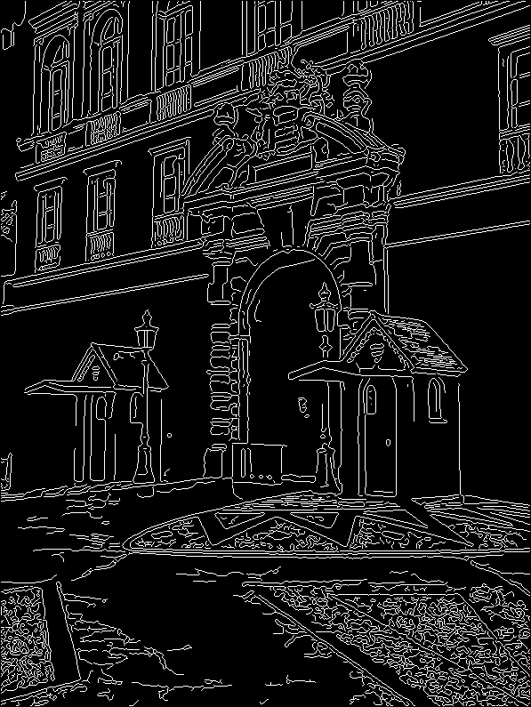
1. Image → Canny Edge Detection

Slide 54
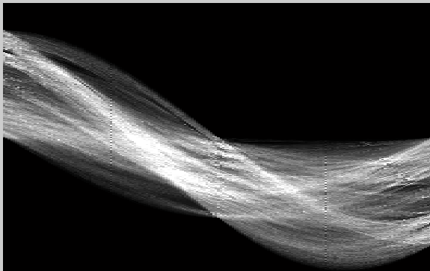
2. Canny → Hough votes

Slide 55
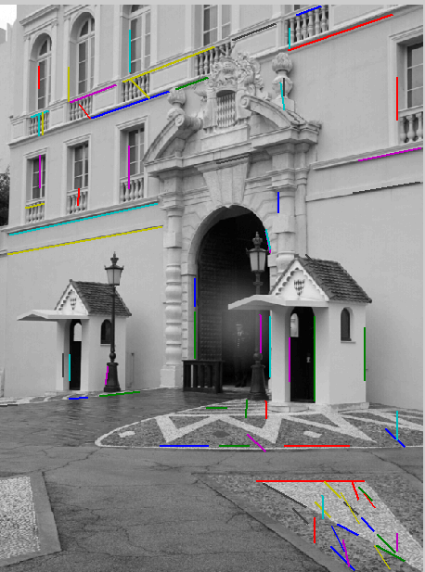
3. Hough votes → Edges
Find peaks and post-process

Slide 56
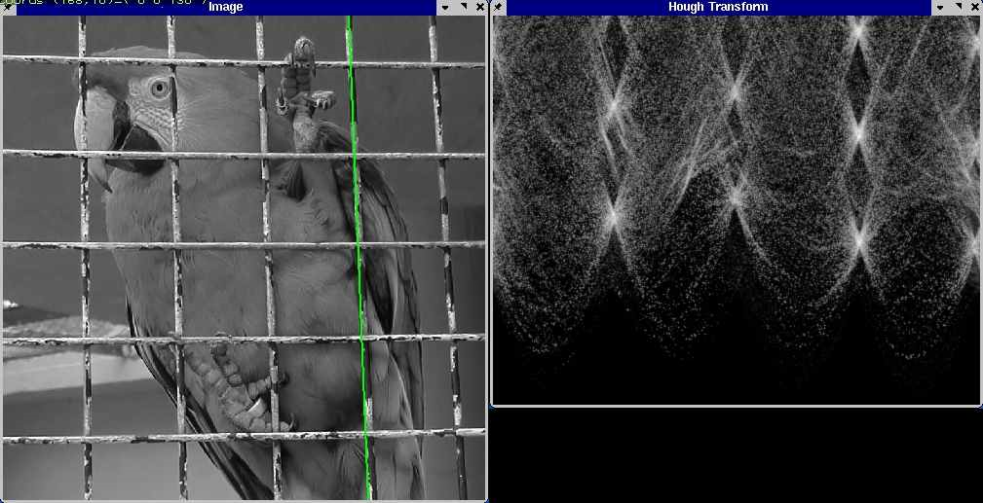
Hough transform example
http://ostatic.com/files/images/ss_hough.jpg

Slide 57
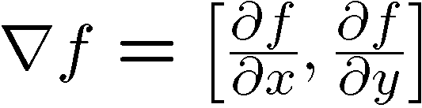

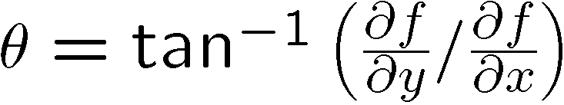
Incorporating image gradients
Recall: when we detect an
edge point, we also know its
gradient direction
But this means that the line
is uniquely determined!
Modified Hough transform:
For each edge point (x,y)
θ = gradient orientation at (x,y)
ρ = x cos θ + y sin θ
H(θ, ρ) = H(θ, ρ) + 1
end

Slide 58
Finding lines using Hough transform
Using m,b parameterization
Using r, theta parameterization
  Using oriented gradients
Practical considerations
  Bin size
  Smoothing
  Finding multiple lines
  Finding line segments

Slide 59
Hough Transform
How would we find circles?
  Of fixed radius
  Of unknown radius
  Of unknown radius but with known edge orientation

Slide 60
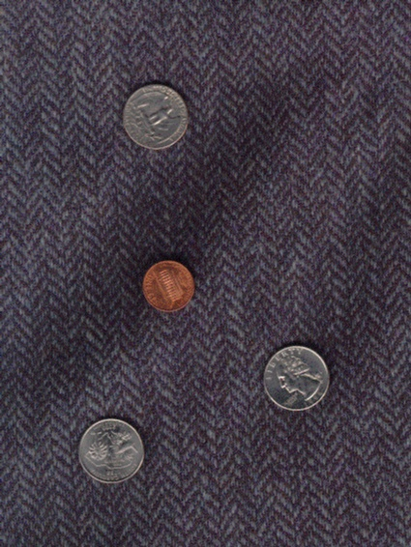
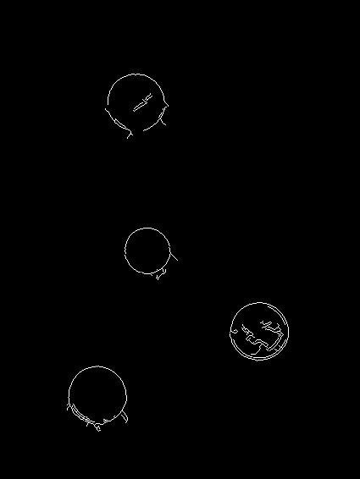
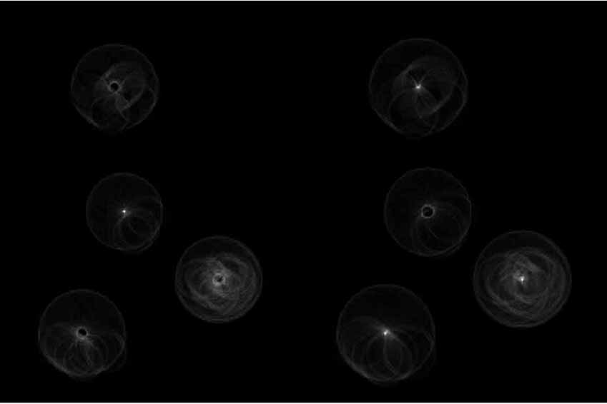
Example: detecting circles with Hough
Original
Edges
Votes: Penny
Note: a different Hough transform (with separate accumulators) was used for each circle radius (quarters vs. penny).

Slide 61
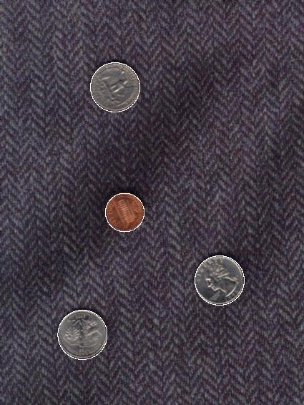
Example: detecting circles with Hough
Combined detections
Edges
Votes: Quarter
Note: a different Hough transform (with separate accumulators) was used for each circle radius (quarters vs. penny).
Coin finding sample images from: Vivek Kwatra

Slide 62
Hough Transform
How would we find circles?
  Of fixed radius
  Of unknown radius
  Of unknown radius but with known edge orientation

Slide 63
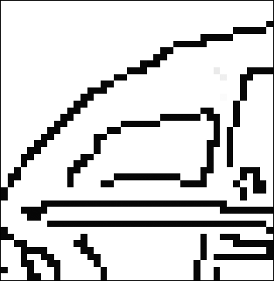
Hough transform for circles
Grid search equivalent procedure: for each (x,y,r), draw the corresponding circle in the image and compute its “support”
r
x
y

Slide 64
Hough Transform
How would we find circles?
  Of fixed radius
  Of unknown radius
  Of unknown radius but with known edge orientation

Slide 65
Hough transform for circles
image space
Hough parameter space
r
y
(x,y)
x
x
y

Slide 66
Hough transform conclusions
Good
Robust to outliers: each point votes separately
Fairly efficient (often faster than trying all sets of parameters)
Provides multiple good fits
Bad
Some sensitivity to noise
Bin size trades off between noise tolerance, precision, and speed/memory
  Can be hard to find sweet spot
Not suitable for more than a few parameters
  grid size grows exponentially
Common applications
Line fitting (also circles, ellipses, etc.)
Object instance recognition (parameters are affine transform)
Object category recognition (parameters are position/scale)

Slide 67
Fitting and Alignment: Methods
Global optimization / Search for parameters
  Least squares fit
  Robust least squares
  Other parameter search methods
Hypothesize and test
  Generalized Hough transform
  RANSAC
Iterative Closest Points (ICP)

Slide 68
RANSAC
_{(RANdom SAmple Consensus) :}
Fischler & Bolles in ‘81.
Algorithm:
Sample (randomly) the number of points required to fit the model
Solve for model parameters using samples
Score by the fraction of inliers within a preset threshold of the model
Repeat 1-3 until the best model is found with high confidence
Notes:
Let me give you an intuition of what is going on. Suppose we have the standard line fitting problem in presence of outliers.
We can formulate this problem as follows: want to find the best partition of points in inlier set and outlier set such that…
The objective consists of adjusting the parameters of a model function so as to best fit a data set.
"best" is defined by a function f that needs to be minimized.
Such that the best parameter of fitting the line give rise to a residual error lower that delta
as when the sum, S, of squared residuals

Slide 69
RANSAC
Line fitting example
Algorithm:
Sample (randomly) the number of points required to fit the model (#=2)
Solve for model parameters using samples
Score by the fraction of inliers within a preset threshold of the model
Repeat 1-3 until the best model is found with high confidence
Illustration by Savarese
Notes:
Let me give you an intuition of what is going on. Suppose we have the standard line fitting problem in presence of outliers.
We can formulate this problem as follows: want to find the best partition of points in inlier set and outlier set such that…
The objective consists of adjusting the parameters of a model function so as to best fit a data set.
"best" is defined by a function f that needs to be minimized.
Such that the best parameter of fitting the line give rise to a residual error lower that delta
as when the sum, S, of squared residuals

Slide 70
RANSAC
Line fitting example
Algorithm:
Sample (randomly) the number of points required to fit the model (#=2)
Solve for model parameters using samples
Score by the fraction of inliers within a preset threshold of the model
Repeat 1-3 until the best model is found with high confidence
Notes:
Let me give you an intuition of what is going on. Suppose we have the standard line fitting problem in presence of outliers.
We can formulate this problem as follows: want to find the best partition of points in inlier set and outlier set such that…
The objective consists of adjusting the parameters of a model function so as to best fit a data set.
"best" is defined by a function f that needs to be minimized.
Such that the best parameter of fitting the line give rise to a residual error lower that delta
as when the sum, S, of squared residuals

Slide 71
RANSAC
Line fitting example
Algorithm:
Sample (randomly) the number of points required to fit the model (#=2)
Solve for model parameters using samples
Score by the fraction of inliers within a preset threshold of the model
Repeat 1-3 until the best model is found with high confidence
Notes:
Let me give you an intuition of what is going on. Suppose we have the standard line fitting problem in presence of outliers.
We can formulate this problem as follows: want to find the best partition of points in inlier set and outlier set such that…
The objective consists of adjusting the parameters of a model function so as to best fit a data set.
"best" is defined by a function f that needs to be minimized.
Such that the best parameter of fitting the line give rise to a residual error lower that delta
as when the sum, S, of squared residuals

Slide 72
RANSAC
Algorithm:
Sample (randomly) the number of points required to fit the model (#=2)
Solve for model parameters using samples
Score by the fraction of inliers within a preset threshold of the model
Repeat 1-3 until the best model is found with high confidence
Notes:
Let me give you an intuition of what is going on. Suppose we have the standard line fitting problem in presence of outliers.
We can formulate this problem as follows: want to find the best partition of points in inlier set and outlier set such that…
The objective consists of adjusting the parameters of a model function so as to best fit a data set.
"best" is defined by a function f that needs to be minimized.
Such that the best parameter of fitting the line give rise to a residual error lower that delta
as when the sum, S, of squared residuals

