Slide 1
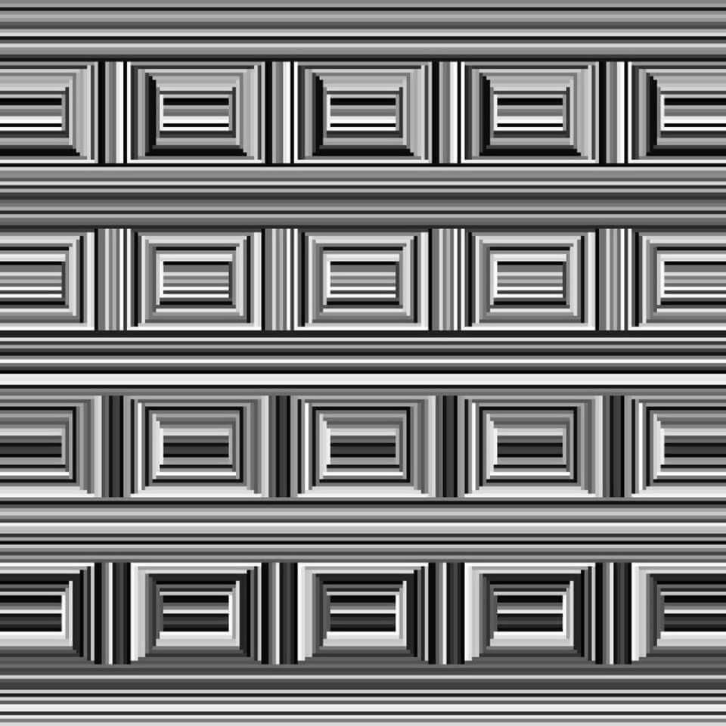

Slide 2

Notes:
http://www.erikjohanssonphoto.com/

Slide 3
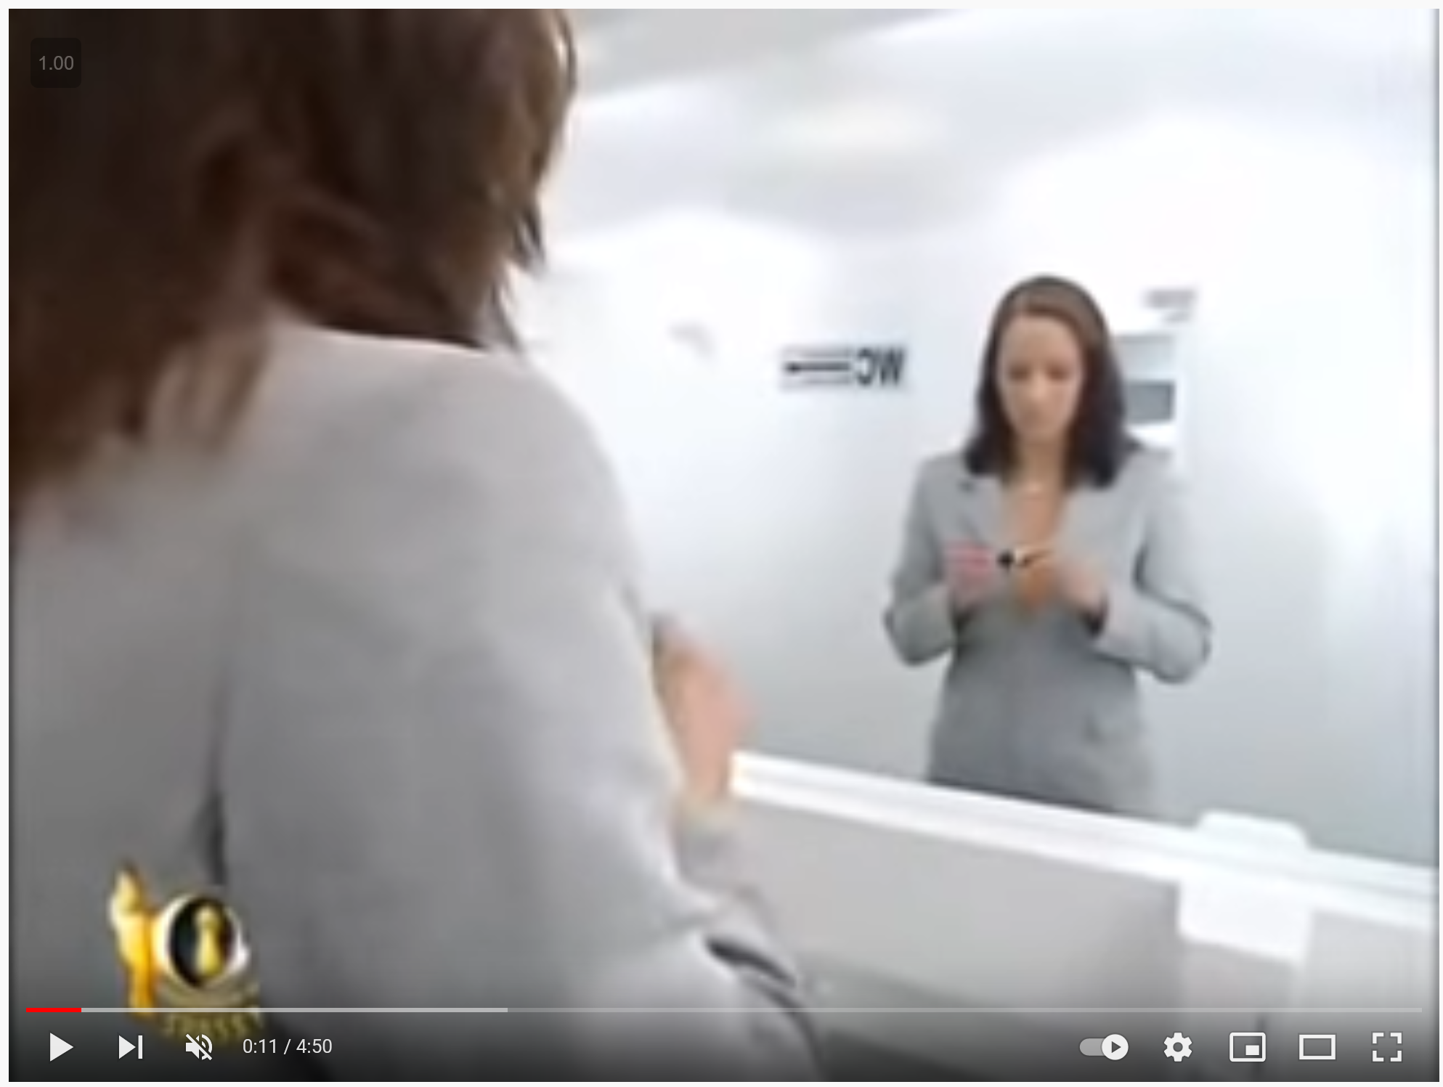
Stereo and lidar can fall victim to reflections?
Yes, there’s no easy way around that
https://youtu.be/pBzU8TD1iks

Slide 4
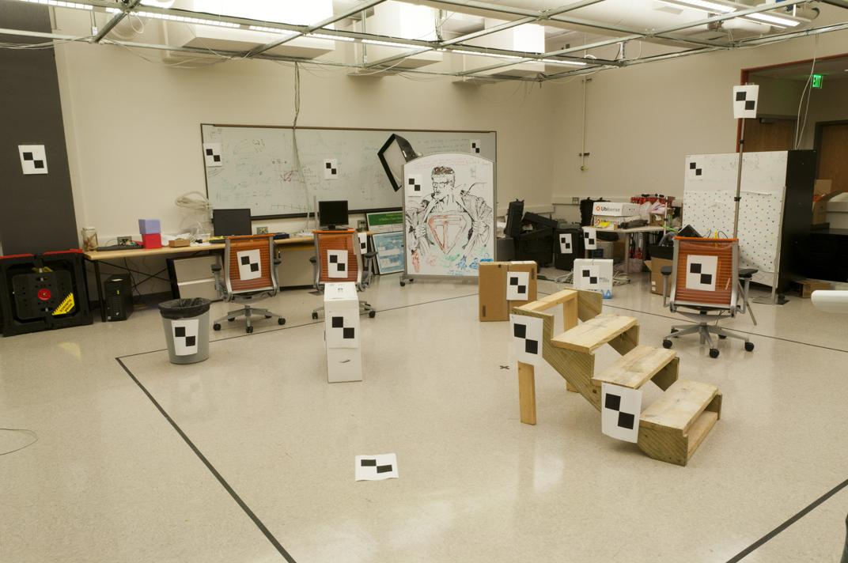
Previous lecture: World vs Camera coordinates

Slide 5
Unknown Camera Parameters
Previous lecture:
Known 2d image coords
Known 3d locations
Method 2 – nonhomogeneous linear system. Solve for m’s entries using linear least squares
Ax=b form
M = A\Y;
M = [M;1];
M = reshape(M,[],3)';
For python, see
numpy.linalg.lstsq

Slide 6
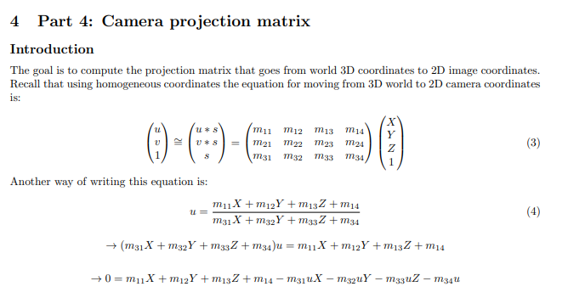

Slide 7
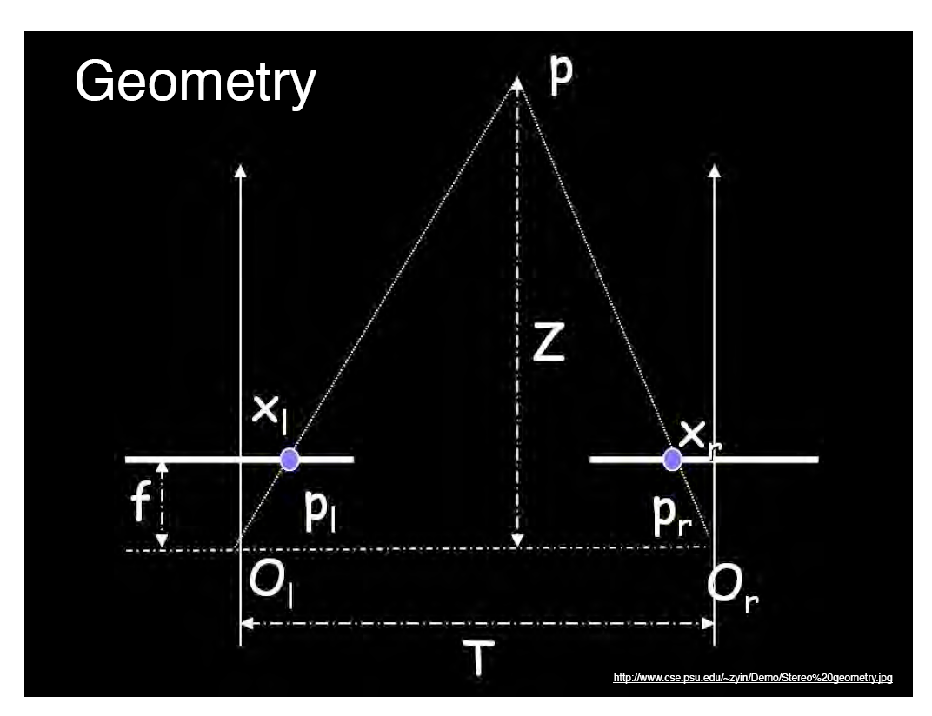
Previous Lecture: Geometry for a simple stereo system
Assume parallel optical axes, known camera parameters (i.e., calibrated cameras). What is expression for Z?
Similar triangles (p_{l}, P, p_{r}) and (O_{l}, P, O_{r}):
-
disparity
Notes:
7

Slide 8
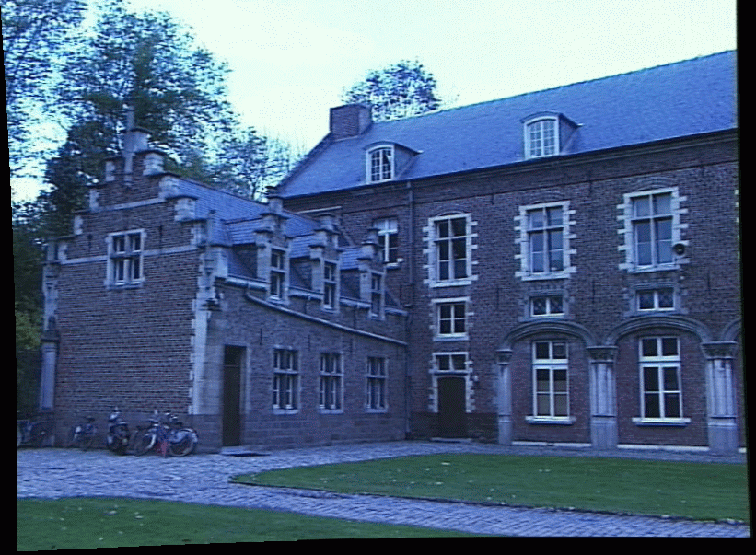
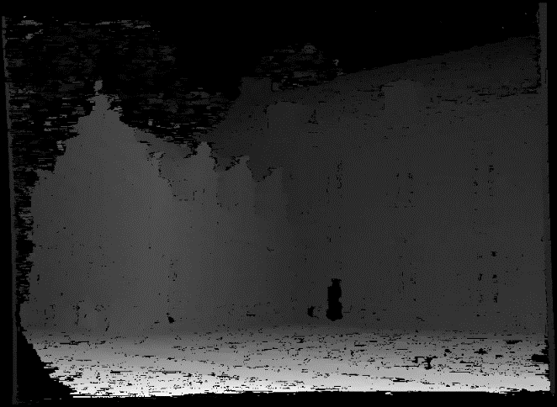
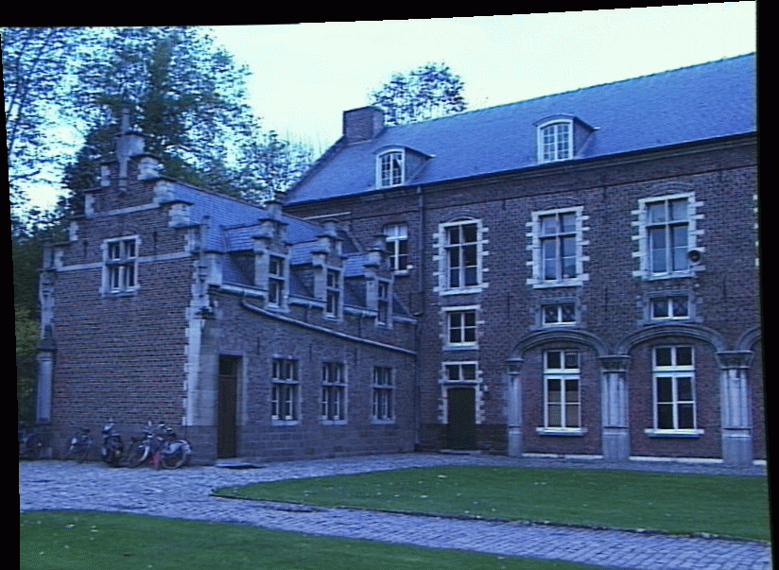
Depth from disparity
image I(x,y)
Disparity map D(x,y)
image I´(x´,y´)
(x´,y´)=(x+D(x,y), y)
So if we could find the corresponding points in two images, we could estimate relative depth…

Slide 9
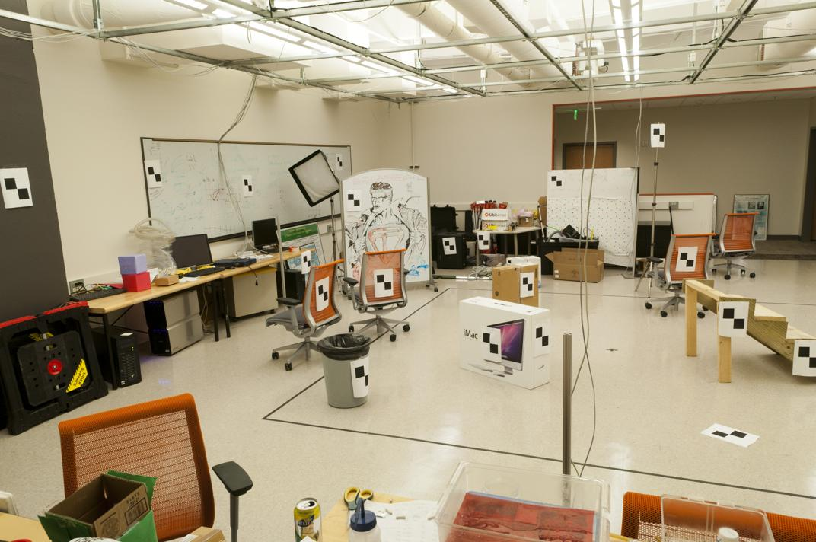
If we have a 2D point of interest, where do we need to search for its corresponding point in another view?

Slide 10
Today’s Outline
Epipolar Geometry
  Finding epipolar relationship between two images
  Using epipolar geometry to rule out outliers
  Finding dense correspondence along epipolar lines

Slide 11
Epipolar Geometry and Stereo Vision
Chapter 11.3 in Szeliski
Many slides adapted from Derek Hoiem, Lana Lazebnik, Silvio Saverese, Steve Seitz, many figures from Hartley & Zisserman

Slide 12
Epipolar geometry
  Relates cameras from two positions

Slide 13
Depth from Stereo
Goal: recover depth by finding image coordinate x’ that corresponds to x
X
X
x
z
x
x’
x'
f
f
C
Baseline
B
C’

Slide 14
Depth from Stereo
Goal: recover depth by finding image coordinate x’ that corresponds to x
Sub-Problems
  Calibration: How do we recover the relation of the cameras (if not already known)?
  Correspondence: How do we search for the matching point x’?
X
x
x'

Slide 15
Correspondence Problem
x
?
We have two images taken from cameras with different intrinsic and extrinsic parameters
How do we match a point in the first image to a point in the second? How can we constrain our search?

Slide 16
Key idea: Epipolar constraint

Slide 17
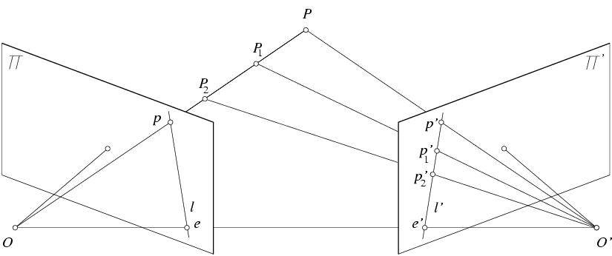
Key idea: Epipolar constraint
X
X
X
x
x’
x’
x’
Potential matches for x have to lie on the corresponding line l’.
Potential matches for x’ have to lie on the corresponding line l.

Slide 18
Wouldn’t it be nice to know where matches can live? To constrain our 2d search to 1d.

Slide 19
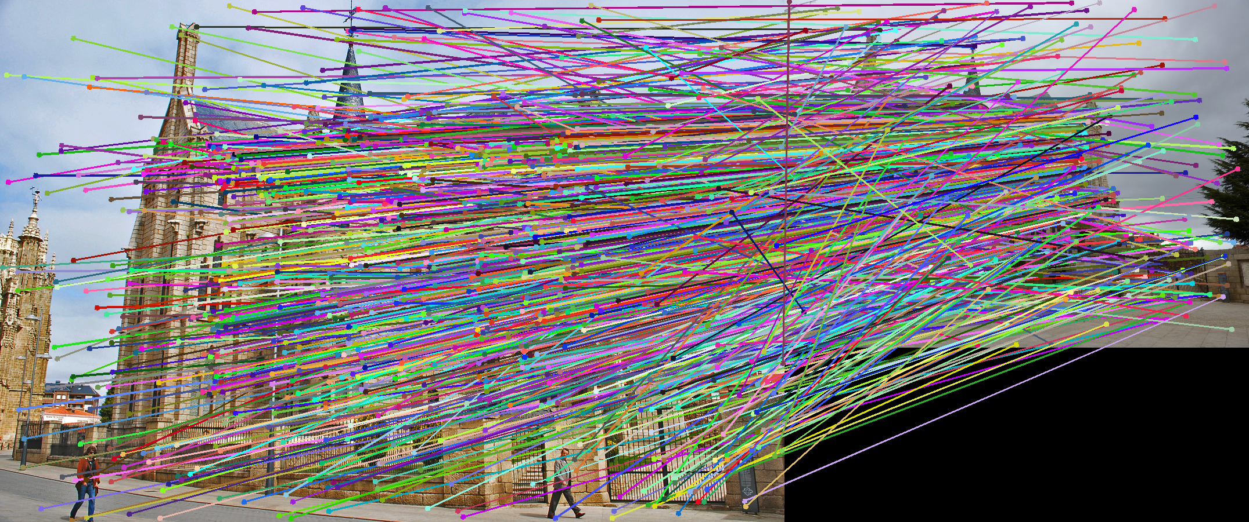
VLFeat’s 800 most confident matches among 10,000+ local features.

Slide 20
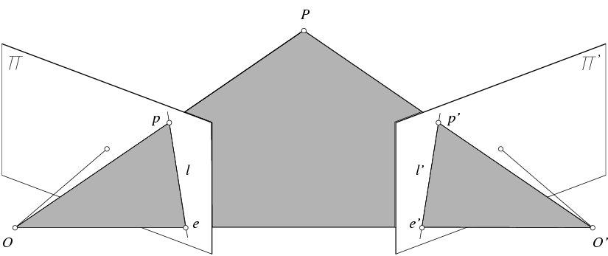
Epipolar geometry: notation
X
x
x’
Baseline – line connecting the two camera centers
Epipoles
= intersections of baseline with image planes
= projections of the other camera center
Epipolar Plane – plane containing baseline (1D family)

Slide 21
Epipolar geometry: notation
X
x
x’
Baseline – line connecting the two camera centers
Epipoles
= intersections of baseline with image planes
= projections of the other camera center
Epipolar Plane – plane containing baseline (1D family)
Epipolar Lines - intersections of epipolar plane with image
planes (always come in corresponding pairs)

Slide 22
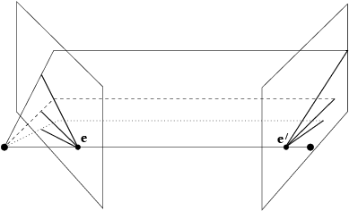
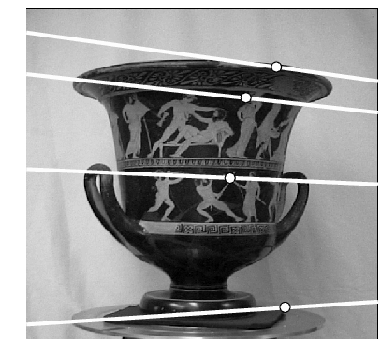
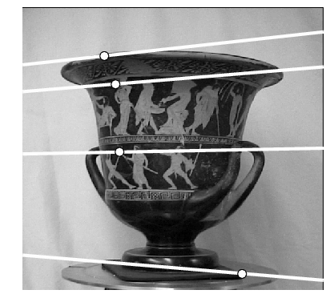
Example: Converging cameras

Slide 23
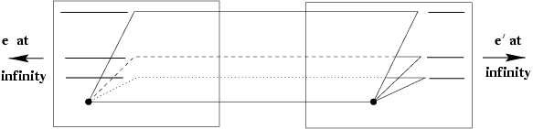
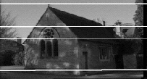
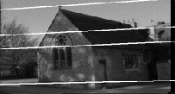
Example: Motion or displacement parallel to image plane

Slide 24
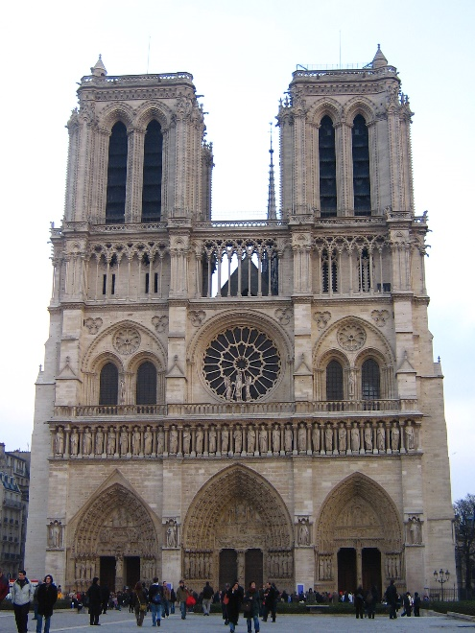
Example: Forward motion
What would the epipolar lines look like if the camera moves forward?
a
b
c
d

Slide 25
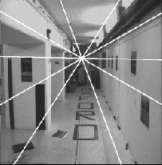
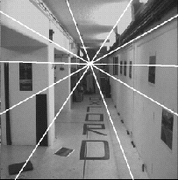
Example: Forward motion
e’
e
Epipole has same coordinates in both images.
Points move along lines radiating from e: “Focus of expansion”

Slide 26
Epipolar constraint: Calibrated case
X
x
x’
Given the intrinsic parameters of the cameras:
  Convert to normalized coordinates by pre-multiplying all points with the inverse of the calibration matrix; set first camera’s coordinate system to world coordinates
3D scene point
Homogeneous 2d point (3D ray towards X)
2D pixel coordinate (homogeneous)
3D scene point in 2nd camera’s 3D coordinates

Slide 27
Epipolar constraint: Calibrated case
X
x
x’
Given the intrinsic parameters of the cameras:
  Convert to normalized coordinates by pre-multiplying all points with the inverse of the calibration matrix; set first camera’s coordinate system to world coordinates
  Define some R and t that relate X to X’ as below
for some scale factor

Slide 28



Epipolar constraint: Calibrated case
X
x
x’
$$\hat{x}$$
$${\hat{x}}^{′}$$
(because $\hat{x}, R{\hat{x}}^{′},$ and $t$ are co-planar)
Notes:
X’ is X in the second camera’s coordinate system
We can identify the non-homogeneous 3D vectors X and X’ with the homogeneous coordinate vectors x and x’ of the projections of the two points into the two respective images

Slide 29
Essential matrix
X
x
x’
Essential Matrix
(Longuet-Higgins, 1981)
Notes:
[t]_{x} is the skew symmetric matrix of t

Slide 30
Properties of the Essential matrix
X
x
x’
Drop ^ below to simplify notation
Skew-symmetric matrix
E x’ is the epipolar line associated with x’ (l = E x’)
E^{T}x is the epipolar line associated with x (l’ = E^{T}x)
E e’ = 0 and E^{T}e = 0
E is singular (rank two)
E has five degrees of freedom
  (3 for R, 2 for t because it’s up to a scale)

Slide 31
Epipolar constraint: Uncalibrated case
X
x
x’
If we don’t know K and K’, then we can write the epipolar constraint in terms of unknown normalized coordinates:

Slide 32
The Fundamental Matrix
Without knowing K and K’, we can define a similar relation using unknown normalized coordinates
Fundamental Matrix
(Faugeras and Luong, 1992)

Slide 33
Properties of the Fundamental matrix
X
x
x’
F x’ = 0 is the epipolar line associated with x’
F^{T}x = 0 is the epipolar line associated with x
F e’ = 0 and F^{T}e = 0
F is singular (rank two): det(F)=0
F has seven degrees of freedom: 9 entries but defined up to scale, det(F)=0

Slide 34
Estimating the Fundamental Matrix
8-point algorithm
  Least squares solution using SVD on equations from 8 pairs of correspondences
  Enforce det(F)=0 constraint using SVD on F
7-point algorithm
  Use least squares to solve for null space (two vectors) using SVD and 7 pairs of correspondences
  Solve for linear combination of null space vectors that satisfies det(F)=0
Minimize reprojection error
  Non-linear least squares
Note: estimation of F (or E) is degenerate for a planar scene.

Slide 35
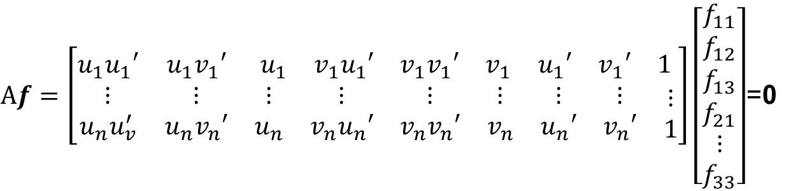
8-point algorithm
Solve a system of homogeneous linear equations
  Write down the system of equations
$$uu^{′}f_{11}+uv^{′}f_{12}+uf_{13}+vu^{′}f_{21}+vv^{′}f_{22}+vf_{23}+u^{′}f_{31}+v^{′}f_{32}+f_{33}=0$$
$Af=\left[\begin{matrix}u_{1}u_{1}′ & u_{1}v_{1}′ & \begin{matrix}u_{1} & v_{1}u_{1}′ & \begin{matrix}v_{1}v_{1}′ & v_{1} & \begin{matrix}u_{1}′ & v_{1}′ & 1\end{matrix}\end{matrix}\end{matrix} \\ \begin{matrix}⋮ \\ u_{n}u_{v}^{′}\end{matrix} & \begin{matrix}⋮ \\ u_{n}v_{n}′\end{matrix} & \begin{matrix}\begin{matrix}⋮ \\ u_{n}\end{matrix} & \begin{matrix}⋮ \\ v_{n}u_{n}′\end{matrix} & \begin{matrix}\begin{matrix}⋮ \\ v_{n}v_{n}′\end{matrix} & \begin{matrix}⋮ \\ v_{n}\end{matrix} & \begin{matrix}\begin{matrix}⋮ \\ u_{n}′\end{matrix} & \begin{matrix}⋮ \\ v_{n}′\end{matrix} & \begin{matrix}⋮ \\ 1\end{matrix}\end{matrix}\end{matrix}\end{matrix}\end{matrix}\right]\left[\begin{matrix}f_{11} \\ f_{12} \\ \begin{aligned}f_{13} \\ f_{21} \\ ⋮ \\ f_{33}\end{aligned}\end{matrix}\right]$=0

Slide 36
8-point algorithm
Solve a system of homogeneous linear equations
  Write down the system of equations
  Solve f from Af=0 using SVD
Matlab:
[U, S, V] = svd(A);
f = V(:, end);
F = reshape(f, [3 3])’;
For python, see
numpy.linalg.svd

Slide 37
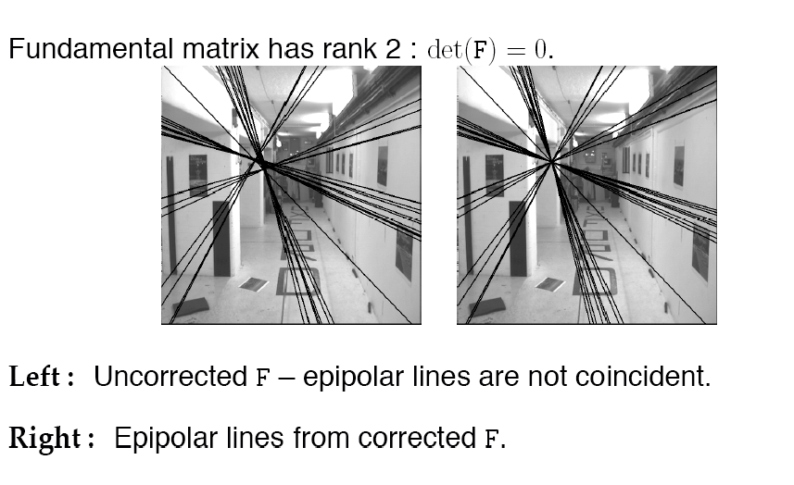
Need to enforce singularity constraint

Slide 38
8-point algorithm
Solve a system of homogeneous linear equations
  Write down the system of equations
  Solve f from Af=0 using SVD
Resolve det(F) = 0 constraint using SVD
Matlab:
[U, S, V] = svd(A);
f = V(:, end);
F = reshape(f, [3 3])’;
Matlab:
[U, S, V] = svd(F);
S(3,3) = 0;
F = U*S*V’;
For python, see
numpy.linalg.svd

Slide 39
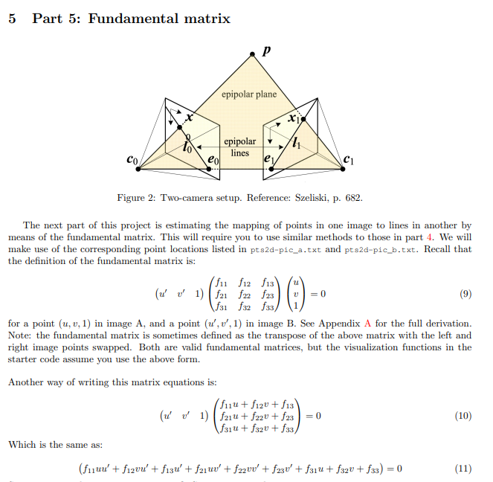

Slide 40
Problem with eight-point algorithm

Slide 41
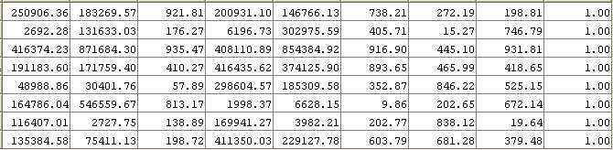
Problem with eight-point algorithm
Poor numerical conditioning
Can be fixed by rescaling the data

Slide 42
The normalized eight-point algorithm
(Hartley, 1995)
Center the image data at the origin, and scale it so the mean squared distance between the origin and the data points is 2 pixels
Use the eight-point algorithm to compute F from the normalized points
Enforce the rank-2 constraint (for example, take SVD of F and throw out the smallest singular value)
Transform fundamental matrix back to original units: if T and T’ are the normalizing transformations in the two images, than the fundamental matrix in original coordinates is T’^{T} F T

Slide 43
But which 8 points do we choose?

Slide 44
VLFeat’s 800 most confident matches among 10,000+ local features.

Slide 45
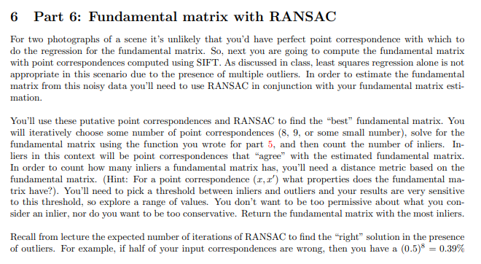

Slide 46
  How to test for outliers?

Slide 47
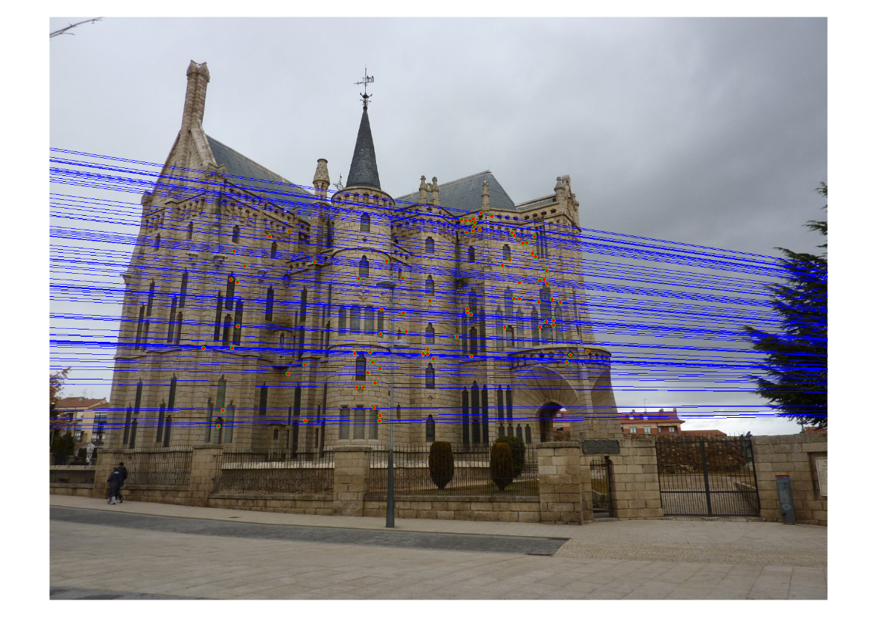
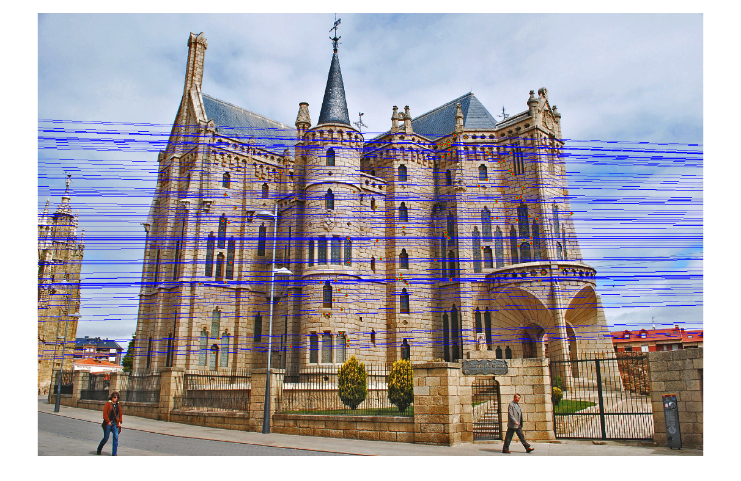
Epipolar lines

Slide 48
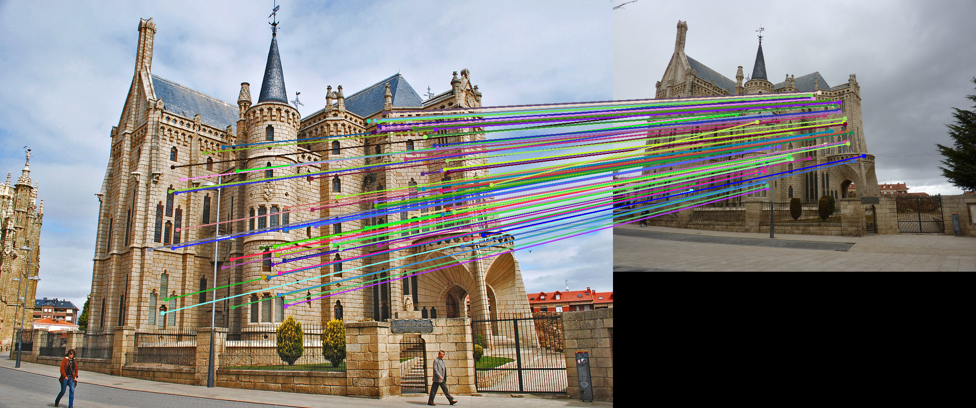
Keep only the matches at are “inliers” with respect to the “best” fundamental matrix

Slide 49
The scale of algorithm name quality
better
RANSAC
SIFT
Deep Learning
Optical Flow
Hough Transform
Neural Networks
Essential and Fundamental Matrix
worse
Dynamic Programming

Slide 50
In class written Quiz format
15 to 20 short answer or multiple-choice questions
Typically can be done in half an hour
No calculators needed
Closed book
Only covers material discussed in class, not book. But the book is still a useful resource
Covers all material through the quiz date

Slide 51
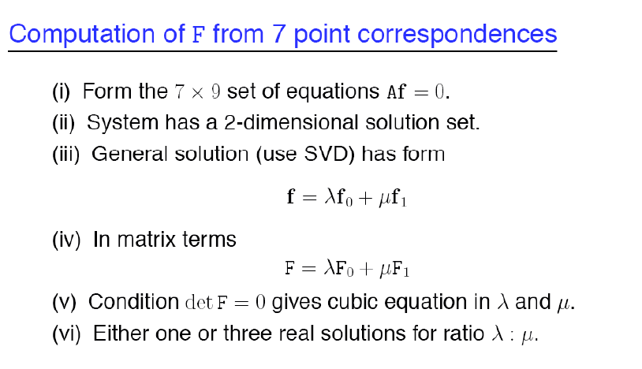
7-point algorithm
Faster (need fewer points) and could be more robust (fewer points), but also need to check for degenerate cases

Slide 52
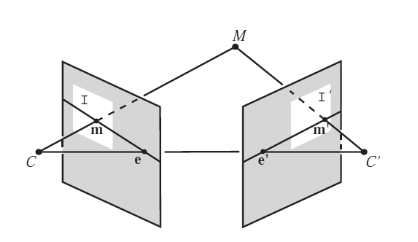
“Gold standard” algorithm
Use 8-point algorithm to get initial value of F
Use F to solve for P and P’ (discussed later)
Jointly solve for 3d points X and F that minimize the squared re-projection error
X
x
x'
See Algorithm 11.2 and Algorithm 11.3 in HZ (pages 284-285) for details

Slide 53
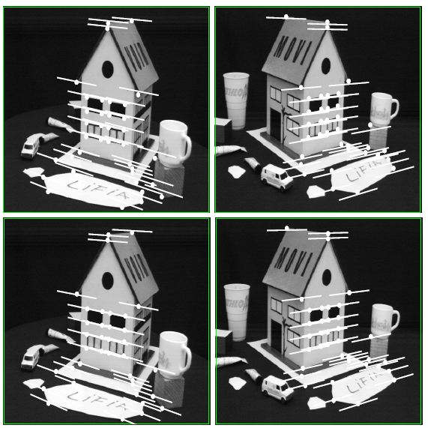
Comparison of estimation algorithms
 | 8-point | Normalized 8-point | Nonlinear least squares
Av. Dist. 1 | 2.33 pixels | 0.92 pixel | 0.86 pixel
Av. Dist. 2 | 2.18 pixels | 0.85 pixel | 0.80 pixel

Slide 54
We can get projection matrices P and P’ up to a projective ambiguity
Code:
function P = vgg_P_from_F(F)
[U,S,V] = svd(F);
e = U(:,3);
P = [-vgg_contreps(e)*F e];
K’*rotation
K’*translation
See HZ p. 255-256
If we know the intrinsic matrices (K and K’), we can resolve the ambiguity

Slide 55
From epipolar geometry to camera calibration
Estimating the fundamental matrix is known as “weak calibration”
We cIf we know the calibration matrices of the two cameras, we can estimate the essential matrix: E = K^{T}FK’
The essential matrix gives us the relative rotation and translation between the cameras, or their extrinsic parameters

Slide 56
Let’s recap…
Fundamental matrix song

