Slide 1
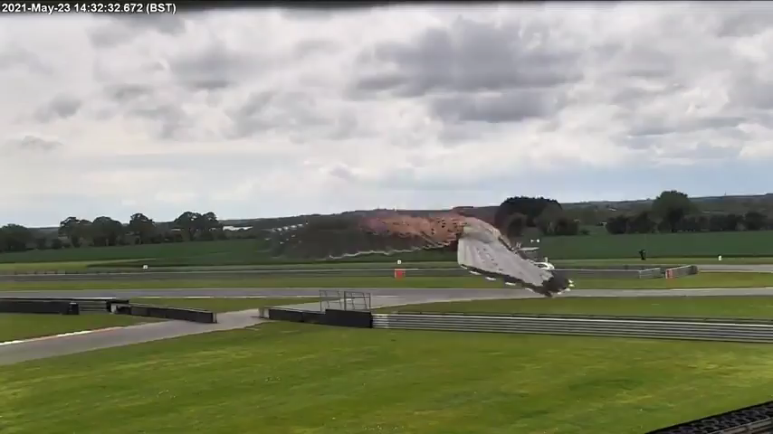

Slide 2
Deeper Deep Learning

Slide 3
Today’s outline
What came after AlexNet?
  VGG Net
  Google Inception architectures
  ResNet

Slide 4
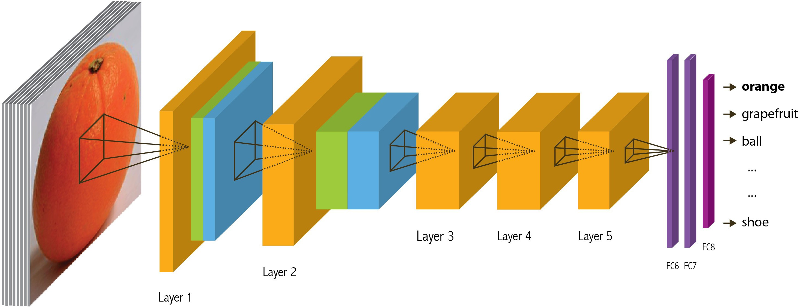
Recap: Convolutional Network, AlexNet

Slide 5




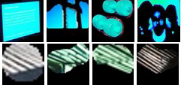
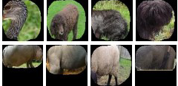



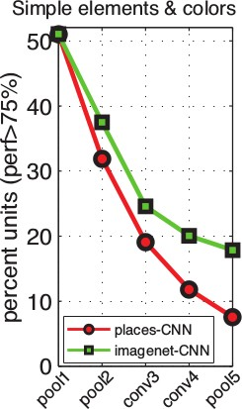
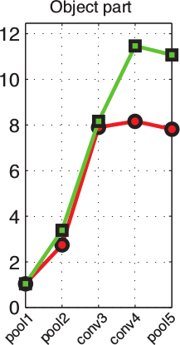
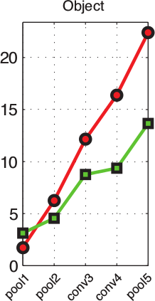
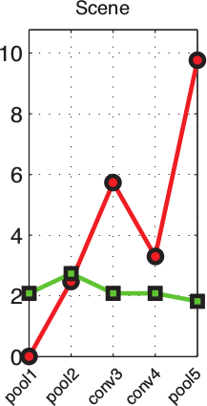
Recap: Convolutional Network Interpretation
1
Object detectors emerge within CNN trained to classify scenes, without any object supervision!

Slide 6
Beyond AlexNet

Slide 7
VERY DEEP CONVOLUTIONAL NETWORKS FOR LARGE-SCALE IMAGE RECOGNITION
Karen Simonyan & Andrew Zisserman 2015
These are the “VGG” networks.
“Perceptual Loss” in generative deep learning refers to these networks
150k citations as of 10/14/2025

Slide 8
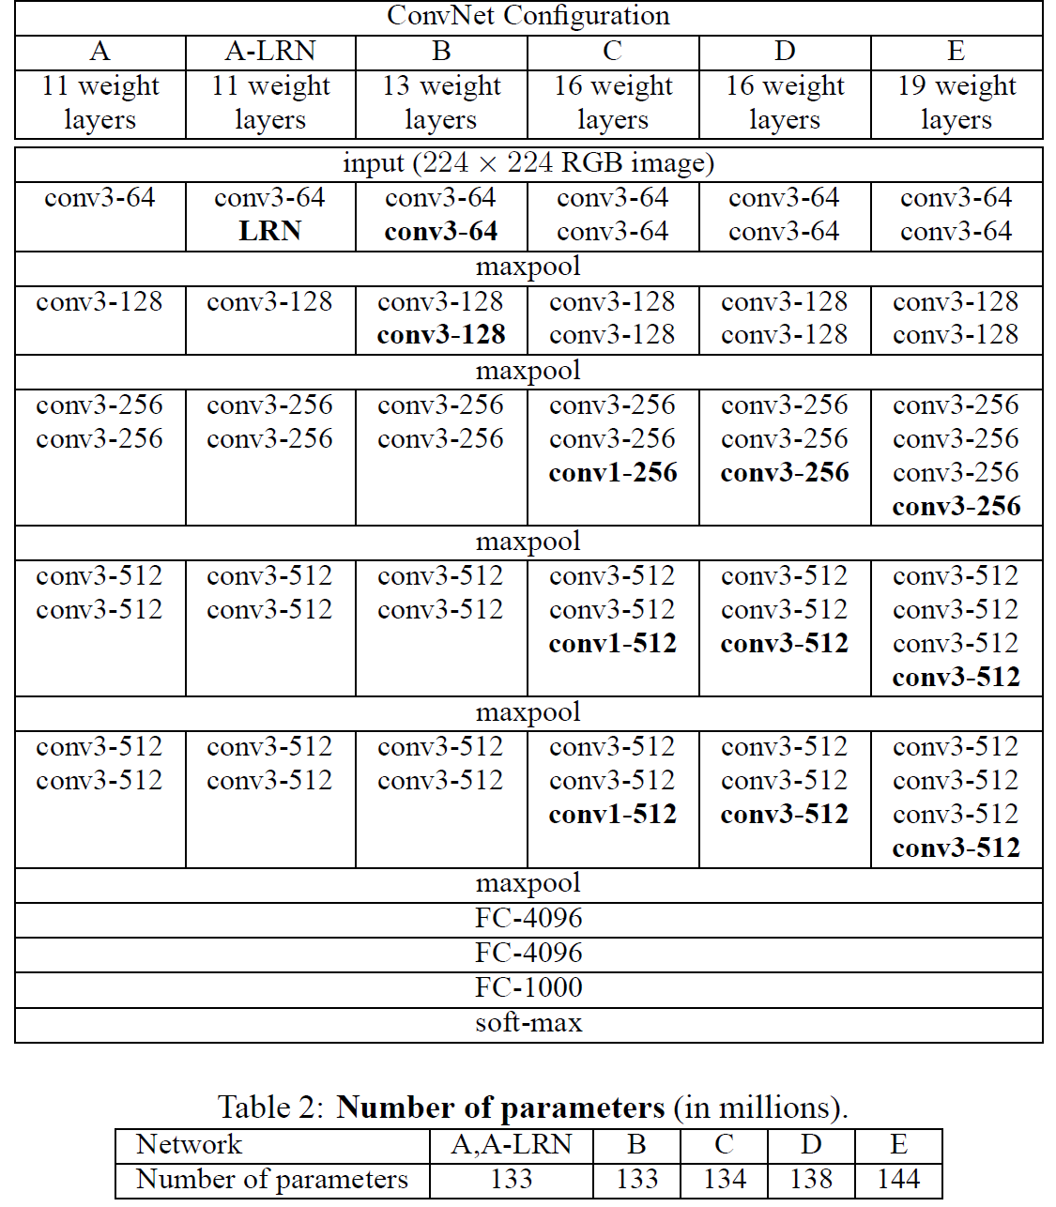
Notes:
“We note that using local response normalisation (A-LRN network) does not improve on the
model A without any normalisation layers. We thus do not employ normalisation in the deeper
architectures (B–E).”

Slide 9
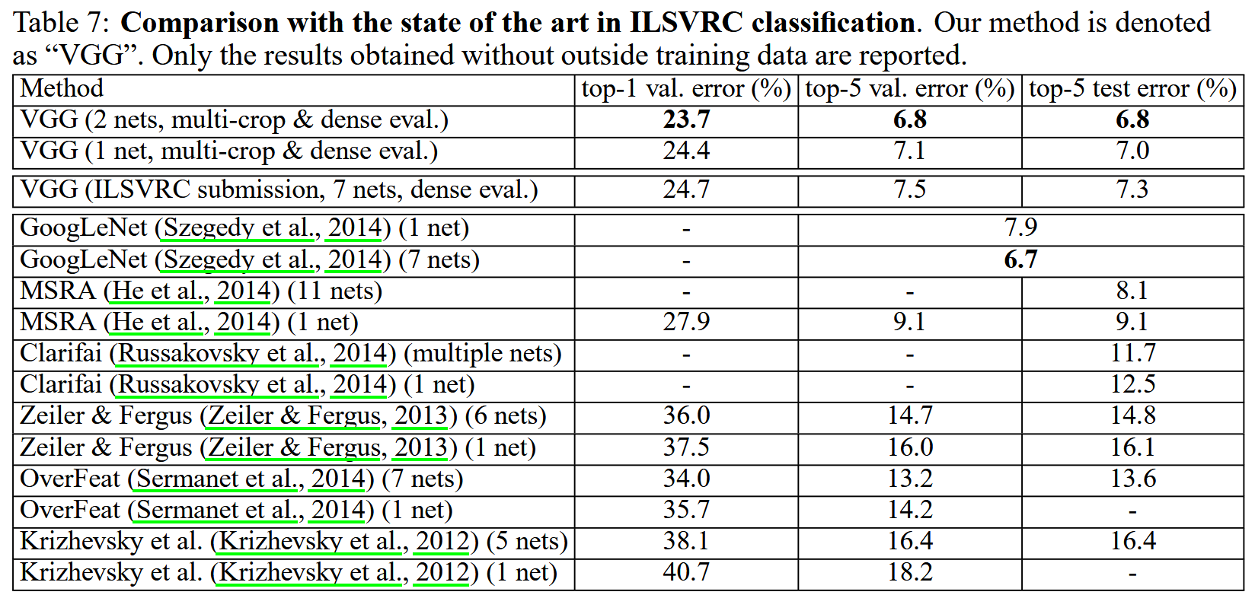
Notes:
Compared to Alex-Net – Deeper, smaller convolutions, more parameters

Slide 10
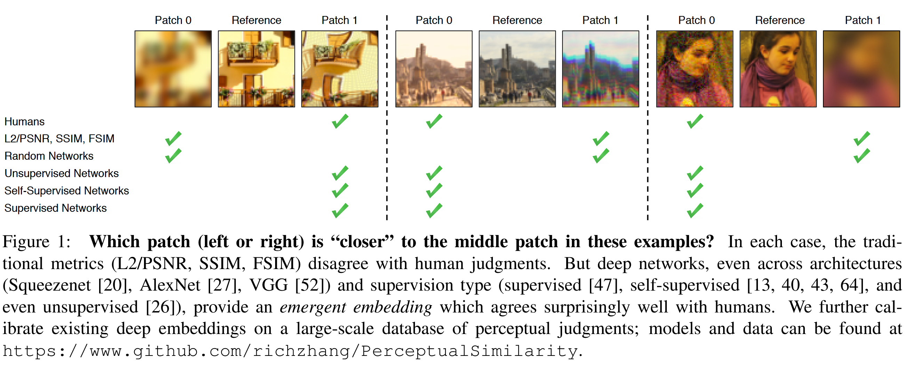
The Unreasonable Effectiveness of Deep Features as a Perceptual Metric
Richard Zhang, Phillip Isola, Alexei A. Efros, Eli Shechtman, Oliver Wang. 2018

Slide 11
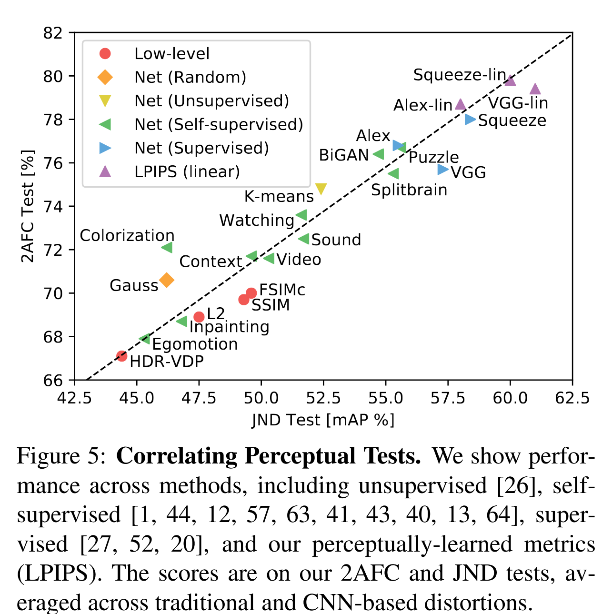

Slide 12
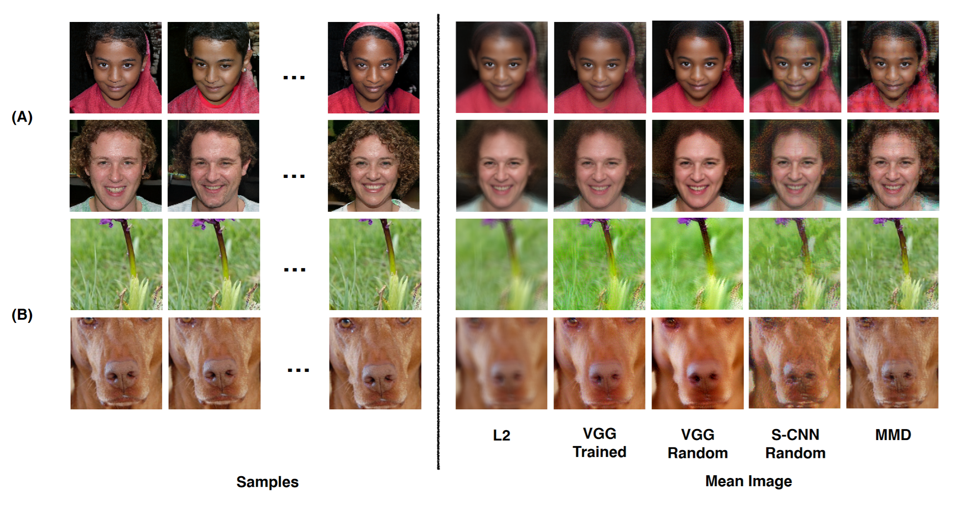
“VGG” networks are commonly used as the basis for “Perceptual Loss”.
The images on the right are as close as possible to all images on the left in various feature spaces.
Understanding and Simplifying Perceptual Distances. Dan Amir and Yair Weiss. CVPR 2021

Slide 13
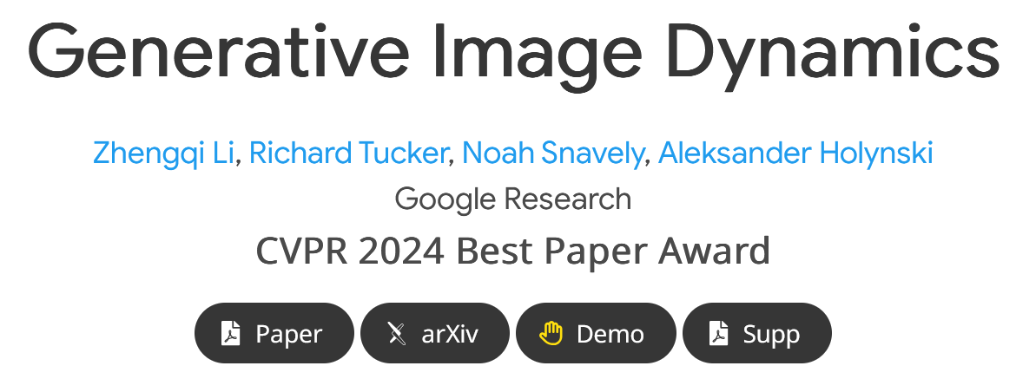
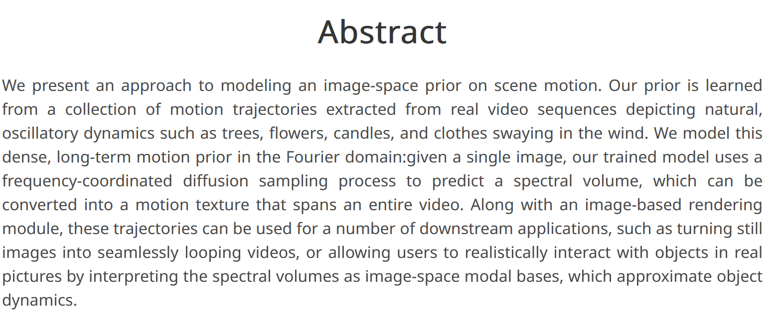
https://generative-dynamics.github.io/

Slide 14
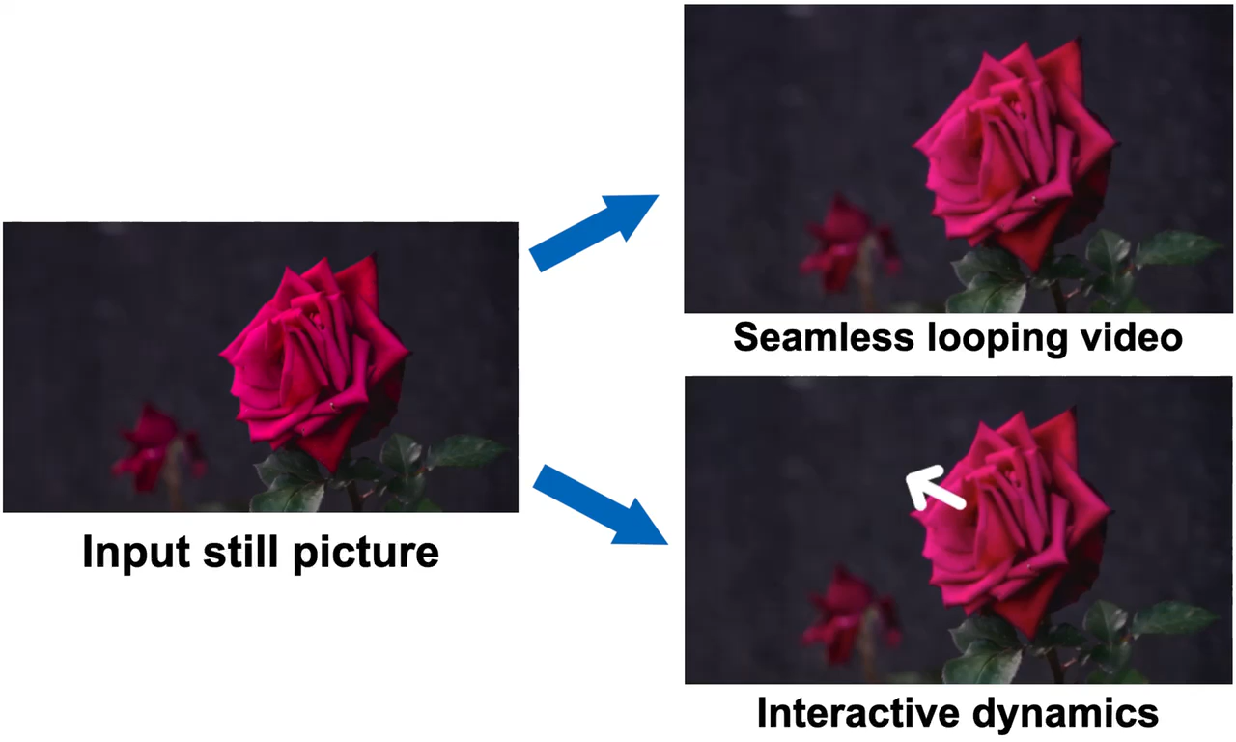
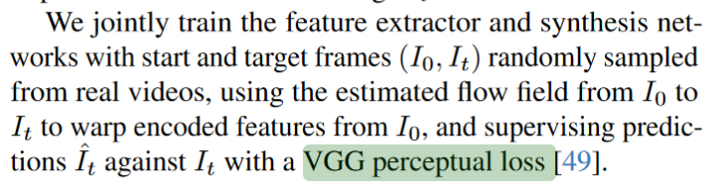
https://generative-dynamics.github.io/

Slide 15
Going Deeper with Convolutions
Christian Szegedy, Wei Liu, Yangqing Jia, Pierre Sermanet, Scott Reed,
Dragomir Anguelov, Dumitru Erhan, Vincent Vanhoucke, Andrew Rabinovich
2015
This is the “Inception” architecture or “GoogLeNet”
*The architecture blocks are called “Inception” modules
and the collection of them into a particular net is “GoogLeNet”
70k citations as of 10/14/2025

Slide 16
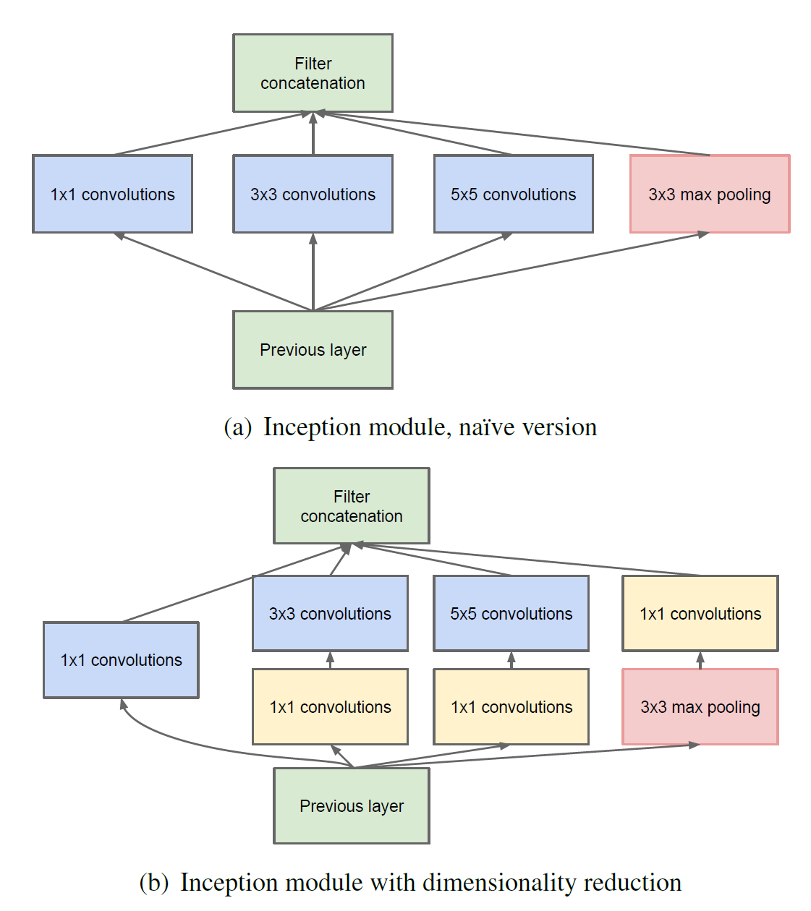

Slide 17
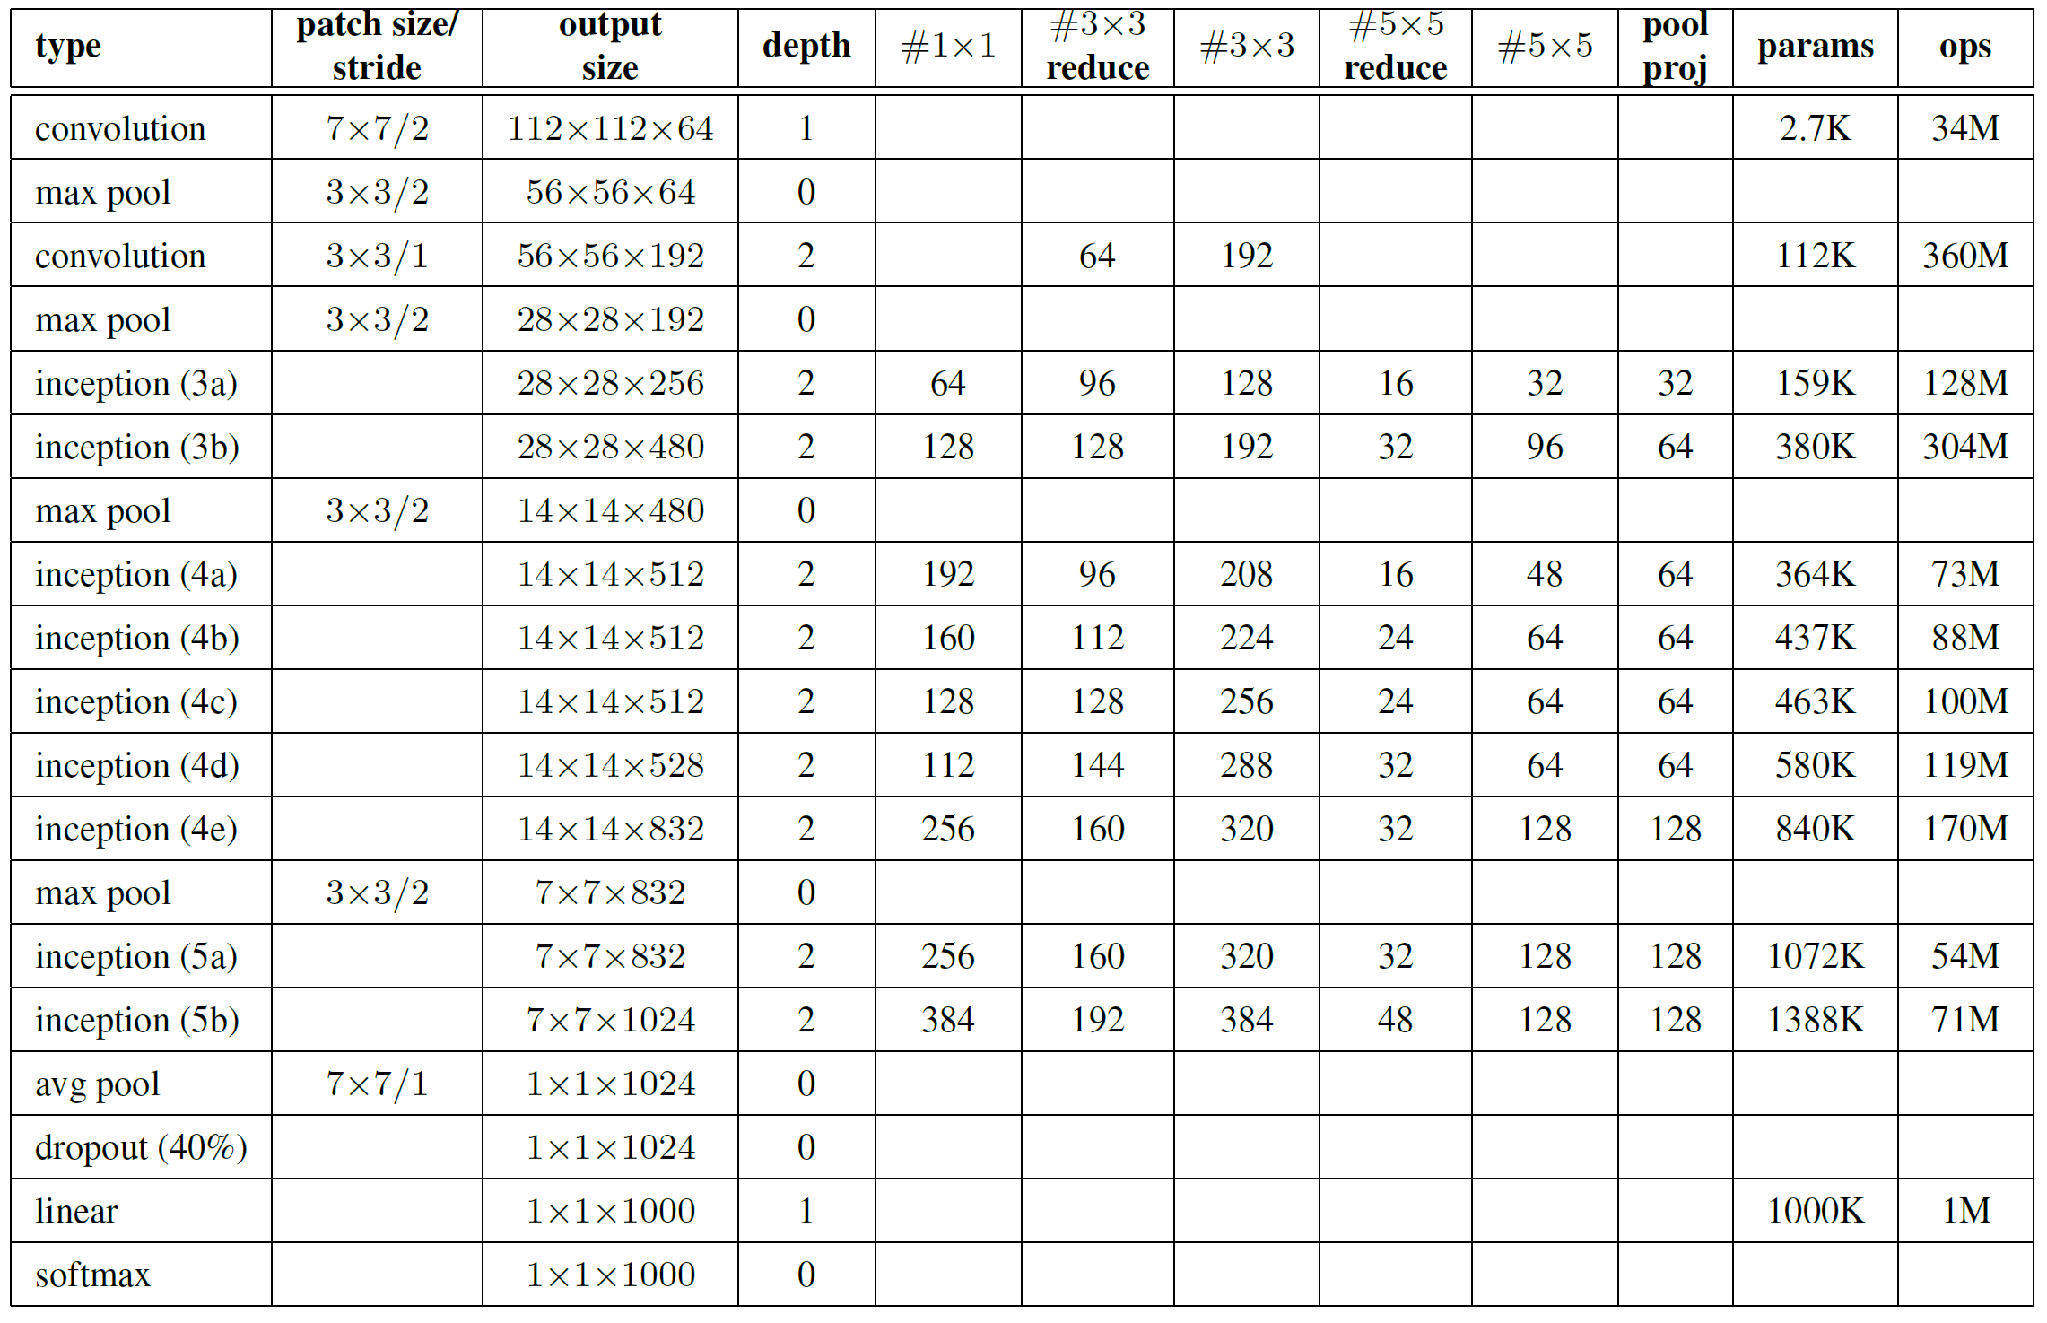
Only 6.8 million parameters. AlexNet ~60 million, VGG up to 138 million

Slide 18
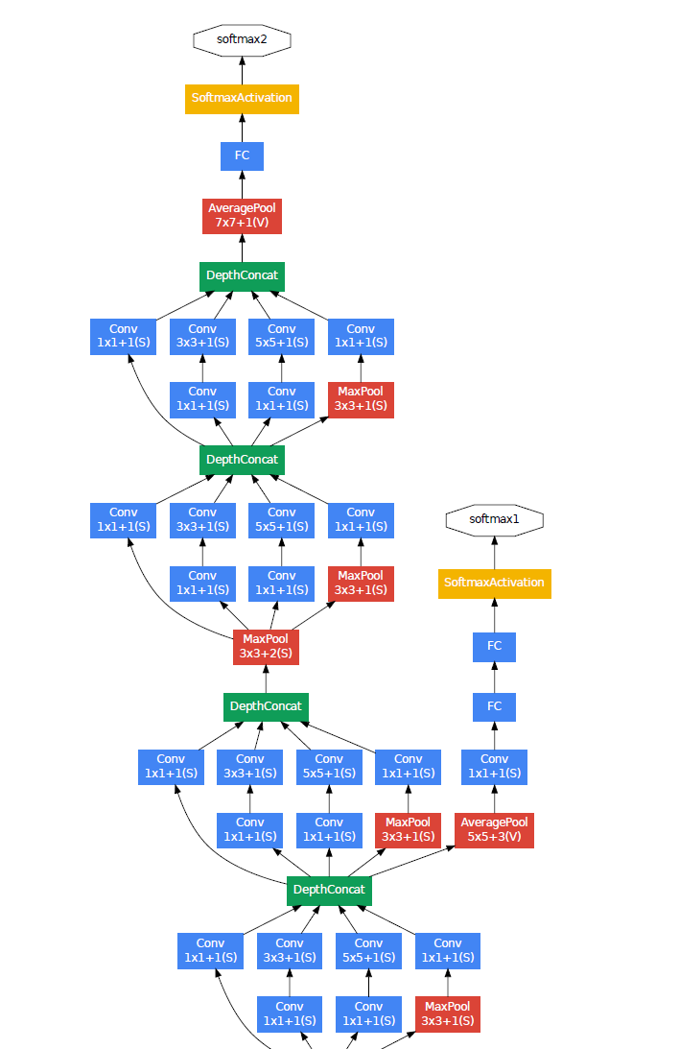
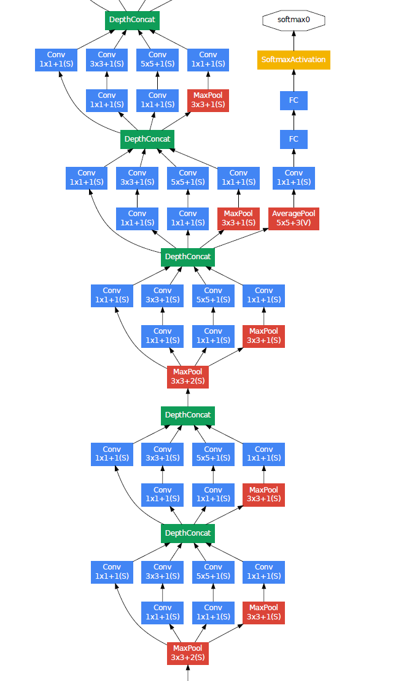
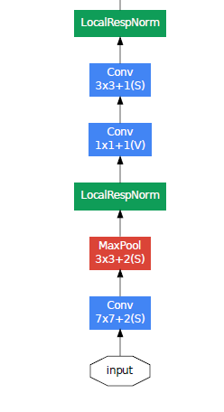

Slide 20
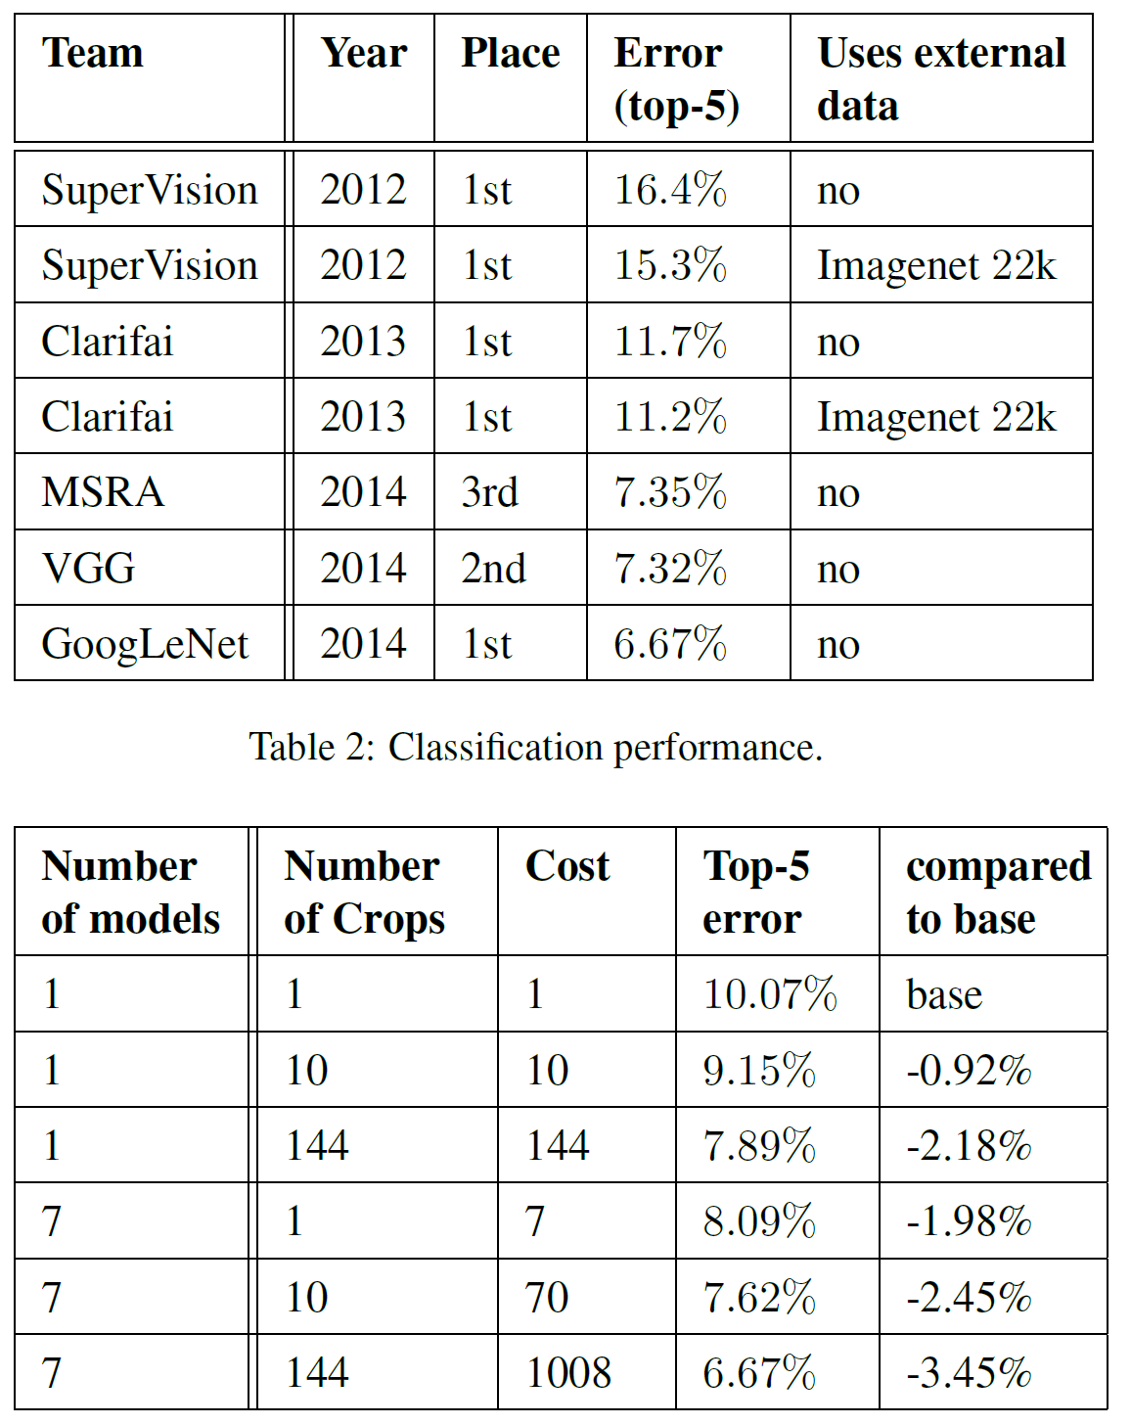

Slide 21
Inception Embeddings
Just like VGG, Inception embeddings are still used as an evaluation metric.
Frechet Inception Distance (FID) and Inception Score (IS)
We’ll revisit this when we talk about image generation

Slide 22




ConvNet Depth
28.2
25.8
16.4
11.7
22 layers
6.7
19 layers
7.3
8 layers
8 layers
shallow
 | ILSVRC'14 | ILSVRC'14 | ILSVRC'13 | ILSVRC'12 | ILSVRC'11 | ILSVRC'10
 | GoogleNet | VGG |  | AlexNet
ImageNet Classification top-5 error (%)

Slide 23
Surely it would be ridiculous to go any deeper…

Slide 24
Deep Residual Learning for Image Recognition
Kaiming He, Xiangyu Zhang, Shaoqing Ren, Jian Sun
7x7 conv, 64, /2, pool/2
1x1 conv, 64
3x3 conv, 64 1x1 conv, 256 1x1 conv, 64 3x3 conv, 64
1x1 conv, 256 1x1 conv, 64 3x3 conv, 64 1x1 conv, 256
1x1 conv, 128, /2
3x3 conv, 128
1x1 conv, 512
1x1 conv, 128
3x3 conv, 128
1x1 conv, 512
1x1 conv, 128
3x3 conv, 128
1x1 conv, 512
1x1 conv, 128
3x3 conv, 128
1x1 conv, 512
1x1 conv, 128
3x3 conv, 128
1x1 conv, 512
1x1 conv, 128
3x3 conv, 128
1x1 conv, 512
1x1 conv, 128
3x3 conv, 128
1x1 conv, 512
1x1 conv, 128
3x3 conv, 128
1x1 conv, 512
1x1 conv, 256, /2
3x3 conv, 256
1x1 conv, 1024
1x1 conv, 256
3x3 conv, 256
1x1 conv, 1024
1x1 conv, 256
3x3 conv, 256
1x1 conv, 1024
1x1 conv, 256
3x3 conv, 256
1x1 conv, 1024
1x1 conv, 256
3x3 conv, 256
1x1 conv, 1024
1x1 conv, 256
3x3 conv, 256
1x1 conv, 1024
1x1 conv, 256
3x3 conv, 256
1x1 conv, 1024
1x1 conv, 256
3x3 conv, 256
1x1 conv, 1024
1x1 conv, 256
3x3 conv, 256
1x1 conv, 1024
1x1 conv, 256
3x3 conv, 256
1x1 conv, 1024
1x1 conv, 256
3x3 conv, 256
1x1 conv, 1024
1x1 conv, 256
3x3 conv, 256
1x1 conv, 1024
1x1 conv, 256
3x3 conv, 256
1x1 conv, 1024
1x1 conv, 256
3x3 conv, 256
1x1 conv, 1024
1x1 conv, 256
3x3 conv, 256
1x1 conv, 1024
1x1 conv, 256
3x3 conv, 256
1x1 conv, 1024
1x1 conv, 256
3x3 conv, 256
1x1 conv, 1024
1x1 conv, 256
3x3 conv, 256
1x1 conv, 1024
1x1 conv, 256
3x3 conv, 256
1x1 conv, 1024
1x1 conv, 256
3x3 conv, 256
1x1 conv, 1024
1x1 conv, 256
3x3 conv, 256
1x1 conv, 1024
1x1 conv, 256
3x3 conv, 256
1x1 conv, 1024
1x1 conv, 256
3x3 conv, 256
1x1 conv, 1024
1x1 conv, 256
3x3 conv, 256
1x1 conv, 1024
1x1 conv, 256
3x3 conv, 256
1x1 conv, 1024
1x1 conv, 256
3x3 conv, 256
1x1 conv, 1024
1x1 conv, 256
3x3 conv, 256
1x1 conv, 1024
1x1 conv, 256
3x3 conv, 256
1x1 conv, 1024
1x1 conv, 256
3x3 conv, 256
1x1 conv, 1024
1x1 conv, 256
3x3 conv, 256
1x1 conv, 1024
1x1 conv, 256
3x3 conv, 256
1x1 conv, 1024
1x1 conv, 256
3x3 conv, 256
1x1 conv, 1024
1x1 conv, 256
3x3 conv, 256
1x1 conv, 1024
1x1 conv, 256
3x3 conv, 256
1x1 conv, 1024
1x1 conv, 256
3x3 conv, 256
1x1 conv, 1024
1x1 conv, 256
3x3 conv, 256
1x1 conv, 1024
1x1 conv, 512, /2
3x3 conv, 512
1x1 conv, 2048
1x1 conv, 512
3x3 conv, 512
1x1 conv, 2048
1x1 conv, 512
3x3 conv, 512
1x1 conv, 2048
ave pool, fc 1000
Cited by 290k papers as of 10/14/2025
Nearing the most cited paper ever

Slide 25
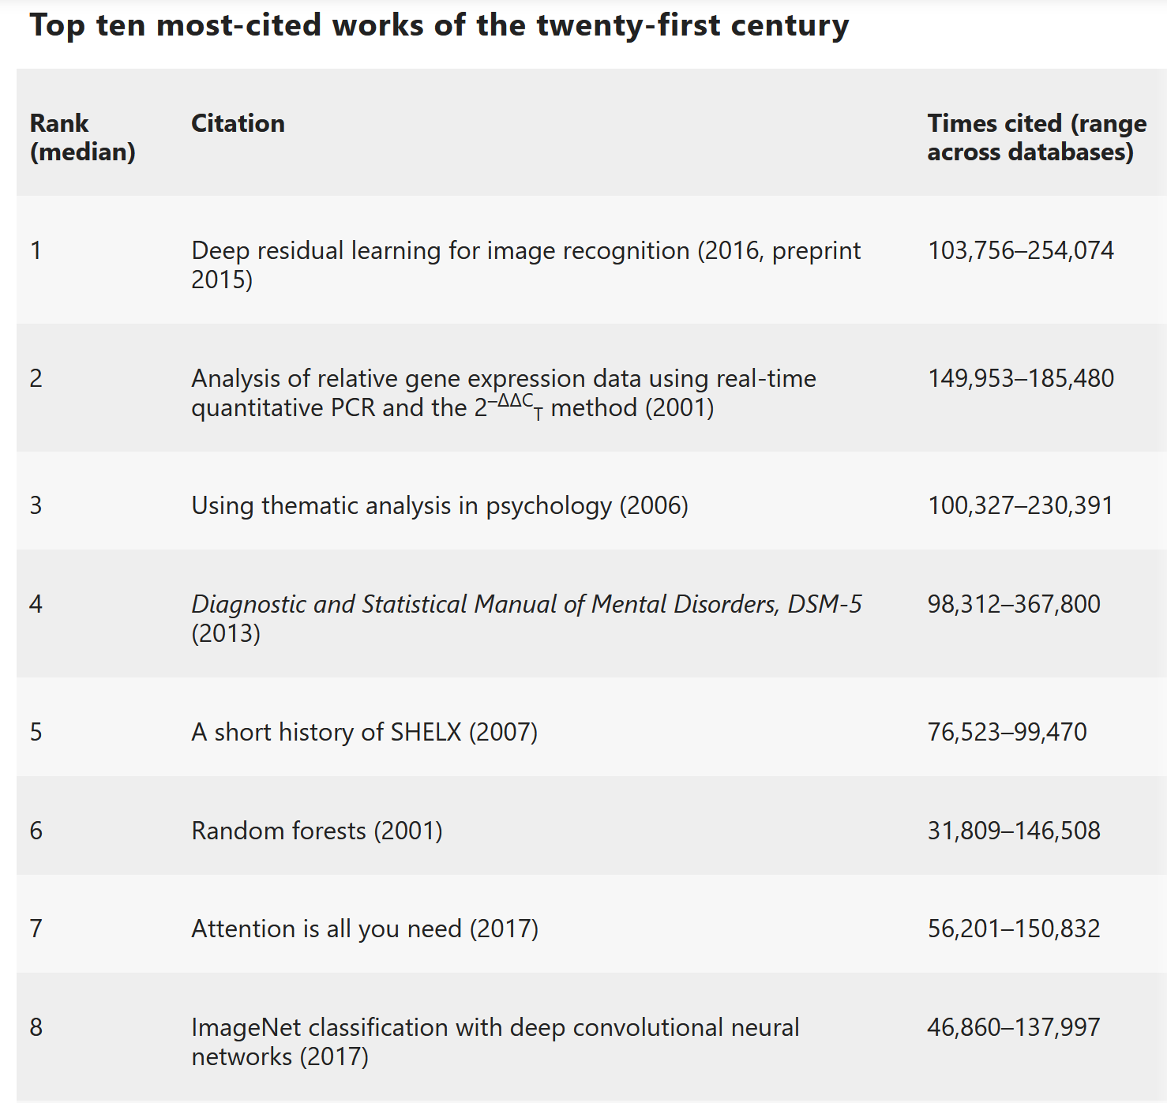
https://www.nature.com/articles/d41586-025-01125-9

Slide 26


Slide 27
ResNet @ ILSVRC & COCO 2015 Competitions
1st places in all five main tracks
ImageNet Classification: “Ultra-deep” 152-layer nets
ImageNet Detection: 16% better than 2nd
ImageNet Localization: 27% better than 2nd
COCO Detection: 11% better than 2nd
COCO Segmentation: 12% better than 2nd
*improvements are relative numbers

Slide 28
Revolution of Depth
28.2
25.8
152 layers
16.4
11.7
22 layers
6.7
19 layers
7.3
3.57
8 layers
8 layers
shallow
ILSVRC'15 | ILSVRC'14 | ILSVRC'14 | ILSVRC'13 | ILSVRC'12 | ILSVRC'11 | ILSVRC'10
ResNet | GoogleNet | VGG |  | AlexNet
ImageNet Classification top-5 error (%)

Slide 29
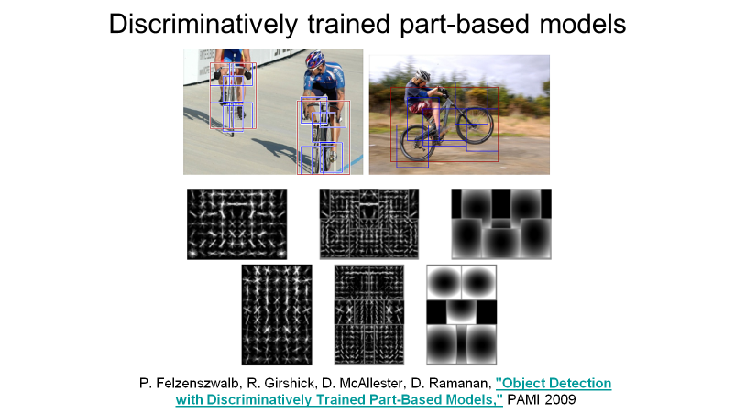
Revolution of Depth
101 layers
86
Engines of
visual recognition
66
58
34
16 layers
8 layers
shallow
HOG, DPM
AlexNet (RCNN)
VGG (RCNN)
ResNet (Faster RCNN)*
PASCAL VOC 2007 Object Detection mAP (%)
*w/ other improvements & more data

Slide 30
Revolution of Depth
AlexNet, 8 layers
(ILSVRC 2012)
11x11 conv, 96, /4, pool/2
5x5 conv, 256, pool/2
3x3 conv, 384
3x3 conv, 384
3x3 conv, 256, pool/2
fc, 4096
fc, 4096
fc, 1000

Slide 31
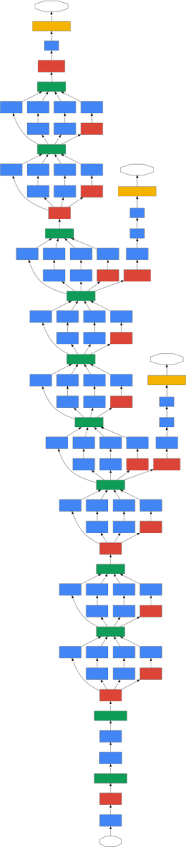
Revolution of Depth
soft max2
Soft maxAct ivat ion
FC
AlexNet, 8 layers
(ILSVRC 2012)
11x11 conv, 96, /4, pool/2
VGG, 19 layers
(ILSVRC 2014)
3x3 conv, 64
GoogleNet, 22 layers
(ILSVRC 2014)
AveragePool 7x7 + 1 (V)
Dept hConcat
5x5 conv, 256, pool/2
3x3 conv, 64, pool/2
Conv Conv Conv Conv 1x1 + 1 (S) 3x3 + 1 (S) 5x5 + 1 (S) 1x1 + 1 (S)
Conv Conv MaxPool 1x1 + 1 (S) 1x1 + 1 (S) 3x3 + 1 (S)
3x3 conv, 384
3x3 conv, 128
Dept hConcat
Conv Conv Conv Conv 1x1 + 1 (S) 3x3 + 1 (S) 5x5 + 1 (S) 1x1 + 1 (S)
soft max1
3x3 conv, 384
3x3 conv, 128, pool/2
Conv Conv MaxPool 1x1 + 1 (S) 1x1 + 1 (S) 3x3 + 1 (S)
Soft maxAct ivat ion
MaxPool 3x3 + 2 (S)
FC
3x3 conv, 256, pool/2
3x3 conv, 256
Dept hConcat
FC
Conv Conv Conv Conv Conv 1x1 + 1 (S) 3x3 + 1 (S) 5x5 + 1 (S) 1x1 + 1 (S) 1x1 + 1 (S)
fc, 4096
3x3 conv, 256
Conv Conv MaxPool AveragePool 1x1 + 1 (S) 1x1 + 1 (S) 3x3 + 1 (S) 5x5 + 3 (V)
Dept hConcat
fc, 4096
3x3 conv, 256
Conv Conv Conv Conv 1x1 + 1 (S) 3x3 + 1 (S) 5x5 + 1 (S) 1x1 + 1 (S)
Conv Conv MaxPool 1x1 + 1 (S) 1x1 + 1 (S) 3x3 + 1 (S)
fc, 1000
3x3 conv, 256, pool/2
Dept hConcat
soft max0
Conv Conv Conv Conv 1x1 + 1 (S) 3x3 + 1 (S) 5x5 + 1 (S) 1x1 + 1 (S)
Soft maxAct ivat ion
3x3 conv, 512
Conv Conv MaxPool 1x1 + 1 (S) 1x1 + 1 (S) 3x3 + 1 (S)
FC
Dept hConcat
FC
3x3 conv, 512
Conv Conv Conv Conv Conv 1x1 + 1 (S) 3x3 + 1 (S) 5x5 + 1 (S) 1x1 + 1 (S) 1x1 + 1 (S)
Conv Conv MaxPool AveragePool 1x1 + 1 (S) 1x1 + 1 (S) 3x3 + 1 (S) 5x5 + 3 (V)
3x3 conv, 512
Dept hConcat
Conv Conv Conv Conv 1x1 + 1 (S) 3x3 + 1 (S) 5x5 + 1 (S) 1x1 + 1 (S)
3x3 conv, 512, pool/2
Conv Conv MaxPool 1x1 + 1 (S) 1x1 + 1 (S) 3x3 + 1 (S)
MaxPool 3x3 + 2 (S)
3x3 conv, 512
Dept hConcat
Conv Conv Conv Conv 1x1 + 1 (S) 3x3 + 1 (S) 5x5 + 1 (S) 1x1 + 1 (S)
3x3 conv, 512
Conv Conv MaxPool 1x1 + 1 (S) 1x1 + 1 (S) 3x3 + 1 (S)
Dept hConcat
3x3 conv, 512
Conv Conv Conv Conv 1x1 + 1 (S) 3x3 + 1 (S) 5x5 + 1 (S) 1x1 + 1 (S)
Conv Conv MaxPool 1x1 + 1 (S) 1x1 + 1 (S) 3x3 + 1 (S)
3x3 conv, 512, pool/2
MaxPool 3x3 + 2 (S)
LocalRespNorm
fc, 4096
Conv 3x3 + 1 (S)
Conv 1x1 + 1 (V)
fc, 4096
LocalRespNorm
MaxPool 3x3 + 2 (S)
fc, 1000
Conv 7x7 + 2 (S)
input

Slide 32
7x7 conv, 64, /2, pool/2
1x1 conv, 64
3x3 conv, 64
1x1 conv, 256
1x1 conv, 64
3x3 conv, 64
1x1 conv, 256
1x1 conv, 64
3x3 conv, 64
1x1 conv, 256
Revolution of Depth
11x11 conv, 96, /4, pool/2
1x2 conv, 128, /2
3x3 conv, 128
1x1 conv, 512
1x1 conv, 128
3x3 conv, 128
1x1 conv, 512
1x1 conv, 128
3x3 conv, 128
1x1 conv, 512
1x1 conv, 128
3x3 conv, 128
1x1 conv, 512
1x1 conv, 128
3x3 conv, 128
1x1 conv, 512
1x1 conv, 128
3x3 conv, 128
1x1 conv, 512
1x1 conv, 128
3x3 conv, 128
1x1 conv, 512
1x1 conv, 128
3x3 conv, 128
1x1 conv, 512 1x1 conv, 256, /2 3x3 conv, 256
1x1 conv, 1024
AlexNet, 8 layers
(ILSVRC 2012)
5x5 conv, 256, pool/2
3x3 conv, 384
3x3 conv, 384 3x3 conv, 256, pool/2
fc, 4096
fc, 4096
fc, 1000
VGG, 19 layers
(ILSVRC 2014)
3x3 conv, 64
3x3 conv, 64, pool/2 3x3 conv, 128
3x3 conv, 128, pool/2 3x3 conv, 256
3x3 conv, 256
3x3 conv, 256 3x3 conv, 256, pool/2
3x3 conv, 512
3x3 conv, 512
3x3 conv, 512 3x3 conv, 512, pool/2
3x3 conv, 512
3x3 conv, 512
3x3 conv, 512 3x3 conv, 512, pool/2
fc, 4096
fc, 4096
fc, 1000
ResNet, 152 layers
(ILSVRC 2015)
1x1 conv, 256
3x3 conv, 256
1x1 conv, 1024
1x1 conv, 256
3x3 conv, 256
1x1 conv, 1024
1x1 conv, 256
3x3 conv, 256
1x1 conv, 1024
1x1 conv, 256
3x3 conv, 256
1x1 conv, 1024
1x1 conv, 256
3x3 conv, 256
1x1 conv, 1024
1x1 conv, 256
3x3 conv, 256
1x1 conv, 1024
1x1 conv, 256
3x3 conv, 256
1x1 conv, 1024
1x1 conv, 256
3x3 conv, 256
1x1 conv, 1024
1x1 conv, 256
3x3 conv, 256
1x1 conv, 1024
1x1 conv, 256
3x3 conv, 256
1x1 conv, 1024
1x1 conv, 256
3x3 conv, 256
1x1 conv, 1024
1x1 conv, 256
3x3 conv, 256
1x1 conv, 1024
1x1 conv, 256
3x3 conv, 256
1x1 conv, 1024
1x1 conv, 256
3x3 conv, 256
1x1 conv, 1024
1x1 conv, 256
3x3 conv, 256
1x1 conv, 1024
1x1 conv, 256
3x3 conv, 256
1x1 conv, 1024
1x1 conv, 256
3x3 conv, 256
1x1 conv, 1024
1x1 conv, 256
3x3 conv, 256
1x1 conv, 1024
1x1 conv, 256
3x3 conv, 256
1x1 conv, 1024
1x1 conv, 256
3x3 conv, 256
1x1 conv, 1024
1x1 conv, 256
3x3 conv, 256
1x1 conv, 1024
1x1 conv, 256
3x3 conv, 256
1x1 conv, 1024
1x1 conv, 256
3x3 conv, 256
1x1 conv, 1024
1x1 conv, 256
3x3 conv, 256
1x1 conv, 1024
1x1 conv, 256
3x3 conv, 256
1x1 conv, 1024
1x1 conv, 256
3x3 conv, 256
1x1 conv, 1024
1x1 conv, 256
3x3 conv, 256
1x1 conv, 1024
1x1 conv, 256
3x3 conv, 256
1x1 conv, 1024
1x1 conv, 256
3x3 conv, 256
1x1 conv, 1024
1x1 conv, 256
3x3 conv, 256
1x1 conv, 1024
1x1 conv, 256
3x3 conv, 256
1x1 conv, 1024
1x1 conv, 256
3x3 conv, 256
1x1 conv, 1024
1x1 conv, 256
3x3 conv, 256
1x1 conv, 1024
1x1 conv, 256
3x3 conv, 256
1x1 conv, 1024
1x1 conv, 256
3x3 conv, 256
1x1 conv, 1024 1x1 conv, 512, /2 3x3 conv, 512
1x1 conv, 2048
1x1 conv, 512
3x3 conv, 512
1x1 conv, 2048
1x1 conv, 512
3x3 conv, 512
1x1 conv, 2048 ave pool, fc 1000

Slide 33
Is learning better networks
as simple as stacking more layers?

Slide 34
Simply stacking layers?
CIFAR-10
train error (%)
20
test error (%)
20
56-layer
56-layer
10
10
20-layer
20-layer
0 ₀
1
2
3
iter. (1e4)
4
5
6
0
0
1
2
3
iter. (1e4)
4
5
6
Plain nets: stacking 3x3 conv layers…
56-layer net has higher training error and test error than 20-layer net

Slide 35
Simply stacking layers?
CIFAR-10
ImageNet-1000
20
56-layer 44-layer 32-layer 20-layer
60
50
error (%)
error (%)
34-layer
10
40
5
plain-20 plain-32 plain-44 plain-56
30
solid: test/val dashed: train
plain-18 plain-34
18-layer
0
0
1
2
3
iter. (1e4)
4
5
6
20
0
10
20
30
iter. (1e4)
40
50
“Overly deep” plain nets have higher training error
A general phenomenon, observed in many datasets

Slide 36
a shallower model
(18 layers)
7x7 conv, 64, /2
7x7 conv, 64, /2
a deeper counterpart (34 layers)
3x3 conv, 64
3x3 conv, 64
3x3 conv, 64
3x3 conv, 64
3x3 conv, 64
3x3 conv, 64
3x3 conv, 64
3x3 conv, 64
3x3 conv, 64
3x3 conv, 64
3x3 conv, 128, /2
3x3 conv, 128, /2
Richer solution space
3x3 conv, 128
3x3 conv, 128
3x3 conv, 128
3x3 conv, 128
3x3 conv, 128
3x3 conv, 128
3x3 conv, 128
A deeper model should not have higher training error
3x3 conv, 128
3x3 conv, 128
“extra” layers
3x3 conv, 128
3x3 conv, 256, /2
3x3 conv, 256, /2
3x3 conv, 256
3x3 conv, 256
3x3 conv, 256
3x3 conv, 256
A solution by construction:
  original layers: copied from a learned shallower model
  extra layers: set as identity
  at least the same training error
3x3 conv, 256
3x3 conv, 256
3x3 conv, 256
3x3 conv, 256
3x3 conv, 256
3x3 conv, 256
3x3 conv, 256
3x3 conv, 256
3x3 conv, 256
3x3 conv, 256
3x3 conv, 512, /2
3x3 conv, 512, /2
3x3 conv, 512
3x3 conv, 512
Optimization difficulties: solvers cannot find the solution when going deeper…
3x3 conv, 512
3x3 conv, 512
3x3 conv, 512
3x3 conv, 512
3x3 conv, 512
3x3 conv, 512
fc 1000
fc 1000

Slide 37


Deep Residual Learning
𝐻 𝑥 is any desired mapping, hope the 2 weight layers fit 𝐻(𝑥)
Plain net
𝑥
weight layer
 | relu
any two stacked layers
weight layer
relu
𝐻(𝑥)

Slide 38


Deep Residual Learning
𝐻 𝑥 is any desired mapping, hope the 2 weight layers fit 𝐻(𝑥) hope the 2 weight layers fit 𝐹(𝑥) let 𝐻 𝑥 = 𝐹 𝑥 + 𝑥
Residual net
𝑥
weight layer
𝐹(𝑥)
relu
identity
𝑥
weight layer
𝐻
𝑥
= 𝐹
𝑥
+ 𝑥
relu

Slide 39
Deep Residual Learning
𝐹 𝑥 is a residual mapping w.r.t. identity
𝑥
If identity were optimal, easy to set weights as 0
If optimal mapping is closer to identity, easier to find small fluctuations
weight layer
 | relu
𝐹(𝑥)
identity
𝑥
weight layer
𝐻
𝑥
= 𝐹
𝑥
+ 𝑥
relu

Slide 40
7x7 conv, 64, /2
7x7 conv, 64, /2
pool, /2
pool, /2
Network “Design”
Keep it simple
3x3 conv, 64
3x3 conv, 64
plain net
3x3 conv, 64
3x3 conv, 64
ResNet
3x3 conv, 64
3x3 conv, 64
3x3 conv, 64
3x3 conv, 64
3x3 conv, 64
3x3 conv, 64
3x3 conv, 64
3x3 conv, 64
3x3 conv, 128, /2
3x3 conv, 128, /2
3x3 conv, 128
3x3 conv, 128
3x3 conv, 128
3x3 conv, 128
3x3 conv, 128
3x3 conv, 128
3x3 conv, 128
3x3 conv, 128
3x3 conv, 128
3x3 conv, 128
Our basic design (VGG-style)
  all 3x3 conv (almost)
  spatial size /2 => # filters x2
  Simple design; just deep!
3x3 conv, 128
3x3 conv, 128
3x3 conv, 128
3x3 conv, 128
3x3 conv, 256, /2
3x3 conv, 256, /2
3x3 conv, 256
3x3 conv, 256
3x3 conv, 256
3x3 conv, 256
3x3 conv, 256
3x3 conv, 256
3x3 conv, 256
3x3 conv, 256
3x3 conv, 256
3x3 conv, 256
3x3 conv, 256
3x3 conv, 256
3x3 conv, 256
3x3 conv, 256
3x3 conv, 256
3x3 conv, 256
3x3 conv, 256
3x3 conv, 256
3x3 conv, 256
3x3 conv, 256
3x3 conv, 256
3x3 conv, 256
3x3 conv, 512, /2
3x3 conv, 512, /2
3x3 conv, 512
3x3 conv, 512
3x3 conv, 512
3x3 conv, 512
3x3 conv, 512
3x3 conv, 512
3x3 conv, 512
3x3 conv, 512
3x3 conv, 512
3x3 conv, 512
avg pool
avg pool
fc 1000
fc 1000

Slide 41
CIFAR-10 experiments
CIFAR-10 plain nets
CIFAR-10 ResNets
20
20
ResNet-20 ResNet-32 ResNet-44 ResNet-56
56-layer 44-layer 32-layer 20-layer
ResNet-110
20-layer 32-layer 44-layer 56-layer 110-layer
error (%)
error (%)
10
10
5
plain-20 plain-32 plain-44 plain-56
5
bold: test thin: train
0
0
1
2
3
iter. (1e4)
4
5
6
0
0
1
2
3
iter. (1e4)
4
5
6
• Deep ResNets can be trained without difficulties
• Deeper ResNets have lower training error, and also lower test error

Slide 42
ImageNet experiments
ImageNet plain nets
ImageNet ResNets
60
60
50
50
error (%)
34-layer
error (%)
18-layer
40
40
30
solid: test
30
plain-18
plain-34
dashed: train
18-layer
ResNet-18
ResNet-34
34-layer
20
0
10
20
30
iter. (1e4)
40
50
20
0
10
20
30
iter. (1e4)
40
50
• Deep ResNets can be trained without difficulties
• Deeper ResNets have lower training error, and also lower test error

Slide 43
ImageNet experiments
Deeper ResNets have lower error
8
7.4
this model has
lower time complexity
than VGG-16/19
6.7
7
6.1
5.7
6
5
4
ResNet-152
ResNet-101 ResNet-50
10-crop testing, top-5 val error (%)
ResNet-34

Slide 44
Beyond classification
A treasure from ImageNet is on learning features.
Kaiming He, Xiangyu Zhang, Shaoqing Ren, & Jian Sun. “Deep Residual Learning for Image Recognition”. arXiv 2015.

Slide 45
“Features matter.” (quote [Girshick et al. 2014], the R-CNN paper)
task
2nd-place winner
ResNets
margin
(relative)
12.0 9.0
_{53.6} absolute _{62.1}
ImageNet Localization (top-5 error)
27%
ImageNet Detection (mAP@.5)
16%
8.5% better!
33.5 37.3
COCO Detection (mAP@.5:.95)
11%
COCO Segmentation (mAP@.5:.95)
25.1 28.2
12%
Our results are all based on ResNet-101
Our features are well transferrable
Kaiming He, Xiangyu Zhang, Shaoqing Ren, & Jian Sun. “Deep Residual Learning for Image Recognition”. CVPR 2016.

Slide 46
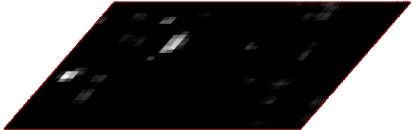
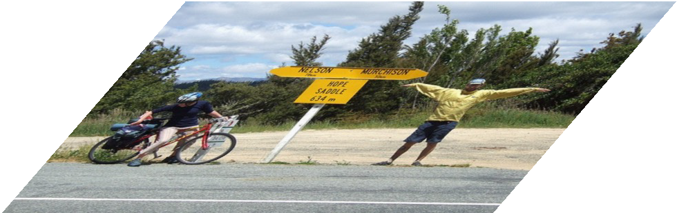
Object Detection (brief)
classifier
RoI pooling
Simply “Faster R-CNN + ResNet”
proposals
Faster R-CNN baseline | mAP@.5 | mAP@.5:.95
VGG-16 | 41.5 | 21.5
ResNet-101 | 48.4 | 27.2
Region Proposal Net
feature map
COCO detection results (ResNet has 28% relative gain)
CNN
image
Kaiming He, Xiangyu Zhang, Shaoqing Ren, & Jian Sun. “Deep Residual Learning for Image Recognition”. CVPR 2016. Shaoqing Ren, Kaiming He, Ross Girshick, & Jian Sun. “Faster R-CNN: Towards Real-Time Object Detection with Region Proposal Networks”. NIPS 2015.

Slide 47
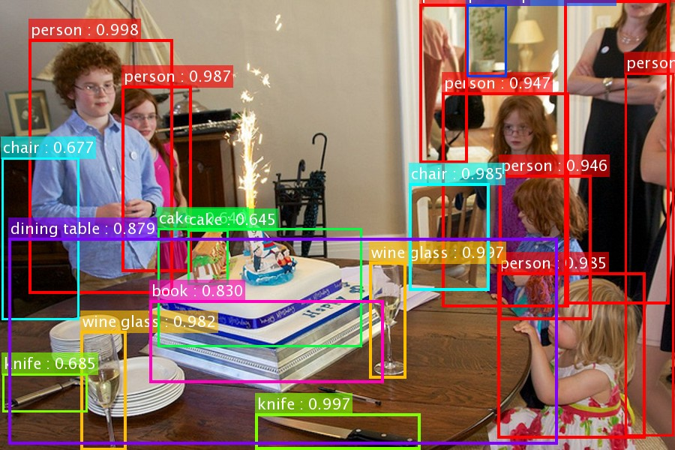
Our results on MS COCO
*the original image is from the COCO dataset
Kaiming He, Xiangyu Zhang, Shaoqing Ren, & Jian Sun. “Deep Residual Learning for Image Recognition”. CVPR 2016. Shaoqing Ren, Kaiming He, Ross Girshick, & Jian Sun. “Faster R-CNN: Towards Real-Time Object Detection with Region Proposal Networks”. NIPS 2015.

Slide 48
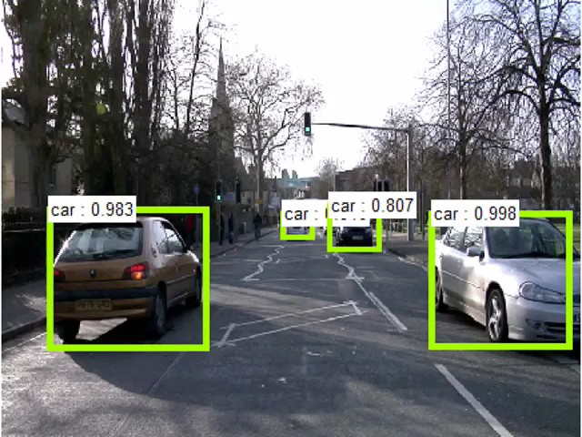
this video is available online: https://youtu.be/WZmSMkK9VuA
Results on real video. Model trained on MS COCO w/ 80 categories. (frame-by-frame; no temporal processing)
Kaiming He, Xiangyu Zhang, Shaoqing Ren, & Jian Sun. “Deep Residual Learning for Image Recognition”. arXiv 2015. Shaoqing Ren, Kaiming He, Ross Girshick, & Jian Sun. “Faster R-CNN: Towards Real-Time Object Detection with Region Proposal Networks”. NIPS 2015.

Slide 49
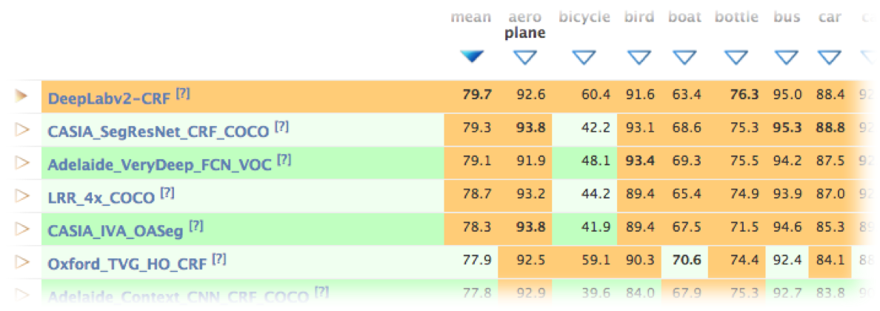
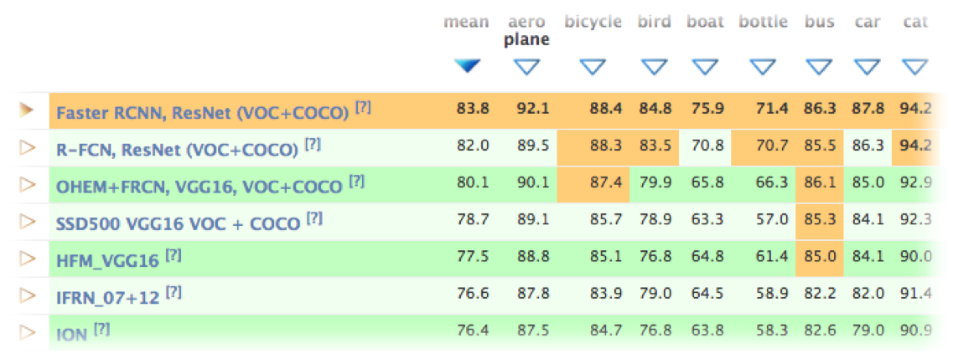
More Visual Recognition Tasks
ResNets lead on these benchmarks (incomplete list):
ImageNet classification, detection, localization
MS COCO detection, segmentation
ResNet-101
PASCAL VOC detection, segmentation
VQA challenge 2016
PASCAL segmentation leaderboard
Human pose estimation [Newell et al 2016]
Depth estimation [Laina et al 2016]
Segment proposal [Pinheiro et al 2016]
…
ResNet-101
PASCAL detection leaderboard

Slide 50
Potential Applications
Visual Recognition
Image Generation (Pixel RNN, Neural Art, etc.)
Natural Language Processing (Very deep CNN)
Speech Recognition (preliminary results)
Advertising, user prediction (preliminary results)
ResNets have shown outstanding or promising results on:
Kaiming He, Xiangyu Zhang, Shaoqing Ren, & Jian Sun. “Deep Residual Learning for Image Recognition”. CVPR 2016.

Slide 51
Conclusions
Deep Residual Networks:
  Easy to train
  Simply gain accuracy from depth
  Well transferrable
Follow-up [He et al. arXiv 2016]
  200 layers on ImageNet, 1000 layers on CIFAR
Kaiming He, Xiangyu Zhang, Shaoqing Ren, & Jian Sun. “Identity Mappings in Deep Residual Networks”. arXiv 2016.
Kaiming He, Xiangyu Zhang, Shaoqing Ren, & Jian Sun. “Deep Residual Learning for Image Recognition”. CVPR 2016.

Slide 52
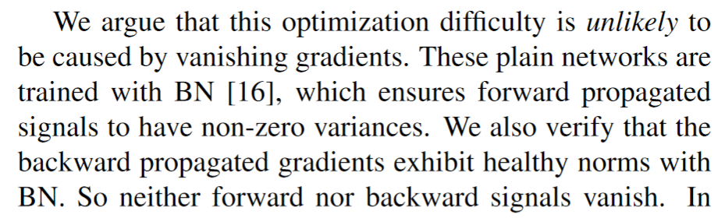
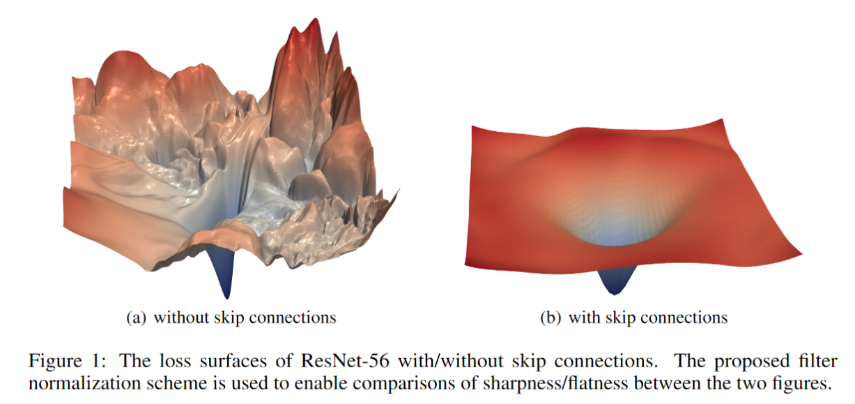
Why does ResNet work so well?
The architecture is somehow easier to optimize.
The authors argue it probably isn’t because it solves the “vanishing gradient” problem.
While the gradients might not be “vanishing” in “plain” nets, they don’t seem as stable and trustworthy, according to follow up work, e.g.
Visualizing the Loss Landscape of Neural Nets. Hao Li, Zheng Xu , Gavin Taylor, Christoph Studer, Tom Goldstein. NeurIPS 2018.

