Slide 1
“Attention” and “Transformer” Architectures
James Hays
Some ViT slides from Noah Snavely.

Slide 2
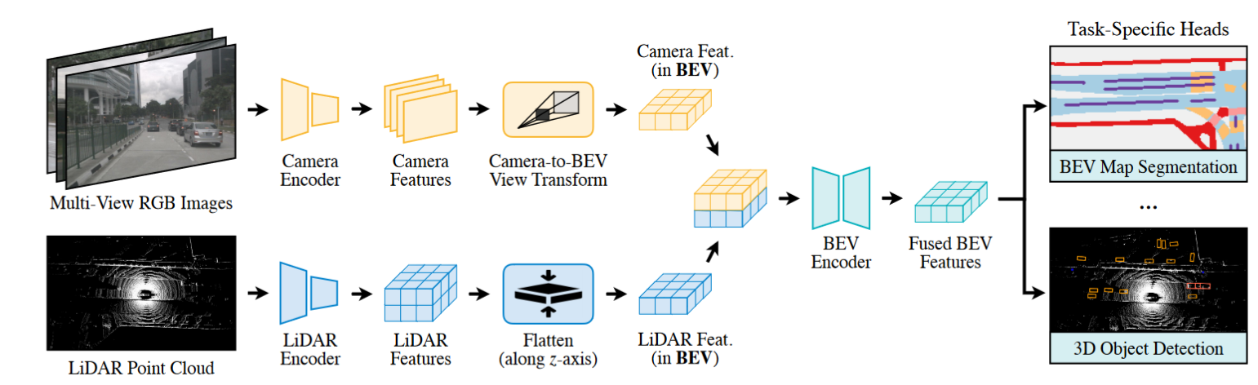
Recap – 3D point processing
Popular CNN backbones aren’t a direct fit for 3D point processing tasks.
It’s not clear how best to use deep learning on 3D data
  Use a truly permutation invariant representation (PointNet)
  Use a voxel representation (VoxelNet)
  Use a bird’s a view representation (PointPillars)
  Create a range image
With lidar, multi-modal approaches (adding images, radar) help surprisingly little compared to lidar-only approaches (~3 mAP).
BEVFusion: Multi-Task Multi-Sensor Fusion with Unified Bird’s-Eye View Representation.
Zhijian Liu, Haotian Tang, Alexander Amini, Xinyu Yang, Huizi Mao, Daniela L. Rus, Song Han

Slide 3
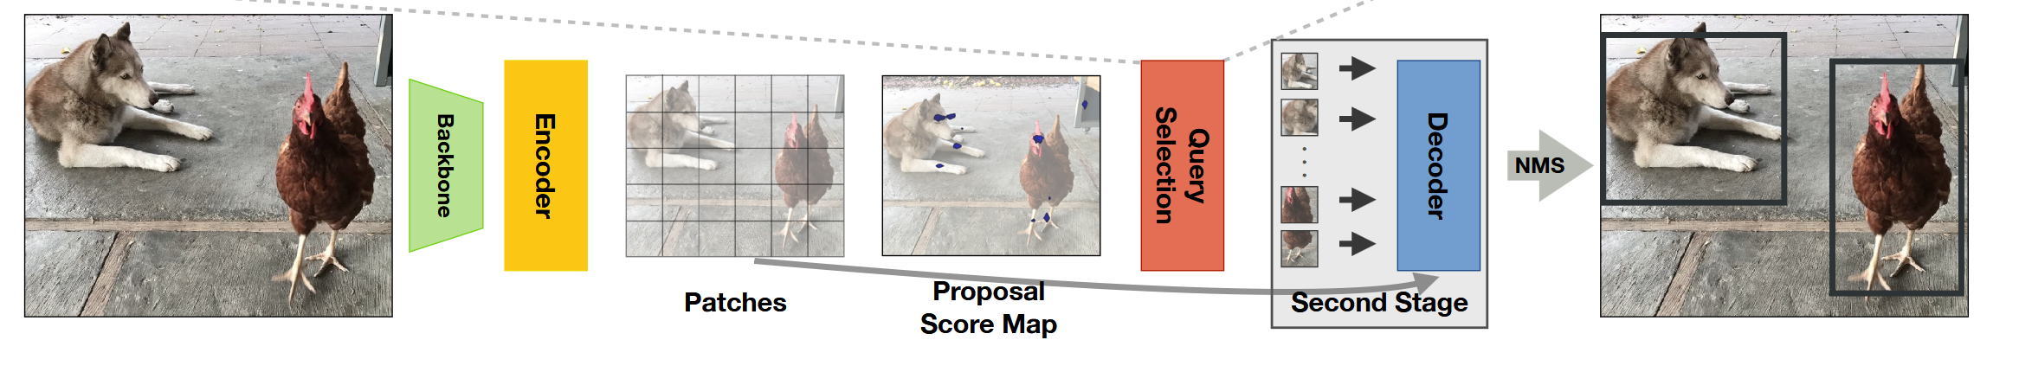
Recap – Object Detection
Break up complicated tasks into subtasks, e.g. propose objects and then classify objects
Many recent transformer architectures (e.g. DETR) perform object detection in one stage with no non-maximum suppression
NMS Strikes Back.
Jeffrey Ouyang-Zhang, Jang Hyun Cho, Xingyi Zhou, Philipp Krähenbühl. 2022

Slide 4
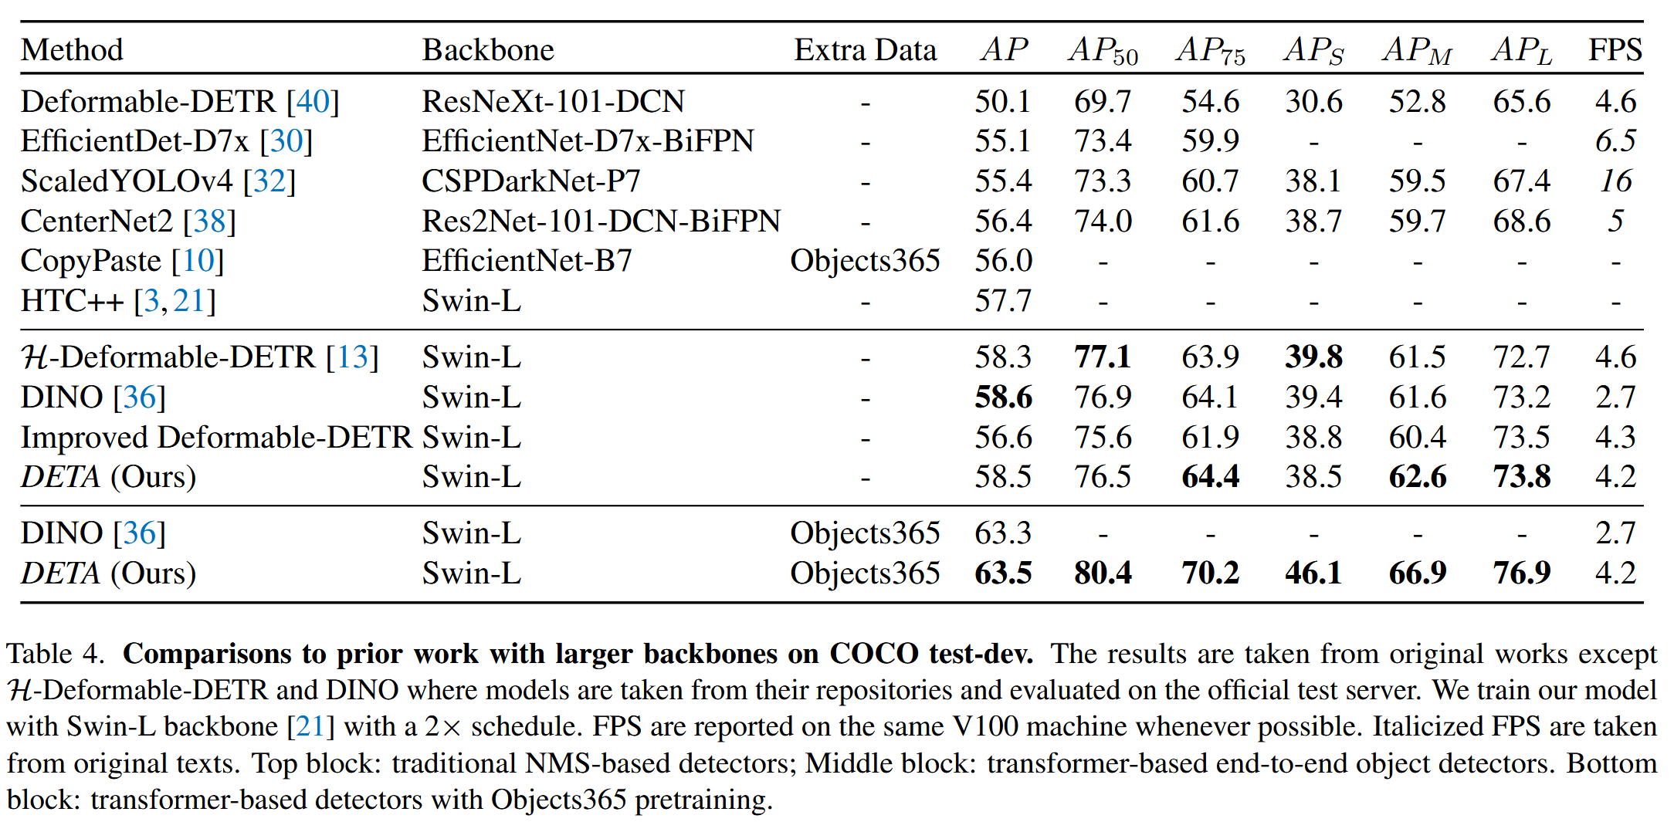
NMS Strikes Back.
Jeffrey Ouyang-Zhang, Jang Hyun Cho, Xingyi Zhou, Philipp Krähenbühl. 2022

Slide 5
Outline
Context and Receptive Field
Going Beyond Convolutions in…
  Text
  Images
  Point Clouds
Notable Transformer “Foundation” models
  CLIP-like models
  DINO models

Slide 6
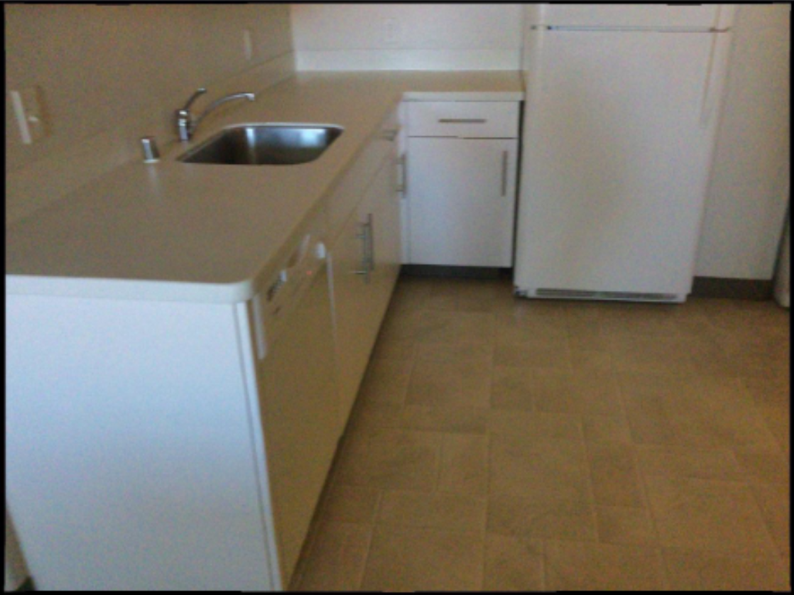

Slide 7
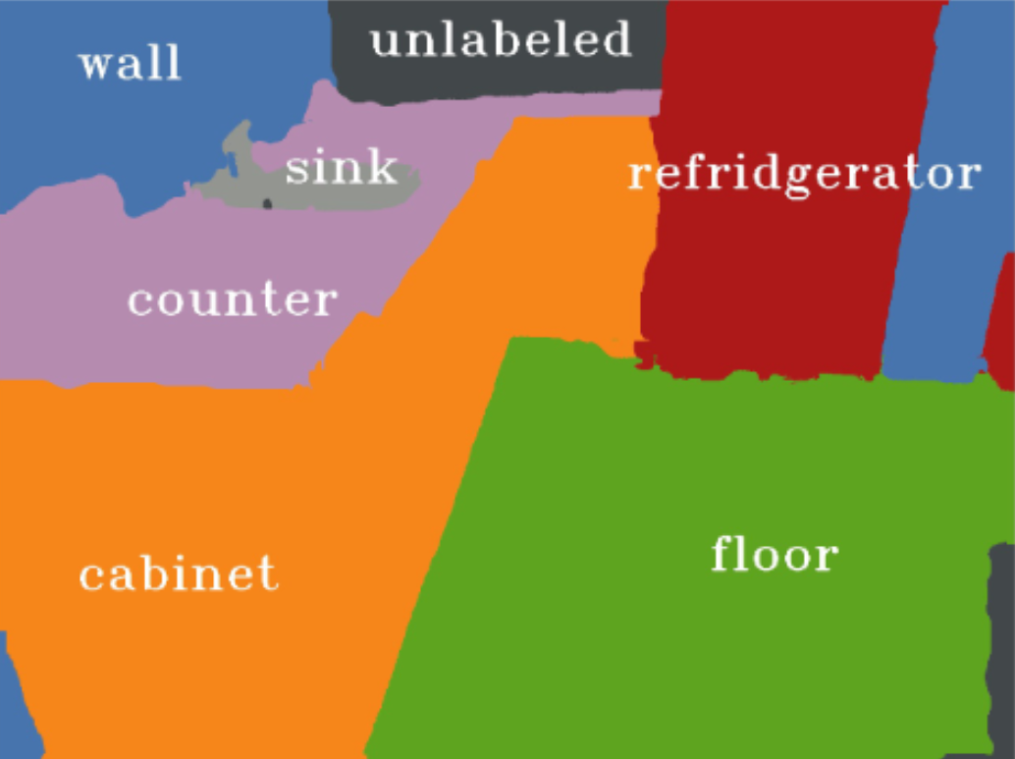
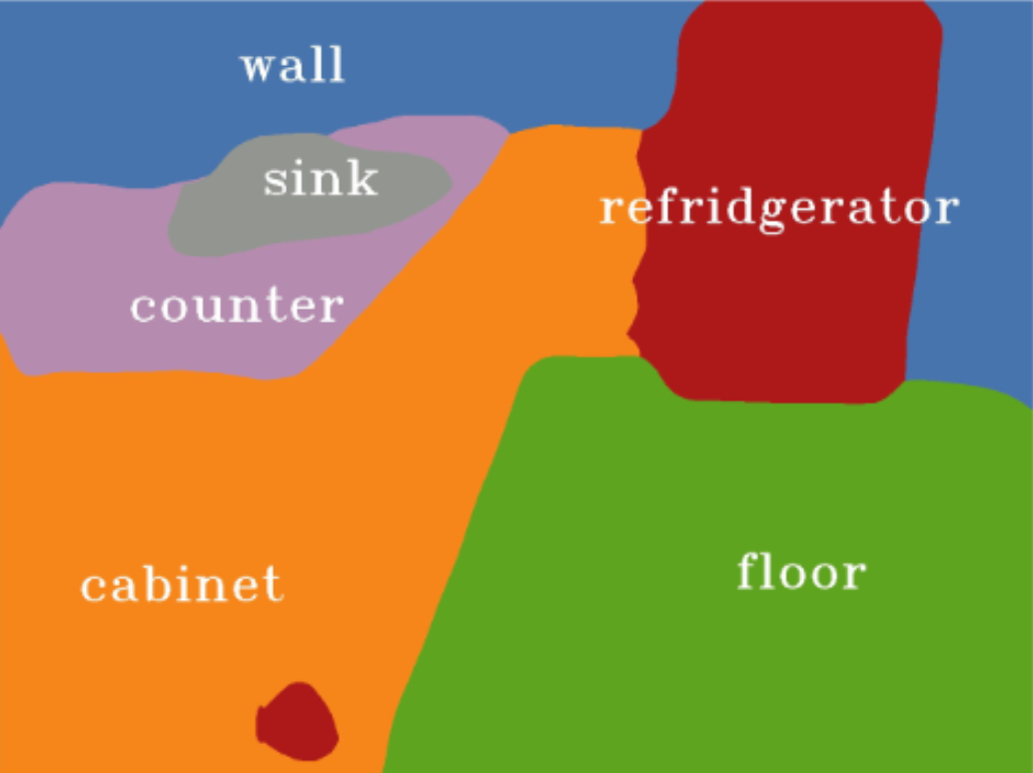
Ground truth
Prediction from Mseg
Notes:
Left – ground truth
Right – result from mseg http://vladlen.info/publications/mseg-composite-dataset-multi-domain-semantic-segmentation/

Slide 11
Language understanding
… serve …

Slide 12
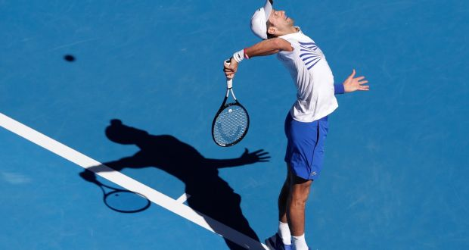
Language understanding
… great serve from Djokovic …

Slide 13

Language understanding
… be right back after I serve these salads …

Slide 14

Longer Range Dependencies
The text of Dune + “Which characters possess the Atreides Ducal Signet?”
1. Duke Leto Atreides
As the head of House Atreides, Leto possesses the ring at the start of the series. During the Harkonnen/Sardaukar sneak attack on Arrakis, Leto is captured. Knowing he is going to his death, his primary concern is the succession. He manages to pass the ring to his loyal Mentat, Thufir Hawat, before being taken to the Baron.
2. Thufir Hawat
Hawat carries the ring briefly after the fall of House Atreides. Despite being captured by the Harkonnens and forced into their service (via "residual poison" coercion), he manages to keep the ring hidden or secured. His ultimate goal remains the preservation of the Atreides legacy.
3. Paul Atreides (Muad'Dib)
Paul receives the ring while living among the Fremen in the deep desert. In the novel, it is delivered to him via a message/courier from Hawat (who is being held by the Harkonnens). Taking the ring is a pivotal moment; it marks Paul's formal acceptance of the title Duke of Arrakis and signals his intent to challenge the Emperor and House Harkonnen.

Slide 15
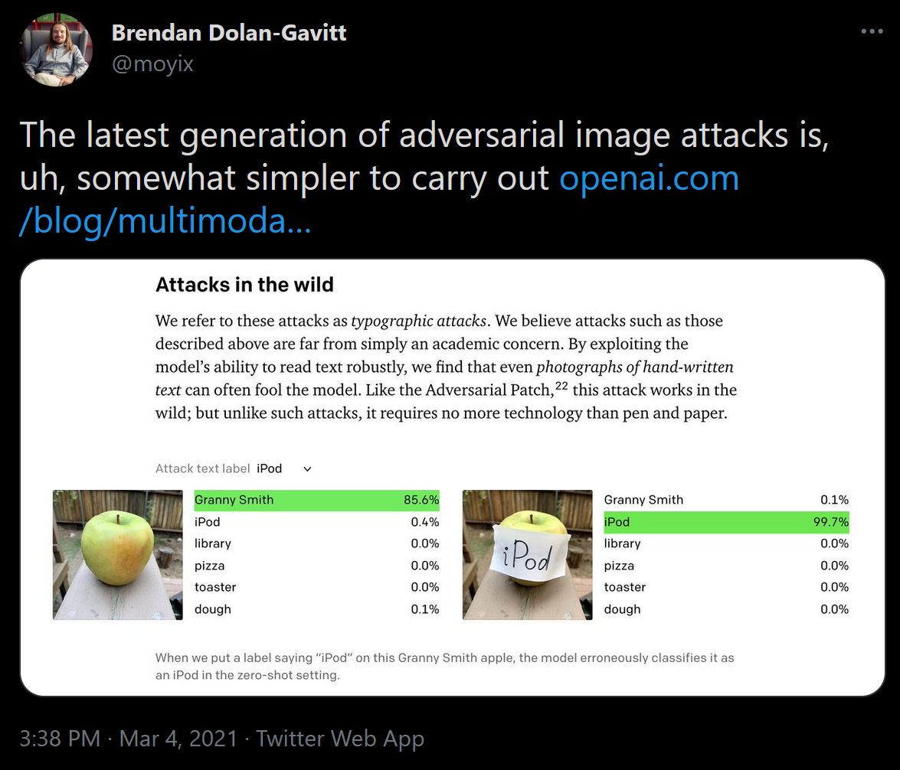

Slide 16
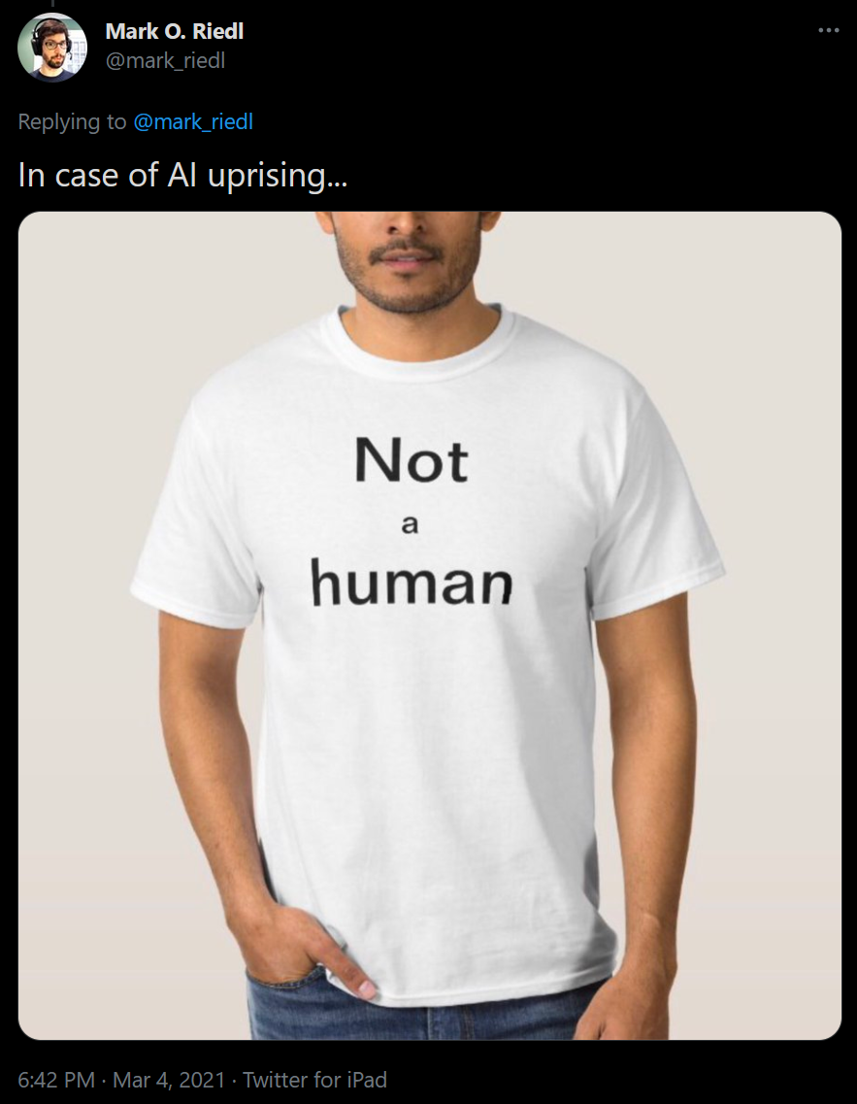
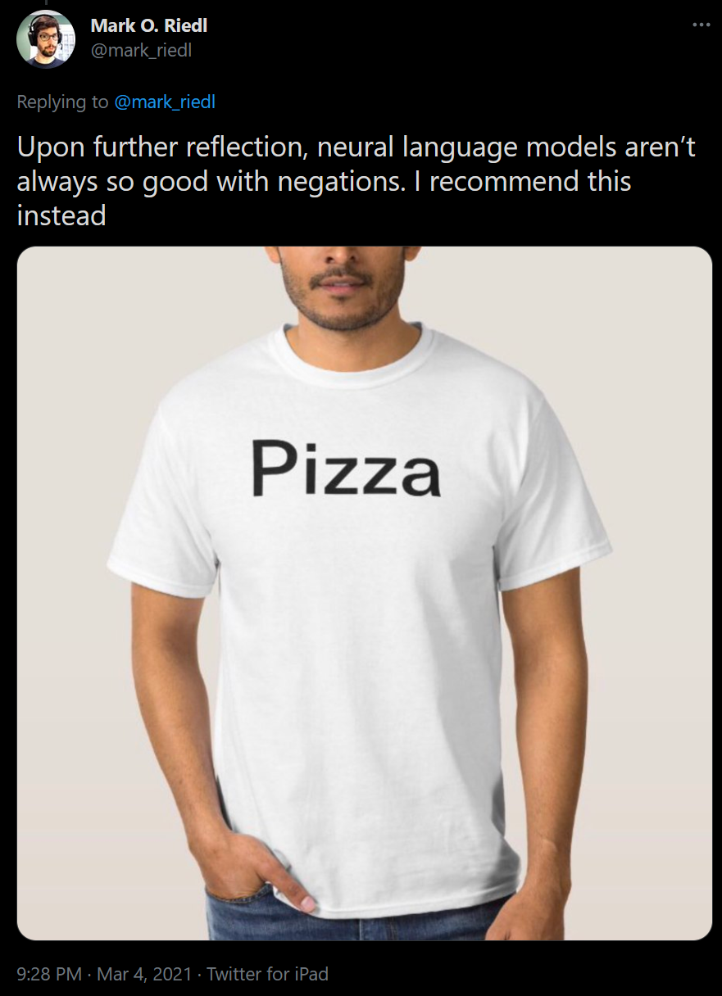

Slide 17
So how do we fix these problems?

Slide 18
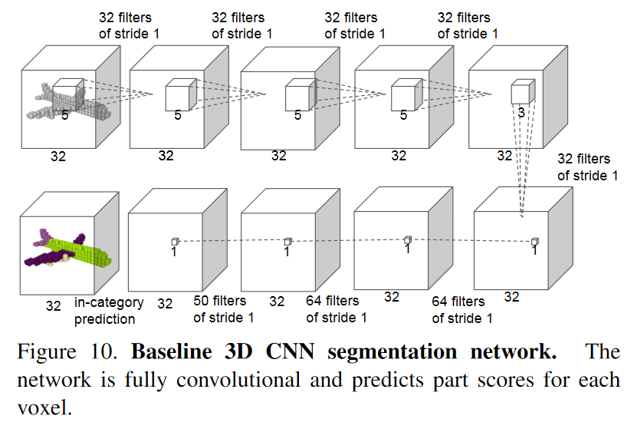
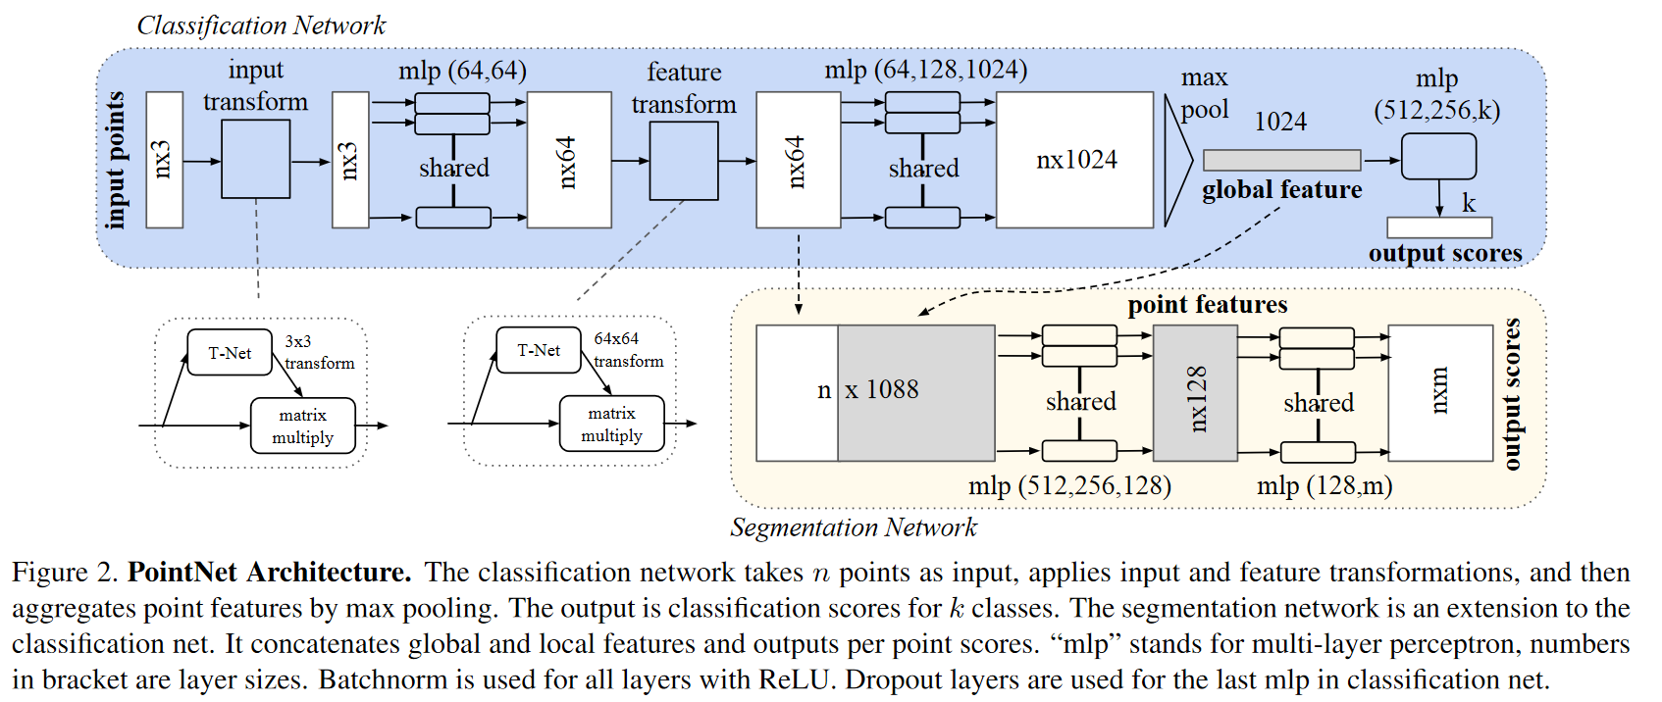
Receptive field could also be an issue in 3D

Slide 19
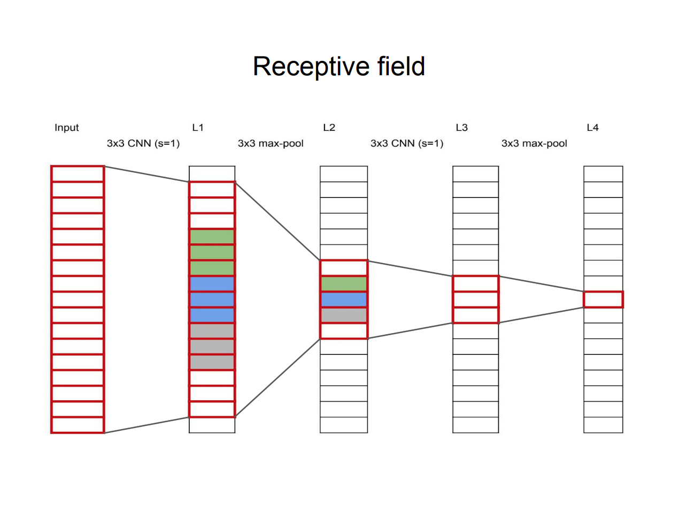
Slide Credit: Frank Dellaert https://dellaert.github.io/19F-4476/resources/receptiveField.pdf

Slide 20
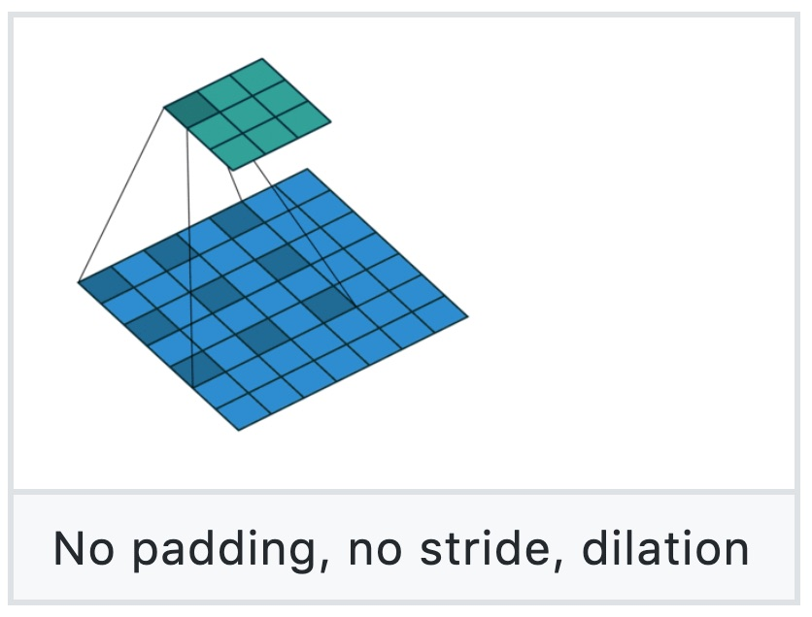
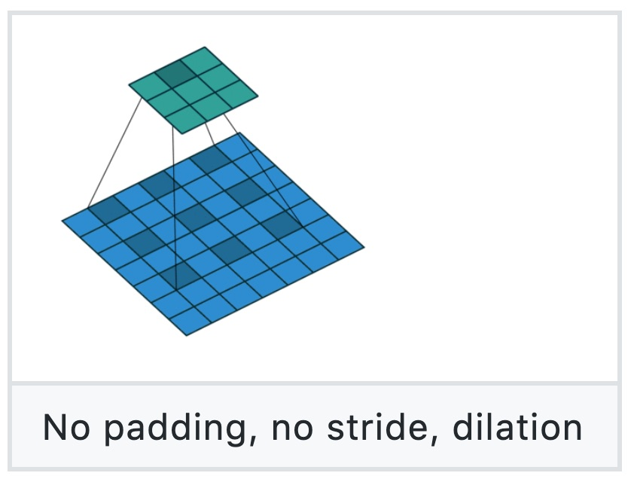
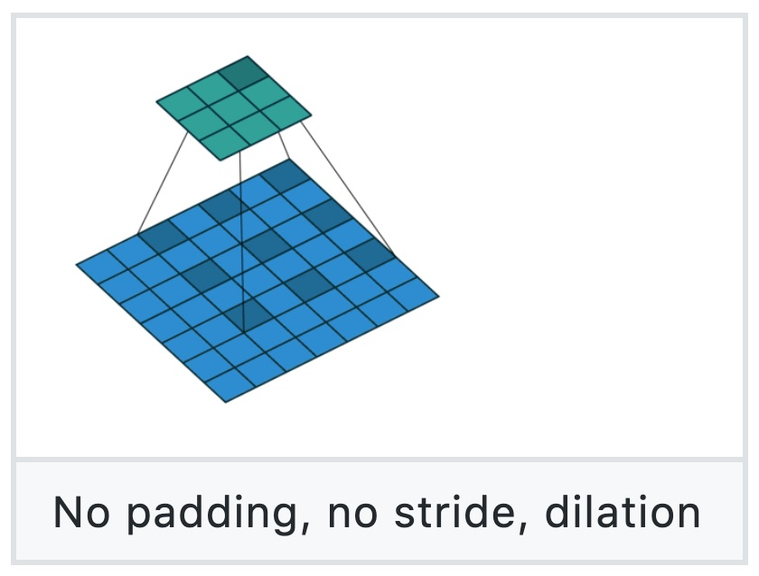
Dilated Convolution
Figure source: https://github.com/vdumoulin/conv_arithmetic

Slide 21
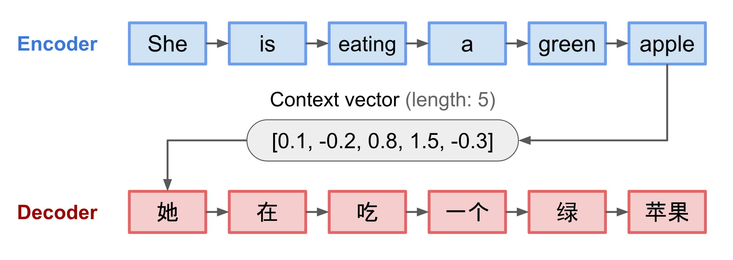
Sequence 2 Sequence models in language
Source: https://lilianweng.github.io/lil-log/2018/06/24/attention-attention.html

Slide 22
Outline
Context and Receptive Field
Going Beyond Convolutions in…
  Text
  Point Clouds
  Images
Notable Transformer “Foundation” models
  CLIP-like models
  DINO models

Slide 23
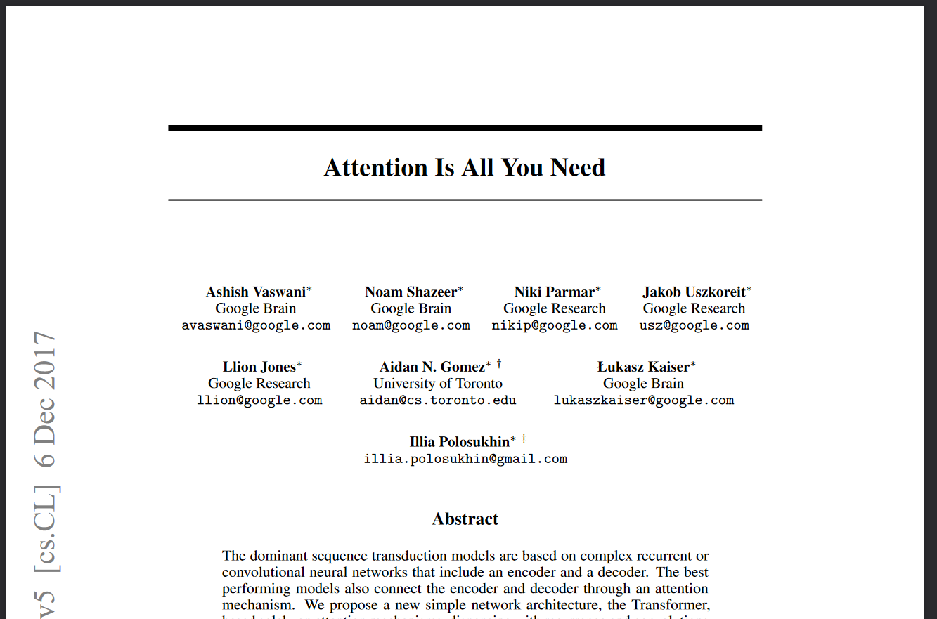
Notes:
*Bert*, GPT, etc build on this. Introduced “transformer”, as well
40 thousand citations in April 2022

Slide 24
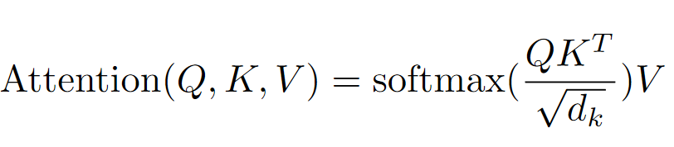
“Many readers will skim over formulas on their first reading of your exposition. Therefore, your sentences should flow smoothly when all but the simplest formulas are replaced by “blah” or some other grunting noise.” - Donald Knuth

Slide 25
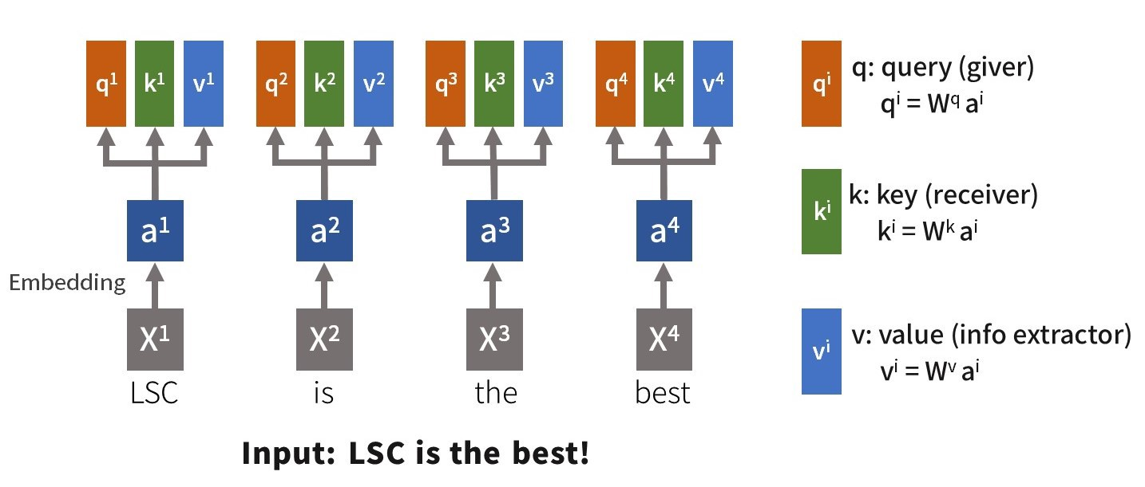
From https://medium.com/lsc-psd/introduction-of-self-attention-layer-in-transformer-fc7bff63f3bc

Slide 26
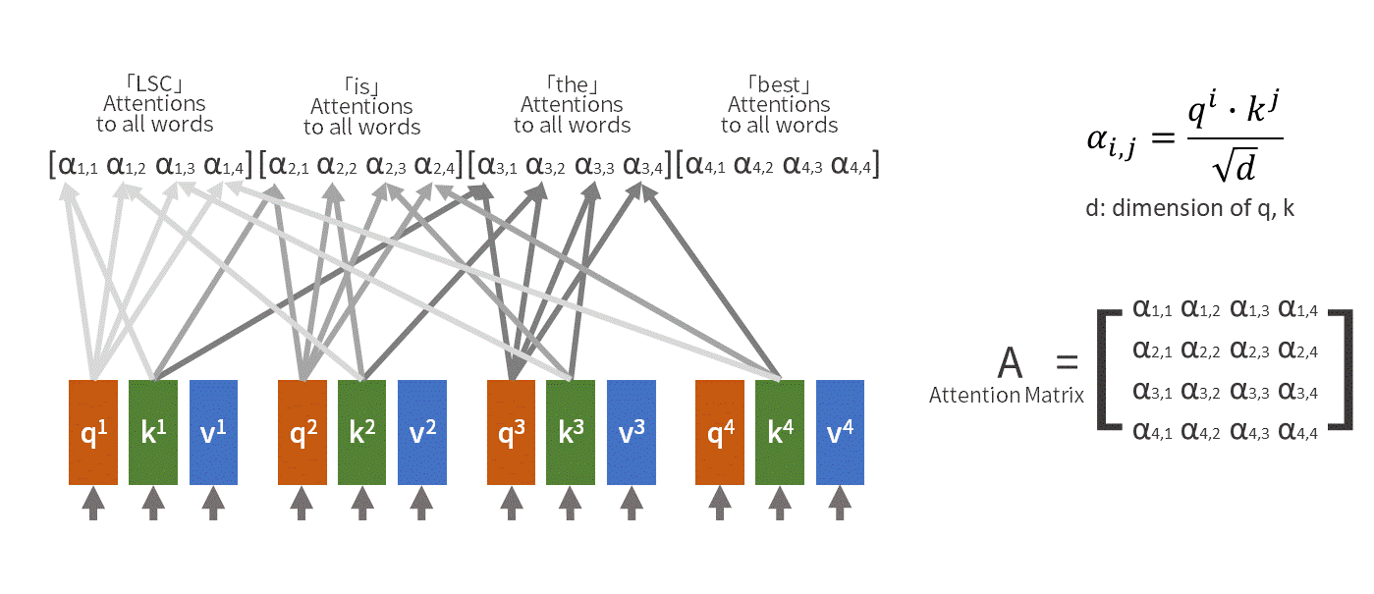
From https://medium.com/lsc-psd/introduction-of-self-attention-layer-in-transformer-fc7bff63f3bc

Slide 27
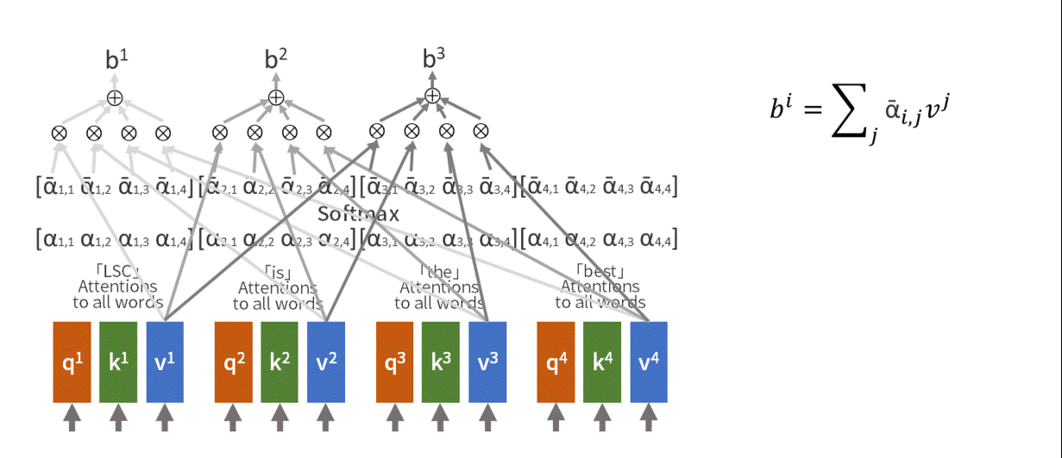

Slide 28
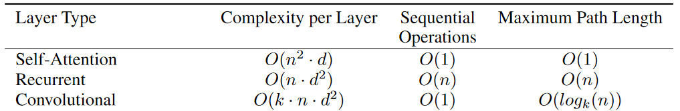
Complexity Comparison
Notes:
Table 1: Maximum path lengths, per-layer complexity and minimum number of sequential operations for different layer types. N is the sequence length, d is the representation dimension, k is the kernel size of convolutions and r the size of the neighborhood in restricted self-attention.

Slide 29
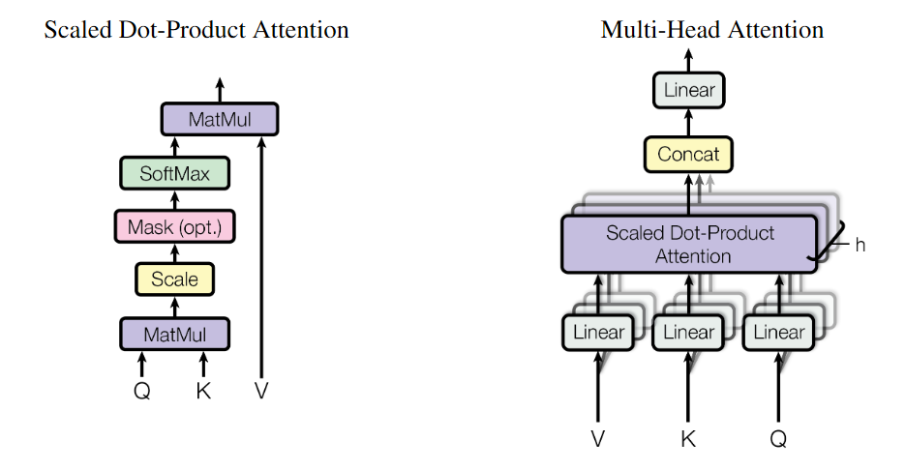

Slide 30
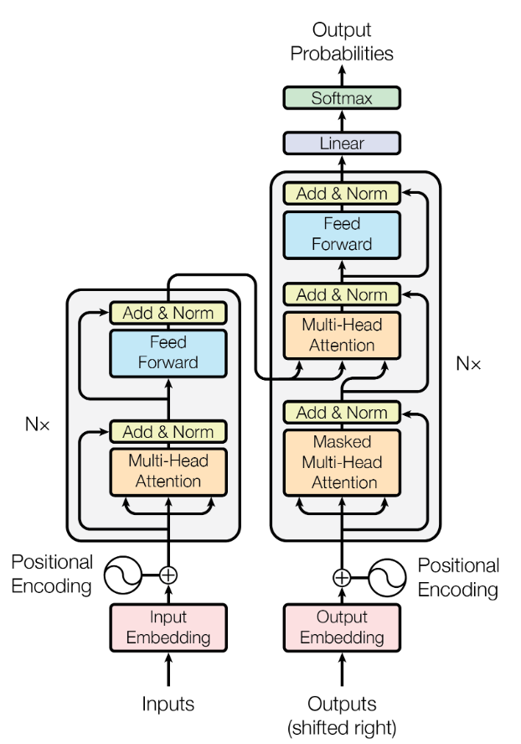
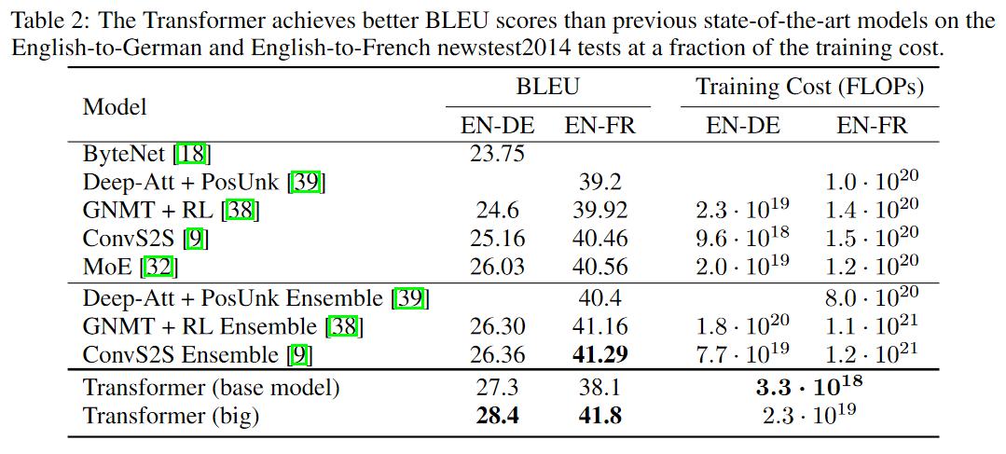
Transformer Architecture
Notes:
GPT and Bert build on these ideas

Slide 31
Outline
Context and Receptive Field
Going Beyond Convolutions in…
  Text
  Images
  Point Clouds
Notable Transformer “Foundation” models
  CLIP-like models
  DINO models

Slide 32
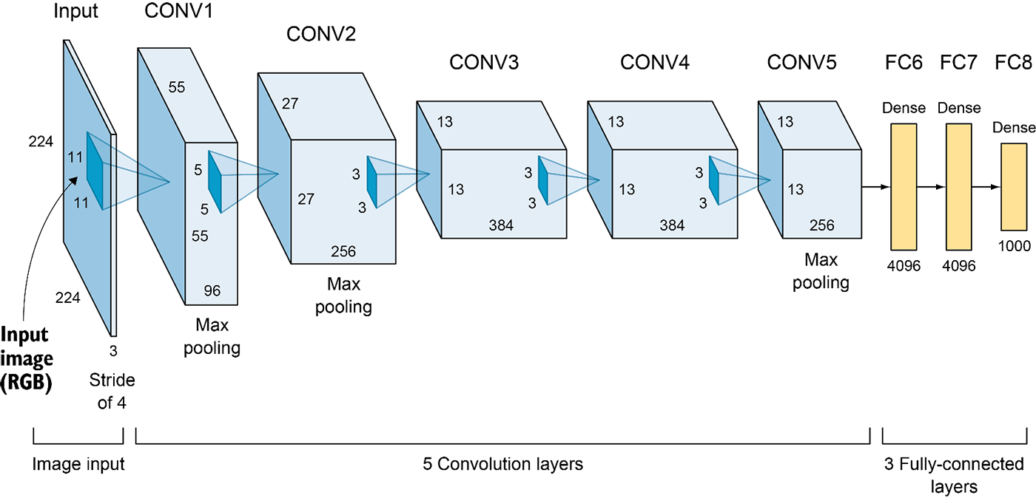
Recall: ConvNets
Elgendy, Deep Learning for Vision Systems, https://livebook.manning.com/book/grokking-deep-learning-for-computer-vision/chapter-5/v-3/

Slide 33
ConvNets assume spatial locality
Assume nearby pixels are more important to making decisions than far away pixels (an example of an “inductive bias”)
Only after stacking together several convolutional layers with spatial downsampling can distant pixels “talk” to each other
As image datasets grow, maybe we can do better by removing the spatial locality assumption and learning how to process images from scratch

Slide 34

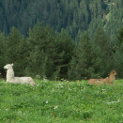
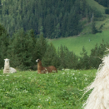
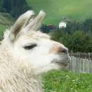
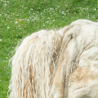
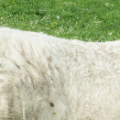
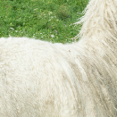
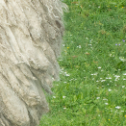
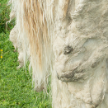
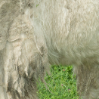
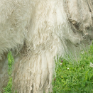
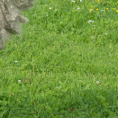
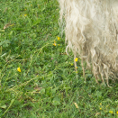
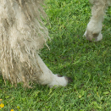
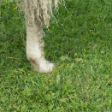
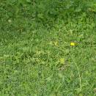
An alternative to convolution: Attention
Goal: consider long-range relationships between pixels

Slide 35
An alternative to convolution: Attention
Step 1: Break image into patches

Slide 36
An alternative to convolution: Attention
Step 1: Break image into patches

Slide 37
An alternative to convolution: Attention
Step 2: Map each patch to three vectors:
Query (Q), Key (K), and Value (V)
Q₁
K₁
V₁
…
…
…
linear mappings

Slide 38
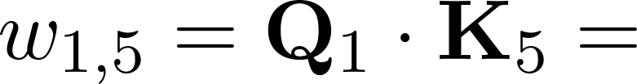
An alternative to convolution: Attention
Step 3: For each patch, compare its query vector to all key vectors
Q₁
K₁
V₁
Q₅
K₅
V₅
0.2
…
…
…
…
…
…
linear mappings
Notes:
\begin{align*}
w_{1,5} = \mathbf{Q}_1 \cdot \mathbf{K}_5 =
\end{align*}

Slide 39
An alternative to convolution: Attention
Step 3: For each patch, compare its query vector to all key vectors

Slide 40
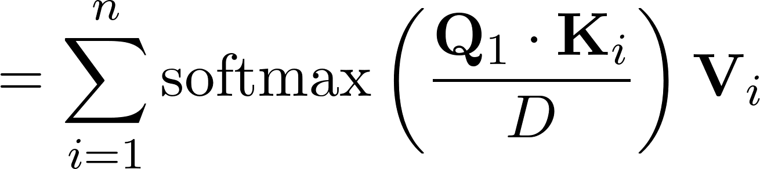
An alternative to convolution: Attention
Step 4: Compute weighted sum of value vectors
New vector y₁
y₁
Notes:
\begin{align*}
= \sum_{i=1}^{n} \mathrm{softmax}\left(\frac{\mathbf{Q}_1 \cdot \mathbf{K}_i}{D}\right) \mathbf{V}_i
\end{align*}

Slide 41
An alternative to convolution: Attention
Step 5: Repeat for all patches
y₁
y₂
y₃
y₄
y₅
y₆
y₇
y₈
y₉
y₁₀
y₁₁
y₁₂
y₁₃
y₁₄
y₁₅
y₁₆

Slide 42
An alternative to convolution: Attention
Result: we’ve transformed all of the input patches into new vectors, by comparing vectors derived from all pairs of patches
This operation is called attention – the network can choose, for each patch, which other patches to attend to (i.e., give high weight to)
Unlike convolution, a patch is allowed to talk to the entire image
Attention is a set-to-set operation – resulting patch representations are covariant under permutation of patch ordering
y₁
y₂
y₃
y₄
y₅
y₆
y₇
y₈
y₉
y₁₀
y₁₁
y₁₂
y₁₃
y₁₄
y₁₅
y₁₆

Slide 43
An alternative to convolution: Attention
Parameters: weight matrices W_{q}, W_{k}, W_{v} that map input patches to query, key, and value vectors
y₁
y₂
y₃
y₄
y₅
y₆
y₇
y₈
y₉
y₁₀
y₁₁
y₁₂
y₁₃
y₁₄
y₁₅
y₁₆
Notes:
\begin{align*}
\mathbf{Q}_i = \mathbf{W_q}\mathbf{x}_i,
\mathbf{K}_i = \mathbf{W_k}\mathbf{x}_i,
\mathbf{V}_i = \mathbf{W_v}\mathbf{x}_i
\end{align*}

Slide 44
Details
Rather than working with raw RGB image patches, the patches can themselves be features (e.g., produced by a linear mapping from RGB patches, or the output of a CNN). (These discrete vectors are called tokens)
The feature vectors produced by the attention layer are often passed through an MLP (adding more parameters to the system)
Each patch can be combined with a positional encoding indicating the spatial location of the patch, enabling spatial reasoning
Instead of single W_{q}, W_{k}, W_{v} weight matrices, multiple linear mappings can be learned for an attention layer, and the resulting features concatenated (multi-headed attention)

Slide 45
Transformers
Just like any network layer, we can stack attention layers – the output of one becomes the input to the next – to form a bigger network, called a transformer
Transformers are very large, powerful learners that transcend convolutional networks by representing a larger class of functions

Slide 46
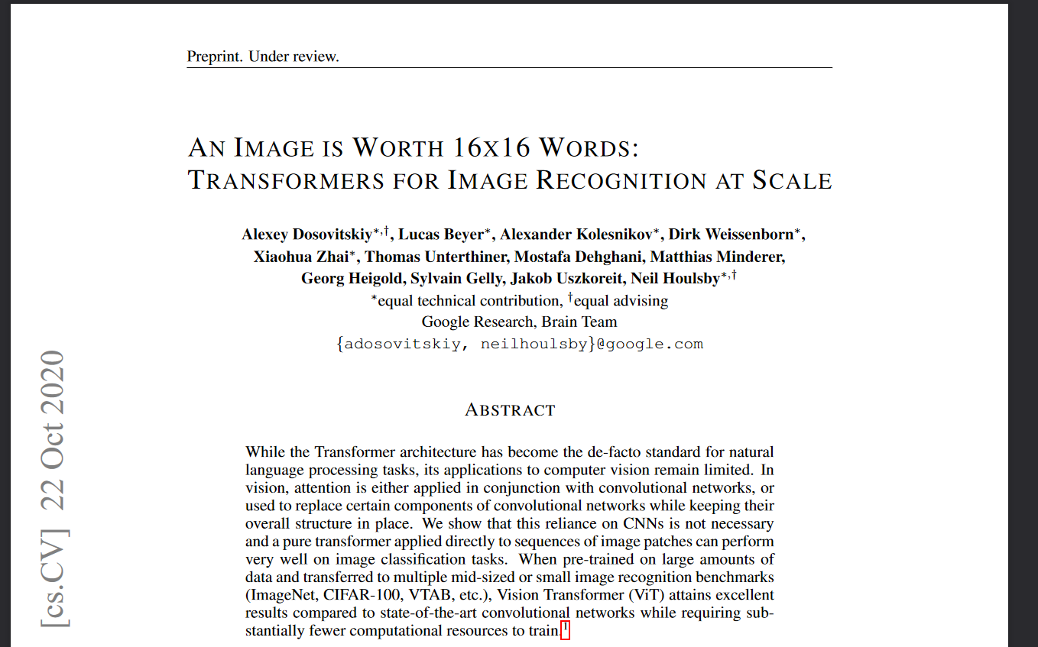
Notes:
3500 citations as of April 2022. Called “ViT” commonly.

Slide 47
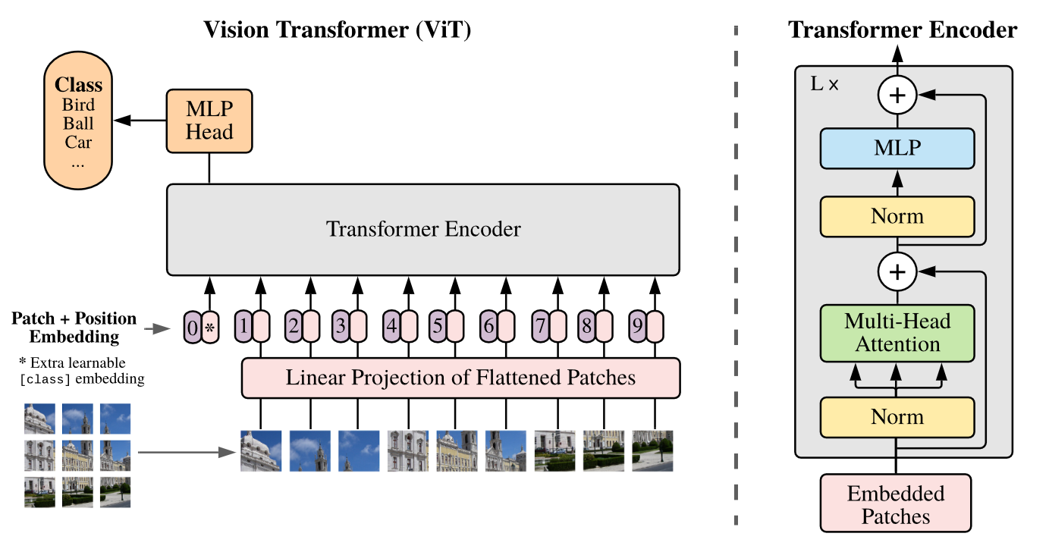
Supervised training on 300M labeled images
Notes:
Model overview. We split an image into fixed-size patches, linearly embed each of them, add position embeddings, and feed the resulting sequence of vectors to a standard Transformer encoder. In order to perform classification, we use the standard approach of adding an extra learnable “classification token” to the sequence. The illustration of the Transformer encoder was inspired by Vaswani et al. (2017)

Slide 48
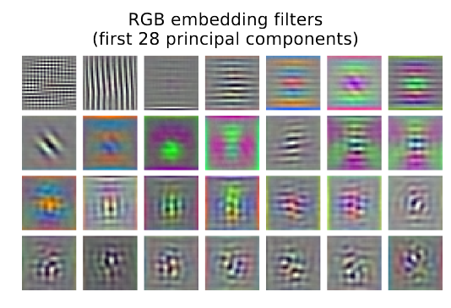
Notes:
Model overview. We split an image into fixed-size patches, linearly embed each of them, add position embeddings, and feed the resulting sequence of vectors to a standard Transformer encoder. In order to perform classification, we use the standard approach of adding an extra learnable “classification token” to the sequence. The illustration of the Transformer encoder was inspired by Vaswani et al. (2017)

Slide 49
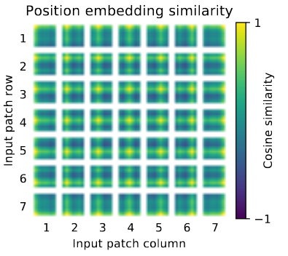
Notes:
Model overview. We split an image into fixed-size patches, linearly embed each of them, add position embeddings, and feed the resulting sequence of vectors to a standard Transformer encoder. In order to perform classification, we use the standard approach of adding an extra learnable “classification token” to the sequence. The illustration of the Transformer encoder was inspired by Vaswani et al. (2017)

Slide 50
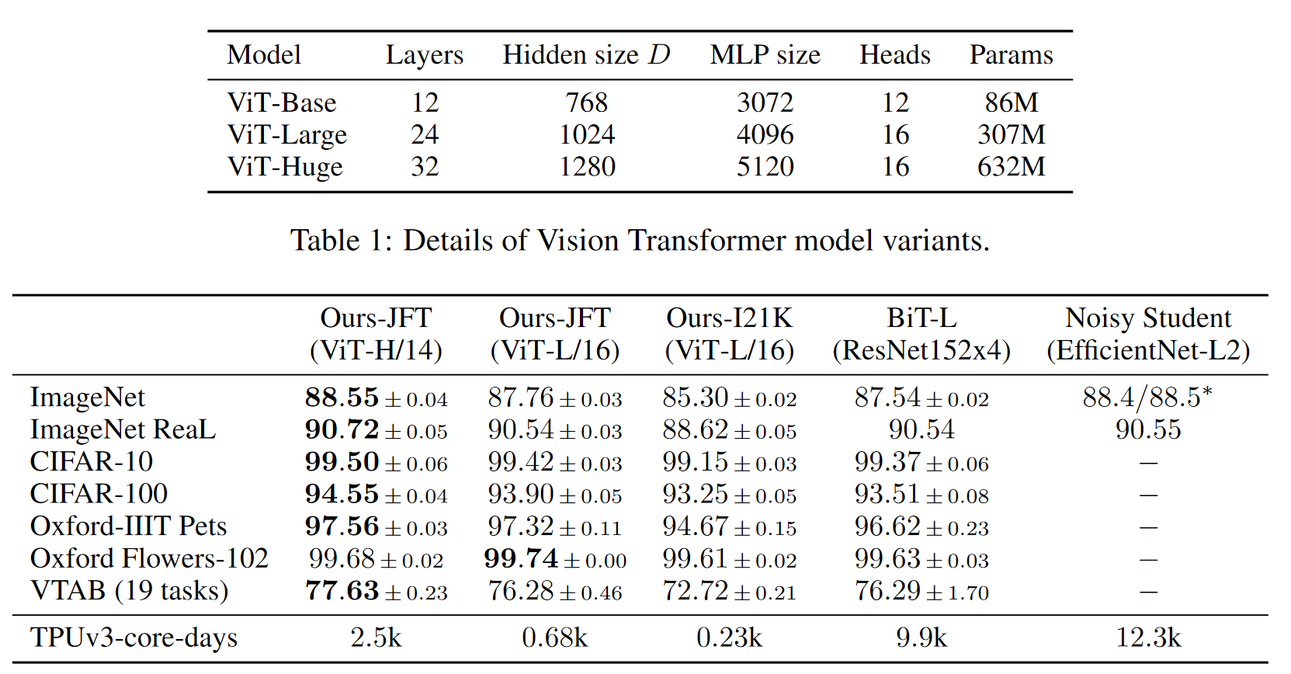
Notes:
Comparison with state of the art on popular image classification benchmarks. We re-
port mean and standard deviation of the accuracies, averaged over three fine-tuning runs. Vision
Transformer models pre-trained on the JFT-300M dataset outperform ResNet-based baselines on all
datasets, while taking substantially less computational resources to pre-train. ViT pre-trained on the
smaller public ImageNet-21k dataset performs well too. ∗Slightly improved 88.5% result reported
in Touvron et al. (2020).

Slide 51
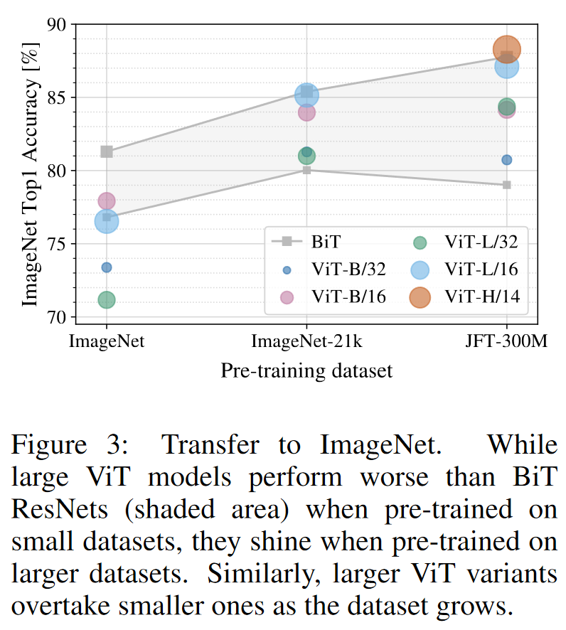
When trained on mid-sized datasets such as ImageNet, such models yield modest accuracies of a few percentage points below ResNets of comparable size. This seemingly discouraging outcome maybe expected: Transformers lack some of the inductive biases inherent to CNNs, such as translation equivariance and locality, and therefore do not generalize well when trained on insufficient amounts of data.
However, the picture changes if the models are trained on larger datasets (14M-300M images). We find that large scale training trumps inductive bias.
Dosovitskiy et al.
https://paperswithcode.com/sota/image-classification-on-imagenet

Slide 52


Slide 53


Slide 54
This can’t be ideal, right?

Slide 55


Slide 56

Swin Transformer: Hierarchical Vision Transformer using Shifted Windows
Ze Liu, Yutong Lin, Yue Cao, Han Hu, Yixuan Wei, Zheng Zhang, Stephen Lin, Baining Guo
Notes:
August 2021, 1163 citations

Slide 57
Swin Transformer outperforms “vanilla” ViT by…
Reintroducing the useful inductive biases of Convolutional Networks
  Hierarchical feature maps
    Lose spatial resolution as you go deeper in the network, gain channel depth
  Local self attention
    E.g. a 7x7 window of patches instead of global attention
    Receptive field expands through the namesake window shifting from layer to layer
  Relative positional encoding

Slide 58


Slide 59


Slide 60


Slide 61



Slide 62


Slide 63



Slide 64
Outline
Context and Receptive Field
Going Beyond Convolutions in…
  Text
  Images
  Point Clouds
Notable Transformer “Foundation” models
  CLIP-like models
  DINO models

Slide 65


Slide 66


Slide 67


Slide 68


Slide 69


Slide 70


Slide 71
Outline
Context and Receptive Field
Going Beyond Convolutions in…
  Text
  Images
  Point Clouds
Notable Transformer “Foundation” models
  CLIP-like models
  DINO models

Slide 72

CLIP

Slide 73

“weakly supervised” contrastive learning on 400M text / image pairs
ViT architecture trained from scratch

Slide 74


Slide 75


Notes:
Zero-shot CLIP is competitive with a fully super-
vised baseline. Across a 27 dataset eval suite, a zero-shot CLIP
classifier outperforms a fully supervised linear classifier fitted on
ResNet-50 features on 16 datasets, including ImageNet.

Slide 76


Slide 77

Notes:
CLIP’s features are more robust to task shift when compared to models pre-trained on ImageNet. For both dataset
splits, the transfer scores of linear probes trained on the representations of CLIP models are higher than other models with similar
ImageNet performance. This suggests that the representations of models trained on ImageNet are somewhat overfit to their task.

Slide 78
Outline
Context and Receptive Field
Going Beyond Convolutions in…
  Text
  Images
  Point Clouds
Notable Transformer “Foundation” models
  CLIP-like models
  DINO models

Slide 79


Slide 80

DinoV2 Datasets
140 M total images
No labels used
Self-supervised with image level strategies (like SimCLR) and patch level strategies (like MAE, masked auto-encoder)
Smaller models are distilled from the largest model

Slide 81


Slide 82

Notes:
Table 4: Linear evaluation on ImageNet-1k of frozen pretrained features. We report Top-1 accuracy
on the validation set for publicly available models trained on public or private data, and with or without
text supervision (text sup.). For reference, we also report the kNN performance on the validation set. We
compare across any possible architectures (Arch.), at resolution 224 × 224 unless stated otherwise. The
dataset used for training EVA-CLIP is a custom mixture, see paper for details (Fang et al., 2023).

Slide 83

Semantic Segmentation
Notes:
Semantic segmentation on ADE20K, CityScapes and Pascal VOC with frozen features
and a linear classifier (lin.) and with multiscale (+ms). The absolute state of the art – from Wang et al.
(2022), Liu et al. (2021) and Chen et al. (2018) respectively – are mentioned at the top of the Table. For
reference, using the Mask2Former pipeline (Steiner et al., 2021) with a ViT-Adapter (Chen et al., 2023b) on
top of our frozen ViT-g/14 backbone gives 60.2 mIoU on ADE-20k.

Slide 84


Slide 85


Slide 86


Slide 87


Slide 88


Slide 89


Slide 90
Summary
“Attention” models outperform recurrent models and convolutional models for sequence processing. They allow long range interactions.
These models do best with LOTS of training data
Naïve attention mechanisms have quadratic complexity with the number of input tokens, but there are often workarounds for this.
Tokenization seems harmful, so we have to fight back against its with positional embeddings or overlapping tokenizations.
Attentional models seem to succeed when they copy the inductive biases of convolutional models.
For “traditional” image processing, it is not clear if Transformers outperform convolutional networks.
You should start with one of these pre-trained models – CLIP if you want semantic / language support, Dino if you want dense spatial reasoning

