Slide 1
Computer Systems An Integrated Approach to Architecture and Operating Systems
Chapter 7
Memory Management Techniques
©Copyright 2008 Umakishore Ramachandran and William D. Leahy Jr.

Slide 2
Review
Hardware
Software
Designing a processor.
Processor instruction-set
Interrupts
Using processor as resource
Scheduling processor to run different programs.
Software entities
Compiler
Linker
Loader (OS)
Process scheduler (OS)

Slide 3
7.1 Basics
What functionalities do we want to provide?
Improved resource utilization
Independence and Protection
Liberation from resource limitations
Sharing of memory by concurrent processes
B
R
O
K
E
R
CPU
Memory
CPU generated
Address
Memory
Address

Slide 4
Overall Goals of Memory Manager
Require minimal hardware support
Keep impact on memory accesses low
Keep memory management overhead low (for allocation and de-allocation of memory)

Slide 5
7.2 Simple Schemes for Memory Management
1. Separation of user and kernel
Fence register
Memory
Low
Kernel
Y
CPU
>
User
CPU generated
Address
N
Memory
Address
High
Trap

Slide 6
7.2 Simple Schemes for Memory Management
2. Static Relocation
Memory bounds for process set at linking time when executable is created.
Memory bounds in PCB & hardware registers
Process can be swapped in & out (to same location)
Process is non-relocatable
A version exists where limits can be changed at load time. These remain fixed until completion

Slide 7
7.2 Simple Schemes for Memory Management
2. Static Relocation
Memory
Kernel
Low
Lower bound
Upper bound
P1
Y
Y
.
.
.
.
CPU
>
<
CPU
Address
N
N
Memory
Address
Trap
Trap
P2
Pn
High

Slide 8
7.2 Simple Schemes for Memory Management
3. Dynamic Relocation
Ability to place executable into any region of memory that can accommodate the memory needs of the process.
Can swap out and then swap in to a different location
Code must be position independent

Slide 9
7.2 Simple Schemes for Memory Management
2. Dynamic Relocation
Memory
Low
Kernel
Base
Limit
P1
.
.
.
.
+
<
Y
CPU
CPU
Address
N
Memory
Address
Trap
P2
Pn
High

Slide 10
7.3 Memory Allocation Schemes
We can have different processes in memory
What options are available to divide up memory for each process?
Assume Base plus Limit hardware exists

Slide 11
7.3.1 Fixed Size Partitions
Partitions fixed at boot time
Fixed (Different) Sized Partitions
Memory
Allocation table
Occupied bit
Partition Size
Process
5K
0
5K
XXX
8K
0
8K
XXX
0
1K
XXX
1K

Slide 12
7.3.1 Fixed Size Partitions
Partitions fixed at boot time
Internal fragmentation =
Size of Fixed partition - Actual memory request
memory
Allocation table
Occupied bit
Partition Size
Process
5K
0
5K
XXX
6K
1
8K
P1
2K
0
1K
XXX
1K

Slide 13
7.3.1 Fixed Size Partitions
External fragmentation =
∑All non-contiguous memory partitions
memory
Allocation table
Occupied bit
Partition Size
Process
5K
0
5K
XXX
6K
1
8K
P1
2K
0
1K
XXX
1K

Slide 14
7.3.2 Variable Size Partitions
To overcome internal fragmentation problems we introduce variable size partitions
Allocation table is dynamic

Slide 15
7.3.2 Variable Size Partitions
Memory
Allocation table
Start address
Size
Process
0
13K
FREE
13K

Slide 16
7.3.2 Variable Size Partitions
After requests for 2K, 6K and 3K
Memory
Allocation table
Start address
Size
Process
11K
0
2K
P1
2K
6K
P2
2K
8K
3K
P3
11K
2K
FREE

Slide 17
7.3.2 Variable Size Partitions
After P1 terminates
Memory
Allocation table
2K
Start address
Size
Process
9K
0
2K
FREE
2K
6K
P2
2K
8K
3K
P3
11K
2K
FREE
What happens if P4 requests 4K?
Do variable size partitions solve the external fragmentation problem?

Slide 18
7.3.2 Variable Size Partitions
Memory
Allocation table
2K
Start address
Size
Process
9K
0
2K
FREE
2K
6K
P2 -> FREE
2K
8K
3K
P3
11K
2K
FREE
As P2 terminates the memory allocator can look for adjacent free blocks

Slide 19
7.3.2 Variable Size Partitions
After coalescing adjacent free blocks
Memory
Allocation table
Start address
Size
Process
8K
0
8K
FREE
3K
8K
3K
P3
2K
11K
2K
FREE

Slide 20
7.3.2 Variable Size Partitions
When space is requested several possible options
Best Fit
Lower internal fragmentation
Longer search time
Table may be indexed by start address which is good for coalescing
Table may be indexed by size which is faster for allocation
First Fit
Faster allocation
Table may be indexed by start address which is good for coalescing

Slide 21
7.3.3 Compaction
If fragmentation becomes excessive we can compact memory by moving processes
This is virtually impossible with modern architectures!
Base register concept
Memory
Allocation table
3K
Start address
Size
Process
0
3K
P3
10K
3K
10K
FREE

Slide 22
7.4 Paged Virtual Memory
As memory size increases problem of external fragmentation increases
Want to attack problem of external fragmentation
User views his memory partition as contigous memory
But does it have to really be contiguous?

Slide 23
7.4 Paged Virtual Memory
B
R
O
K
E
R
CPU
Memory
Virtual
Address
Physical
Address
Need a system to take user virtual addresses and translate into physical address corresponding to the physical memory present

Slide 24
7.4 Paged Virtual Memory
Conceptually break up both logical (virtual) memory and physical memory into equal sized blocks
Physical
Memory
Logical
Memory
Frame
Page
Frame
Page
Frame
Page
Frame
Page
Frame
Page
Frame
Page Size = Frame Size

Slide 25
7.4 Paged Virtual Memory
Where is logical memory?
Need mechanism to translate from logical pages to physical frames
BROKER
CPU
Page
Table
Memory
Virtual
Address
Physical
Address

Slide 26
7.4 Paged Virtual Memory
Physical
Memory
LOW
12
Page Table
User’s view
Page 0
35
15
Page 1
52
Page 2
12
Page 3
15
35
52
HIGH

Slide 27
Key Point
The user still perceives a contiguous memory space
The space is not necessarily contiguous in physical memory
External fragmentation is eliminated!

Slide 28
7.4.1 Page Table
Suppose pages and frames are 4096 bytes long.
What do logical addresses look like?
0 00000000000000000000000000000000
4095 00000000000000000000111111111111
4096 00000000000000000001000000000000
32456 00000000000000000111111011001000

Slide 29
7.4.1 Page Table
Suppose pages and frames are 4096 bytes long.
What do logical addresses look like?
0 00000000000000000000000000000000
4095 00000000000000000000111111111111
4096 00000000000000000001000000000000
32456 00000000000000000111111011001000

Slide 30
7.4.1 Page Table
Suppose pages and frames are 4096 bytes long.
What do logical addresses look like?
0 0x000000000000
4095 0x000000000FFF
4096 0x000000001000
32456 0x000000007EC8

Slide 31
7.4.1 Page Table
Suppose pages and frames are 4096 bytes long.
What do addresses look like?
0 0x000000000000
4095 0x000000000FFF
4096 0x000000001000
32456 0x000000007EC8
Virtual
Page
Number
Offset

Slide 32
7.4.1 Page Table
Assume page/frame size is 4096 bytes
Assume 32 bit virtual address (4 Gb)
Assume 28 bit physical address (256 Mb)
What is the layout of the virtual address and the physical address?
How does a virtual address like 0x3E1234 get translated into a physical address

Slide 33
7.4.1 Page Table
CPU
003E1
234
PTBR
0044
234
v
Memory
0x0
0x0023
0x1
0x0124
0x2
0x1111
0x3
0x3F04
0x3E0
0x0000
0x3E1
0x0044
0x3E2
0x0068

Slide 34
7.4.2 Hardware for Paging
PTBR
Translation hardware VPN to PFN
Page table is in kernel memory space
Note: each process has a page table
How many memory accesses are required for each memory request by the CPU

Slide 35
7.4.3 Page Table Set up
typedef struct control_block_type {
enum state_type state;
address PC;
int reg_file[NUMREGS];
struct control_block *next_pcb;
int priority;
address PTBR;
…
…
} control_block;

Slide 36
7.5 Segmented Virtual Memory
Segmentation is a system allowing a process's memory space to be subdivided into chunks of memory each associated with some aspect of the overall program
Typical segments
Code
Global data
Heap
Stack

Slide 37
7.5 Segmented Virtual Memory
Process address space divided up into n distinct segments
Each segment has
A number
A size
Each segment starts at its own address 0 and goes up to its size – 1.
Segment addressing

Slide 38
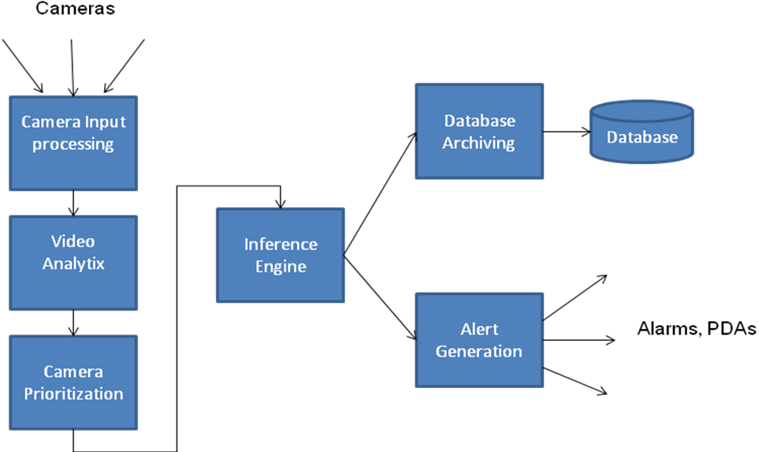
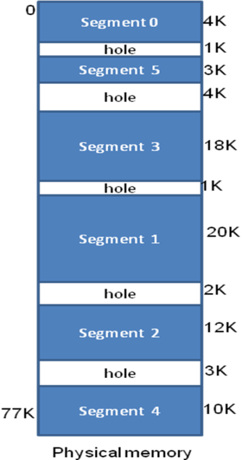
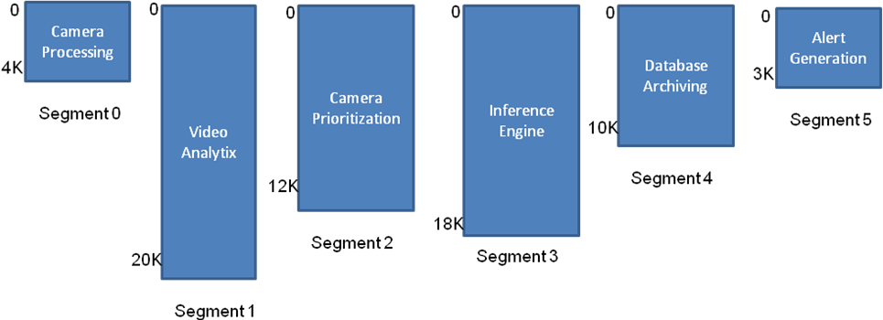
7.5 Segmented Virtual Memory

Slide 39
7.5 Segmented Virtual Memory

Slide 40
7.5 Segmented Virtual Memory

Slide 41
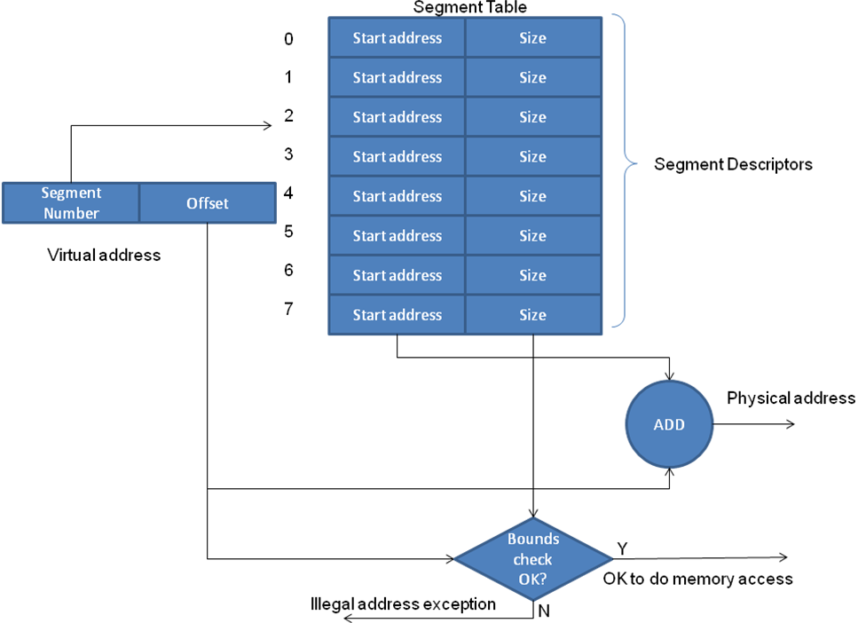
7.5.1 Hardware for Segmentation

Slide 42
7.6 Paging versus Segmentation
Attribute | Paging | Segmentation
User shielded from size limitation of physical memory | Yes | Yes
Relationship to physical memory | Physical memory may be less than or greater than virtual memory | Physical memory may be less than or greater than virtual memory
Address spaces per process | One | Several
Visibility to the user | User unaware of paging; user is given an illusion of a single linear address space | User aware of multiple address spaces each starting at address 0
Software engineering | No obvious benefit | Allows organization of the program components into individual segments at user discretion; enables modular design; increases maintainability
Program debugging | No obvious benefit | Aided by the modular design
Sharing and protection | User has no direct control; operating system can facilitate sharing and protection of pages across address spaces but this has no meaning from the user’s perspective | User has direct control of orchestrating the sharing and protection of individual segments; especially useful for object-oriented programming and development of large software
Size of page/segment | Fixed by the architecture | Variable chosen by the user for each individual segment
Internal fragmentation | Internal fragmentation possible for the portion of a page that is not used by the address space | None
External fragmentation | None | External fragmentation possible since the variable sized segments have to be allocated in the available physical memory thus creating holes (see Figure 7.18)

Slide 43
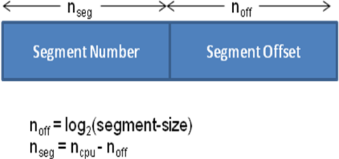
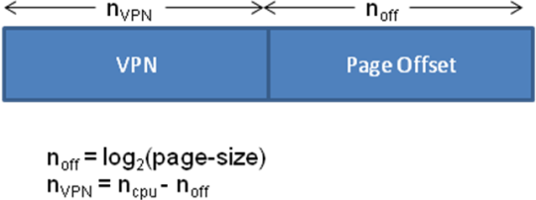
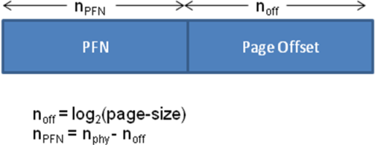
7.6.1 Interpreting the CPU generated address
Memory System | Virtual Address Computation | Physical Address Computation | Size of Tables
Segmentation |  | Segment Start address = Segment-Table [Segment-Number] Physical address = Segment Start Address + Segment Offset | Segment table size = 2^{nseg} entries
Paging |  | PFN = Page-Table[VPN] Physical address: | Page table size = 2^{nVPN} entries

Slide 44
7.7 Summary
Memory Management Criterion | User/ Kernel Separation | Fixed Partition | Variable-sized Partition | Paged Virtual Memory | Segmented Virtual Memory | Paged-segmented Virtual Memory
Improved resource utilization | No | Internal fragmentation bounded by partition size; External fragmentation | External fragmentation | Internal fragmentation bounded by page size | External fragmentation | Internal fragmentation bounded by page size
Independence and protection | No | Yes | Yes | Yes | Yes | Yes
Liberation from resource limitation | No | No | No | Yes | Yes | Yes
Sharing by concurrent processes | No | No | No | Yes | Yes | Yes
Facilitates good software engineering practice | No | No | No | No | Yes | Yes

Slide 45
7.7 Summary
Scheme | Hardware Support | Still in Use?
User/Kernel Separation | Fence register | No
Fixed Partition | Bounds registers | Not in any production operating system
Variable-sized Partition | Base and limit registers | Not in any production operating system
Paged Virtual Memory | Page table and page table base register | Yes, in most modern operating system
Segmented Virtual Memory | Segment table, and segment table base register | Segmentation in this pure form not supported in any commercially popular processors
Paged-segmented Virtual Memory | Combination of the hardware for paging and segmentation | Yes, most modern operating systems based on Intel x86 use this scheme¹
^{[1]} It should be noted that Intel’s segmentation is quite different from the pure form of segmentation presented in this chapter. Please Section 7.8.2 for a discussion of Intel’s paged-segmentation scheme.

Slide 46
7.8 Historical Perspective
Burroughs Corporation introduced segmented virtual memory in B5000 line of machines
GE, in partnership with MULTICS project at MIT introduced paged-segmentation in GE 600 line of machines
IBM introduces system/360 with base and limit registers. Relocation system not effective since base register visible to programmers
IBM introduces system/370 with true virtual memory which eventually dominates market

Slide 47
7.8.1 MULTICS
Some academic computing projects have a profound impact on evolution of field for a very long time.
MULTICS project at MIT was one such.
Unix, Linux, Paging, Segmentation, Security, Protection, etc. had their birth in this project.
OS concepts introduced in MULTICS project were way ahead of their time and processor architectures of that time were not geared to support advanced concepts of memory protection advocated by MULTICS.
MULTICS introduced the concept of paged segmentation.

Slide 48
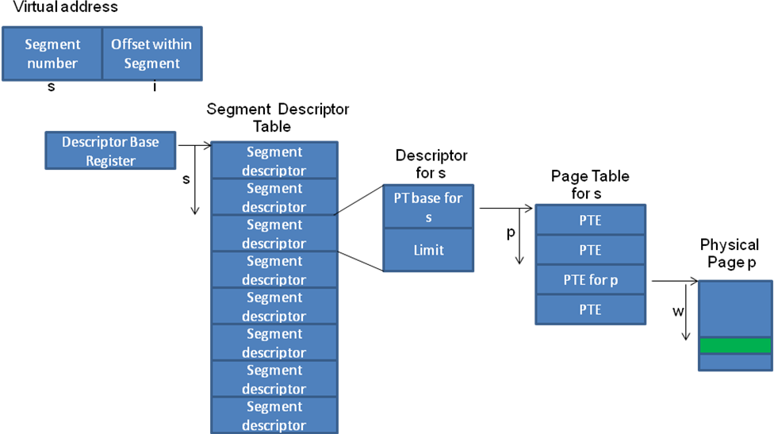
7.8.1 MULTICS

Slide 49
7.8.2 Intel’s Memory Architecture
Intel Pentium line of processors uses paged-segmentation.
Approximately, a virtual address is a segment selector plus an offset
Total segment space divided into two halves
System segments are common to all processes and are used by OS
User segments are unique to each process.
Two descriptor tables
Global Descriptor Table (GDT) common to all processes
Local Descriptor Table (LDT) for each process
A bit in the segment selector identifies whether the segment being named by the virtual address is a system or a user segment.
Segment descriptor for the selected segment contains the details for translating the offset specified in the virtual address to a physical address.
Choice
Use simple segmentation w/o any paging (compatible with earlier processors)
Use paged-segmentation.

Slide 50
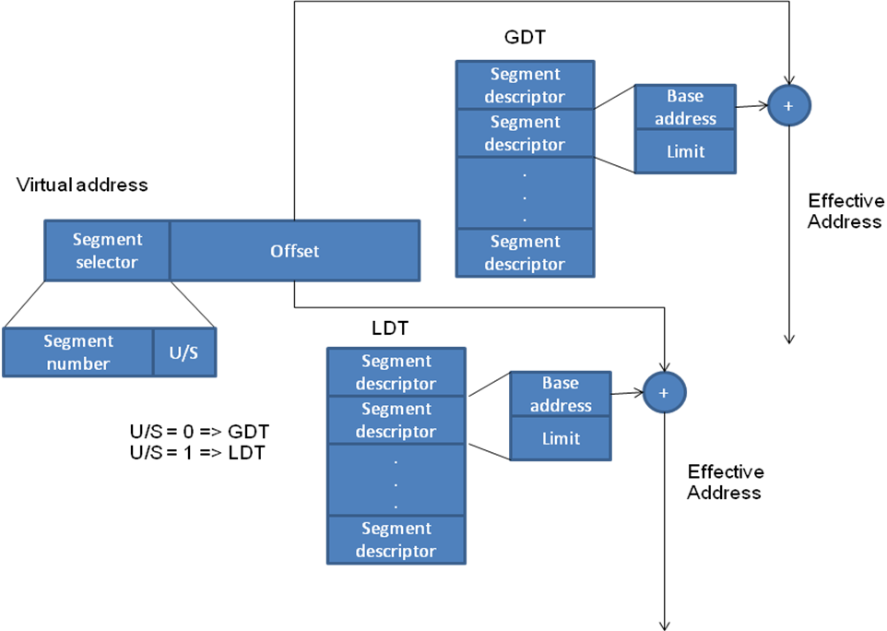
7.8.2 Intel’s Memory Architecture

