Slide 1
Prophet Inequalities with Linear Correlations and Augmentations
Sahil singla
Princeton University and Institute for Advanced Study
Joint work with
Nicole Immorlica and Bo Waggoner

Slide 2
Buying a House
Buyer
Houses
House values revealed one-by-one
Help buyer select online a highly-valued house
Challenges
Online selection
House values correlated by common features
High-Level Results
Simple threshold-based rules don’t suffice
Instead, winnow some options and then use a threshold
Irrevocably select one
$$X_{i}$$
arriving online
Can we even Solve for Independent Values?

Slide 3
Prophet Inequalities
Items
$n$ values drawn independently from known distributions: $X_{i}∼F_{i}$
$τ$-threshold mechanism: Take first item with $X_{i}≥τ$
Theorem: The following give $2$-approximation
Mean: $τ= E\left[max X_{i}\right]/2$ Kleinberg-Weinberg’12
Median: $\operatorname{Pr}\left[\max{X_{i}}≥τ\right]=1/2$ Samuel-Cahn’84
Extensions:
$r$ items: $1+Θ(1/\sqrt{r})$ approx Alaei’11
Matroid: $2$-approx Kleinberg-Weinberg’12
$α$-approx means: $E\left[reward\right]≥1/α⋅E\left[max X_{i}\right]$
Irrevocably Select one
$$X_{i}∼F_{i}$$
arriving online
What if values Correlated? $Ω\left(n\right)$-approx Hill-Kertz’92

Slide 4
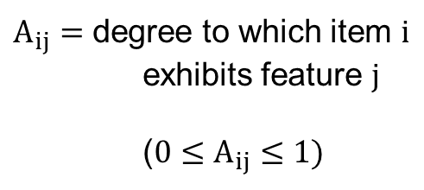
Linear Correlations Model
Bateni-Dehghani-Hajighayi-Seddighin’15
Chawla-Malec-Sivan’15
Values
$$\vec{X}≔A⋅\vec{Y}$$
For a known matrix $A∈{\left[0,1\right]}^{n×m}$ and an unknown vector $\vec{Y}$, with $Y_{i}∼F_{i}$ for known distributions $F_{i}$.
Examples: $A$ is identity matrix or $A∈{\{0,1\}}_{≥0}^{n×m}$
Can we still get $Θ(1)$ Approximation?
value of feature
value of item
$m$ features
$$X_{1}$$
$$Y_{1}$$
$A_{ij}=$ degree to which item $i$ exhibits feature $j$
($0≤A_{ij}≤1)$
$n$ items
$$X_{n}$$
Sparsity of $A$:
$s_{row}$: max # features affecting an item
$s_{col}$: max # items affected by a feature
$$Y_{m}$$
arriving online
drawn independently

Slide 5
Main Results
Thm 1 (Single Item): $Θ(min\{s_{row},s_{col}\})$ approximation
Remark: $τ$-threshold mechanisms have $Ω(n)$ approximation
Remark: For $A∈{\{0,1\}}_{≥0}^{n×m}$, we can get $O(1)$ approximation
Thm 2 (Multiple Items): Selecting $r$ items
For $r≫s_{col}$: $(1+o\left(1\right))$ approximation
For $r≫s_{row}$: $Θ(s_{row})$ approximation
Main Ideas:
Inclusion-threshold mechanisms: Run $τ$-threshold on a ``random subset’’ of items
Augmentation Lemma: Robust to positive “noise”

Slide 6
OUTLINE
Model: Prophet Inequalities with Linear Correlations
Threshold-Based Mechanisms and the Augmentation Problem
Single Item: Column and Row Sparsity
Multiple Items and Conclusion

Slide 7
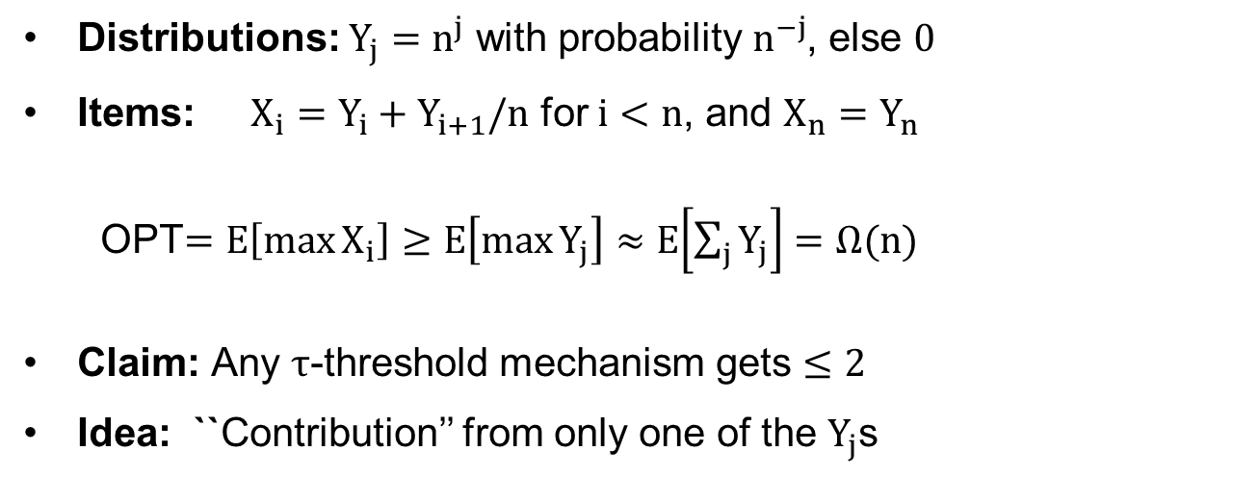
Lower Bound: Tower Instance
Thm: $τ$-threshold mechanisms have $Ω(n)$ approximation, even for $s_{row}=s_{col}=2$
Distributions: $Y_{j}=n^{j}$ with probability $n^{−j}$, else $0$
Items: $X_{i}=Y_{i}+Y_{i+1}/n$ for $i<n$, and $X_{n}=Y_{n}$
OPT$=E\left[\max{X_{i}}\right]≥E\left[\max{Y_{j}}\right]≈E\left[\sum_{j}{Y_{j}}\right]=Ω(n)$
Claim: Any $τ$-threshold mechanism gets $≤2$
Idea: ``Contribution’’ from only one of the $Y_{j}$s
$$X_{1}$$
$$Y_{1}$$
$$X_{n}$$
$$Y_{m}$$

Slide 8
Main Subproblem
Augmentation Problem
Think of $X_{i}$’s = independent part + dependent part: $X_{i}=$ $Z_{i}$ $+$ $W_{i}$
Can we recover $E\left[max Z_{i}\right]$ given only $Z_{i}$ distributions?
Illustrative Example
$X_{1}$ drawn uniformly from $[0,1]$
$X_{2}$ is ${10}^{4}$ w.p. $1/100$; zero otherwise
Median threshold: $τ≈1/2$, picks $X_{1}$ half the time.
Mean threshold: $τ≈50$ never picks $X_{1}$.
positive “noise”
Independent
Correlated with past
Note: Prophet inequality for $W_{i}=0$
$$+2$$
What if we Add some Positive Noise?
all the time
Are Mean Thresholds Always Robust?

Slide 9

Augmentation Lemma
Lemma: Threshold $τ=E\left[\max{Z_{i}}\right]/2$ guarantees $E\left[{ALG}_{τ}\right]≥E\left[\max{Z_{i}}\right]/2$
Proof.
Let $P=\operatorname{Pr}\left[\max{X_{i}}>τ\right]$, $Q_{i}=\operatorname{Pr}\left[X_{i^{′}}<τ,∀i^{′}<i\right]$
$E\left[{ALG}_{τ}\right]$ $≥P⋅τ+\sum_{i}{Q_{i}⋅E\left[{\left(Z_{i}−τ\right)}^{+}∣Q_{i}\right]}$
$≥P⋅τ+\left(1−P\right)⋅E\left[\sum_{i}{{\left(Z_{i}−τ\right)}^{+}}\right]$
$≥P⋅τ+\left(1−P\right)⋅E\left[max\left(Z_{i}−τ\right)\right]$
$=E\left[\max{Z_{i}}\right]/2$
Someone selected
Reaching i
Q.E.D.

Slide 10
OUTLINE
Model: Prophet Inequalities with Linear Correlations
Threshold-Based Mechanisms and the Augmentation Problem
Single Item: Column and Row Sparsity
Multiple Items and Conclusion

Slide 11
Column Sparsity
Thm (Single Item): $O(s_{col})$ approximation
Inclusion-Threshold Mechanism:
Ignore each $X_{i}$ independently w.p. $(1−1/s_{col})$
Assign $Y_{j}$ to first surviving $X_{i}$ that contains it
Define $Z_{i}=\sum_{j→i}{A_{ij}Y_{j}}$ and use Augmentation Lemma
Proof Idea: Show $E\left[max Z_{i}\right]≈\frac{E\left[\max{X_{i}}\right]}{{e⋅s}_{col}}$
Max $X_{i}$ survives with $1/s_{col}$ probability
Pr[$Y_{j}$ in Max $X_{i}$ assigned to $Z_{i}$] $≥{\left(1−1/s_{col}\right)}^{s_{col}−1}≈1/e$
$$Y_{1}$$
$$Y_{m}$$

Slide 12
Row Sparsity
Thm (Single Item): $O(s_{row})$ approximation
Challenge: $Y_{j}$s almost always assigned to $Z_{i}$ with a small $A_{ij}$
Inclusion-Threshold Mechanism:
Primary Item: Assign $Y_{j}$ to some $X_{i}$ where $A_{ij}=1$
Create a directed dependency graph on $Y_{j}$s to “randomly sample”
Use the Augmentation Lemma
$$Y_{1}$$
$$Y_{m}$$

Slide 13
OUTLINE
Model: Prophet Inequalities with Linear Correlations
Threshold-Based Mechanisms and the Augmentation Problem
Single Item: Column and Row Sparsity
Multiple Items and Conclusion

Slide 14


Multiple Items
Thm (Multiple Items): Selecting $r$ items
For $r≫s_{col}$: $(1+o\left(1\right))$ approximation
For $r≫s_{row}$: $Θ(s_{row})$ approximation
Proof idea for $r≫s_{col}$:
Need a $(1+o\left(1\right))$ approx algorithm robust to augmentations
Partition the number line into buckets with different cardinality constraints
Use concentration of number of optimal items in each bucket
Existing algorithms don’t work
$$poly\left(ϵ\right)⋅\frac{OPT}{r}$$
$$\frac{OPT}{poly\left(ϵ\right)}$$

Slide 15
Conclusion
Prophet Inequalities with Linear Correlations $\vec{X}≔A⋅\vec{Y}$
Single Item: $Θ(min\{s_{row},s_{col}\})$ approximation
Multiple Items: $(1+o\left(1\right))$ approximation for $r≫s_{col}$
Techniques
Inclusion-threshold algorithms
Algorithms robust to augmentations
Open Problems
What are the optimal approximation ratios?
Can we extend the results to matroid constraints?
Thanks for Listening

Slide 16
Further SLIDES

Slide 17
Auctions
Allocate to Maximize Welfare
How well can we do using Posted-Prices?
Nothing possible in general
Assume a prior
Bidders
Item

Slide 18
$$X_{1}$$
$$X_{2}$$
$$X_{3}$$
$$Z_{1}$$
$$Z_{2}$$

