Slide 1
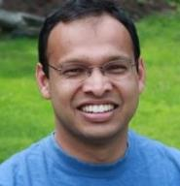
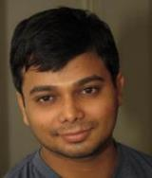
Online Vector Balancing and Geometric Discrepancy
Sahil singla
IAS & Princeton
Nikhil
Bansal
Haotian
Jiang
Janardhan
Kulkarni
Makrand
Sinha
Paper 1: “Online Geometric Discrepancy for Stochastic Arrivals with Applications to Envy Minimization” with Haotian and Janardhan
Paper 2: “Online Vector Balancing and Geometric Discrepancy” with Nikhil, Haotian, and Makrand

Slide 2
Interval Balancing
Offline Interval Balancing:
Given $T$ points on a line, color $ε_{t}∈\{1,−1\}$
Every sub-interval nearly balanced, i.e., minimize
$$\max_{I=[a,b]} \left|\sum_{x_{t}∈I}{ε_{t}}\right|$$
Online Interval Balancing:
$T$ points arrive uniformly in $[0,1]$
Immediately color $ε_{t}∈\{1,−1\}$
Every sub-interval nearly balanced
Random coloring gives $Ω(\sqrt{T})$
Can we get $O(1)$ or $polylog(T)$?
Applications in fair division
$$x_{1}$$
$$x_{3}$$
$$+$$
$$x_{2}$$
$$+$$
$$−$$
$$0$$
$$a$$
$$b$$
$$1$$
Just alternate
Interval $I$
Cannot change
Hopeless for adversarial arrival: $Ω(\sqrt{T})$ lower bounds
Other Geometric Problems?

Slide 3
Tusnady’s Problem
$$1$$
Offline Tusnady’s Problem:
Given $T$ points in $\left[0,1\right]×[0,1]$, color $ε_{t}∈\{1,−1\}$
Every axis-parallel rectangle balanced, i.e., minimize
$$\max_{I_{1}×I_{2}}\left|\sum_{x_{t}∈I_{1}×I_{2}}{ε_{t}}\right|$$
Online Tusnady’s Problem:
$T$ points arrive uniformly in $\left[0,1\right]×[0,1]$
Immediately color $ε_{t}∈\{1,−1\}$
Random coloring gives $Ω(\sqrt{T})$
Can we get $O(1)$ or $polylog(T)$?
$$x_{1}$$
$$x_{2}$$
$$x_{4}$$
$$x_{3}$$
$$0$$
$$1$$
Offline is already tricky:
$Ω(\log{T})$ Beck’81
$O(\log^{1.5}{T})$ Nikolov’17
Linear Algebraic View: Vector Balancing

Slide 4
Offline Vector Balancing
Offline Vector Balancing:
Given $n$ dimens vectors $v_{1},v_{2},…,v_{T}$ with ${\left\|v_{t}\right\|}_{∞}≤1$
Color them $ε_{t}∈\{1,−1\}$
Every prefix-sum nearly balanced
$$\max_{t}{\left\|\sum_{τ≤t}{ε_{τ}}v_{τ}\right\|}_{∞}=\max_{t}{\left\|d_{t}\right\|}_{∞}$$
Observations:
Easy for 1-dim: 0.7, 0.9, -0.8, 0.7,… can ensure $\left|\sum_{τ≤t}{ε_{τ}}v_{τ}\right|$ $≤1$
Random coloring: $T^{1/2} \log^{1/2}{n}$
0
$d_{t}$
Std. deviation
per coordinate
Chernoff + union bd
over n coordinates

Slide 5
Motivation and Background
Offline Vector Balancing:
Given $v_{1}, …,v_{T}$ with ${\left\|v_{t}\right\|}_{∞}≤1$, color to minimize
$\max_{t}{\left\|\sum_{τ≤t}{ε_{τ}}v_{τ}\right\|}_{∞}=\max_{t}{\left\|d_{t}\right\|}_{∞}$
Applications:
Fair-division / Sparsification / Rounding / RCTs
Basic problem in discrepancy theory
What’s known:
Spencer’77 showed $\exp\left(n\right)$
Barany-Grinberg’81 showed $≤2n−1$
Banaszczyk’12, Bansal-Garg’17 showed $O(\sqrt{n⋅log T})$
Big Conjecture: $O(\sqrt{n})$
Variants:
Some norm-1 to norm-2
Multiple colors
Find an order
Vectors = items
Coordinates = values
Captures:
Spencer for $\{0,1\}$ vectors
Komlos for $ℓ_{2}$ unit vectors
Steinitz Chobanyan’94
What can we do Online?
0
Items/subjects come one-by-one

Slide 6
Online Vector Balancing
Ideally want $poly\left(n log T\right)$
$$v_{t}$$
What about Adversarial Arrivals?
$v_{t}$ has unit $ℓ_{2}$-norm & is orthogonal to discrep vector $d_{t−1}$
$ℓ_{2}^{2}$-norm increases by 1 each time step $⇒$ $ℓ_{2}$-norm becomes $Ω(\sqrt{T})$
Stochastic Arrivals:
$T$ vectors drawn i.i.d. from distribution $p$ over ${\left[−1,1\right]}^{n}$
Immediately color $ε_{t}∈\{1,−1\}$
Every prefix-sum nearly balanced
$\max_{t}{\left\|\sum_{τ≤t}{ε_{τ}}v_{τ}\right\|}_{∞}=\max_{t}{\left\|d_{t}\right\|}_{∞}$
$$d_{t−1}$$
$\sum_{τ<t}{ε_{τ}}v_{τ }$
Hope: Not always orthogonal
Can we get $poly\left(n log T\right)$?
Why does it capture Interval Balancing?

Slide 7
Why a Generalization?
Discretize using Dyadic Intervals
Embed on a complete binary tree of height $\log{T}$
All sub-intervals corresponding to nodes
Suffices to bound dyadic intervals
Union of $O(\log{T})$ dyadic intervals + Two leaf intervals
Solve Vector Balancing
#dim $n=Θ(T)$: Coordinate for each dyadic interval
Sparsity $s=\log{T}$
$$0$$
$$1$$
Note: Cannot lose $poly\left(n\right)$. Can we get poly(s $\log{T}$)?

Slide 8
Our Results
Theorem 1: Online Vector Balancing for i.i.d. arrivals:
At most $O(n^{2}log T)$
At least $Ω(\sqrt{n}+log^{1/2−ε} T)$
Remark: For independent $\left\{+1,−1\right\}$ coordinates, already by Bansal-Spencer’19
Theorem 2: Online d-dim Tusnady’s Problem for uniform arrivals:
At most $O(log^{2d+1} T)$
At least $Ω(log^{d/2} T)$
Corollary: $O(\log^{3}\left(T\right))$ for interval discrepancy

Slide 9
OUTLINE
Introduction: Vector Balancing and Geometric Discrepancy
Bansal-Spencer: Vector Balancing for Independent $\left\{+1,−1\right\}$ Coordinates
Vector Balancing with Dependencies: Change the Basis
Interval Discrepancy: Attempt 1 and Attempt 2
Tusnady’s Problem via Haar Basis

Slide 10
Online Vector Balancing via a Potential
Problem with Uniform Coordinates
Vector $v_{t}$ drawn uniformly in ${\{−1,1\}}^{n}$
Immediately color $ε_{t}∈\{1,−1\}$
Every prefix-sum: $\max_{t} {\left\|\sum_{τ≤t}{ε_{τ}}v_{τ}\right\|}_{∞}=\max_{t} {\left\|d_{t}\right\|}_{∞}$
Greedy Algorithm on a Potential $Φ(t)$
$Φ\left(t\right)≔\sum_{i}{cosh(λ d_{t}(i))}$
Proof Idea:
Show $∀t$ that w.h.p. $Φ\left(t\right)≤poly(nT)$
$⇒$ $\cosh\left(λ{\left\|d_{t}\right\|}_{∞}\right)≤Φ\left(t\right)≤poly(nT)$, so ${\left\|d_{t}\right\|}_{∞}$ $=\frac{1}{λ}O(\log{nT})$
Hope: Not always orthogonal
$d_{t}$ is discrepancy vector
How “bad” is $d_{t}$?
$$cosh\left(x\right):={(e}^{x}+e^{−x})/2$$
$$λ=n^{−1/2}$$
Note $Φ\left(0\right)=n$. Suffices: $$∀t, E\left[ΔΦ\left(t\right)\right]≤ poly(n)$$
$Φ\left(t\right)$-$Φ\left(t−1\right)$

Slide 11
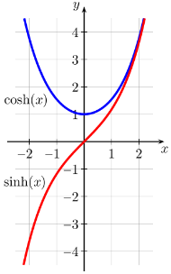
Bansal-Spencer for Indep Coordinates
$Φ\left(t\right)=\sum_{i}{cosh\left(λd_{t−1}\left(i\right)+λε_{t}v_{t}\left(i\right)\right)}$
Want to show $E\left[ΔΦ\left(t\right)\right]≤poly(n)$:
$ΔΦ\left(t\right)$ $≤λε_{t}\sum_{i}{\sinh\left(λd_{t−1}\left(i\right)\right)⋅v_{t}\left(i\right)} + {(λε_{t})}^{2}\sum_{i}{\cosh\left(λd_{t−1}\left(i\right)\right)⋅{\left(v_{t}\left(i\right)\right)}^{2}}$
$≤λε_{t}\sum_{i}{a_{i}X_{i}}+λ^{2}\sum_{i}{\left|a_{i}\right|X_{i}^{2}}+poly(n)$
$≤ −λ\left|\sum_{i}{a_{i}X_{i}}\right|+λ^{2}\sum_{i}{\left|a_{i}\right|X_{i}^{2}}\text{+}poly(n)$
Note: If $E\left[X_{i}\right]=0$, then $E\left[\sum_{i}{a_{i}X_{i}}\right]=0$.
Uniform $±1$ Coordinates:
$E\left|\sum_{i}{a_{i}X_{i}}\right|$ $≈$ ${\left(\sum_{i}{a_{i}^{2}}\right)}^{1/2}$ $≥$ $\sum_{i}{\left|a_{i}\right|/\sqrt{n}}$
Linear and
Quadratic
Let $a_{i}=\sinh\left(λd_{t−1}\left(i\right)\right)$
$$X_{i}=v_{t}\left(i\right)$$
(helping)
(hurting)
$$cosh(x)={(e}^{x}+e^{−x})/2$$
$$sinh\left(x\right)={(e}^{x}−e^{−x})/2$$
| $\cosh\left(x\right)−\left|sinh\left(x\right)\right|$ | $≤1$
Anti-Concentration: For any $(a_{1}…,a_{n})$, do we have $E\left[\left|\sum_{i}{a_{i}X_{i}}\right|\right] ≥λ⋅E\left[\sum_{i}{{|a}_{i}|X_{i}^{2}}\right]$?
So ${\left\|d_{t}\right\|}_{∞}$ $=\frac{1}{λ}O(\log{nT})$
$=O(\sqrt{n} log nT)$
Khintchine
Cauchy-Schwarz

Slide 12
Takeaways
$Φ\left(t\right)≔\sum_{i}{cosh(λ d_{t}(i))}$
Bounding potential $Φ$ implies ${\left\|d_{t}\right\|}_{∞}$ $=\frac{1}{λ}O(\log{nT})$. This reduces to:
Khintchine crucially uses independence of $X_{i}=v_{t}\left(i\right)$
How to handle dependencies, e.g., interval balancing?
Why anti-concent fails with dependencies?
Suppose $a=(1,1,1,…)$
Random subset of size $n/2$ is $+1$ and others $−1$
All $X_{i}$ mean zero, but Linear $=0≪n=$ Quadratic
Anti-Concentration: For any $(a_{1}…,a_{n})$, do we have $E\left[\left|\sum_{i}{a_{i}X_{i}}\right|\right] ≥λ⋅E\left[\sum_{i}{{|a}_{i}|X_{i}^{2}}\right]$?
$$a_{i}=\sinh\left(λd_{t−1}\left(i\right)\right)$$
$$a$$
$$v$$
New way to measure “badness” of $d_{t}$?

Slide 13
OUTLINE
Introduction: Vector Balancing and Geometric Discrepancy
Bansal-Spencer: Vector Balancing for Independent $\left\{+1,−1\right\}$ Coordinates
Vector Balancing with Dependencies: Change the Basis
Interval Discrepancy: Attempt 1 and Attempt 2
Tusnady’s Problem via Haar Basis

Slide 14
Vector Balancing with Dependencies
Recall setting
$T$ vectors drawn i.i.d. from distribution $p$ over ${\left[−1,1\right]}^{n}$
Immediately color $ε_{t}∈\{1,−1\}$
Every prefix-sum nearly balanced $\max_{t} {\left\|\sum_{τ≤t}{ε_{τ}}v_{τ}\right\|}_{∞}$
Change the Basis to get Uncorrelation
Work in eigen basis of Covariance Matrix $E_{v\sim p}\left[vv^{T}\right]=\sum_{k}{λ_{k}u_{k}u_{k}^{T}}$
New $i$-th coordinate of $v$ is $X_{i}=\left\langle v | u_{i}\right\rangle$
Now $E\left[X_{i}X_{j}\right]=E\left[u_{i}^{T}vv^{T}u_{j}\right]=u_{i}^{T}(\sum_{k}{λ_{k}u_{k}u_{k}^{T}})u_{j}=0$
Greedy using Potential $Φ\left(t\right)≔\sum_{i}{cosh\left(λ⋅\left\langle d_{t} | u_{i}\right\rangle \right)}$
WLOG assume symmetric: v & –v equally likely
$X_{i}$ uncorr if $∀i≠j$, $E\left[X_{i}X_{j}\right]=0$
Recall, Bansal-Spencer’19 $Φ\left(t\right)≔\sum_{i}{cosh(λ d_{t}(i))}$
Anti-Concentration?

Slide 15
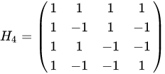
Anti-concentration for Uncorrelated R.V.s
LEMMA : For any $\left(a_{1}, …, a_{n}\right)$ and random variables $X_{1}, …,X_{n}$ that satisfy
(1) Uncorr $∀i≠j$, $E\left[X_{i}X_{j}\right]=0$ (2) Magnitude at most $1$ (3) Sparsity $s$, we have
$$E\left|\sum_{i}{a_{i}X_{i}}\right| ≥\frac{1}{s}⋅E\left[\sum_{i}{{|a}_{i}|X_{i}^{2}}\right]$$
Note: Khintchine + Cauchy-Schwarz gives $1/\sqrt{s}$ for indep $\{1,−1\}$
Tightness (for $s=n$):
Let $a=(1,1,…)$
A random column of $±$Hadamard with $X_{i}$ = $i^{th}$ coordinate
Since rows orthogonal, $∀i≠j$, $E\left[X_{i}X_{j}\right]=0$
$E\left|\sum_{i}{a_{i}X_{i}}\right|=\frac{1}{n}⋅n=1$ and $E\left|\sum_{i}{\left|a_{i}\right|X_{i}^{2}}\right|=n$

Slide 16
Wrapping Up: Vector Balancing
Theorem : Online Vector Balancing has discrepancy $O(n^{2}⋅log nT)$
Work in eigen basis
Uncorrelation implies anti-concent with $λ^{−1}=\sqrt{n}⋅s$
So discrep in new basis $\frac{1}{λ}O\left(\log{nT}\right)=O(\sqrt{n}⋅n⋅log nT)$
Going back to the original basis
Discrepancy-vector $d_{t}$ has $ℓ_{2}$ norm $O(n^{2}⋅log nT)$
Since $ℓ_{2}$ norm preserved, and upper bounds $ℓ_{∞}$ norm
Why Geometric Discrepancy is Tricky?
Sparsity might be lost in eigen basis
Can’t lose $\sqrt{n}$ going back as $n=Θ(T)$

Slide 17
OUTLINE
Introduction: Vector Balancing and Geometric Discrepancy
Bansal-Spencer: Vector Balancing for Independent $\left\{+1,−1\right\}$ Coordinates
Vector Balancing with Dependencies: Change the Basis
Interval Discrepancy: Attempt 1 and Attempt 2
Tusnady’s Problem via Haar Basis

Slide 18
Online Interval Discrepancy
$$x_{1}$$
Recall setting
$T$ points arrive uniformly in unit interval $[0,1]$
Immediately color $ε_{t}∈\{1,−1\}$
Hopeless for adversarial arrival
$Ω(T)$ discrepancy for adaptive adversary
$Ω(\sqrt{T})$ discrepancy for oblivious adversary
Why naïve Greedy Algorithms don’t seem to work:
Tension between local and global intervals
$$x_{3}$$
$$x_{2}$$
$$0$$
$$1$$
Interval $I$
$$+$$
$$+$$
$$−$$
$$−$$
$$+$$
$$0$$
$$1$$
Next arrival

Slide 19
Attempt 1
$$I$$
Greedy with a natural potential
$Φ\left(t\right)≔\sum_{I is dyadic}{\cosh\left(λ d_{t}\left(I\right)\right)}$
Ideal Lemma: For a random root-leaf path $P_{ℓ}$:
$E\left|\sum_{i∈P_{ℓ}}{sinh\left(d\left(i\right)\right)}\right| ≥λ⋅E\left[\sum_{i∈P_{ℓ}}{\left|sinh\left(d\left(i\right)\right)\right|}\right]$
Why it Fails and Works?
Linear is exponentially smaller (in height) than Quadratic
Cannot make height $\log{T}$
Can still make height $O(loglog T)$
$$0$$
$$1$$
Linear vs
Quadratic
$$X_{i}=1[x_{t} in interval i]$$
Fractal Structure
How can we do better?
ThM [Jiang-Kulkarni-S]: Gives sub-poly discrepancy: $T^{1/loglog T}$

Slide 20
Attempt 2
Compare to $$\cosh\left(λ d_{t}\left(I\right)\right)$$
$$I$$
A Different Potential
$Φ\left(t\right)≔cosh\left(λ d_{t}^{root}\right)+\sum_{I is dyadic}{\cosh\left(λ d_{t}\left(I^{left}\right)−λ d_{t}\left(I^{right}\right)\right)}$
Why Bounding this Potential Suffices?
$\left|d^{left}−d^{right}\right|≤α$ & $\left|d^{left}+d^{right}\right|≤α$ implies both $≤α$
Why does it help?
Get a Martingale: Equally likely to be in left/right subtree
Burkholder-Davis-Gundy instead of Khintchine
Now Cauchy-Schwarz, ${\left\|d_{t}\right\|}_{∞}≤\frac{1}{λ}O\left(\log{T}\right) \text{=} \text{polylog}\text{(}\text{T}\text{)}$
$$I^{right}$$
$$I^{left}$$
$$0$$
$$1$$
$$I$$
$$I^{left}$$
$$I^{right}$$
Tusnady’s Problem?
What’s Really Happening?

Slide 21
OUTLINE
Introduction: Vector Balancing and Geometric Discrepancy
Bansal-Spencer: Vector Balancing for Independent $\left\{+1,−1\right\}$ Coordinates
Vector Balancing with Dependencies: Change the Basis
Interval Discrepancy: Attempt 1 and Attempt 2
Tusnady’s Problem via Haar Basis

Slide 22
Haar Basis View
$$I$$
$Φ\left(t\right)≔cosh\left(λ d_{t}^{root}\right)+\sum_{I is dyadic}{\cosh\left(λ d_{t}\left(I^{left}\right)−λ d_{t}\left(I^{right}\right)\right)}$
Forms $n$ dimensional orthogonal Haar Basis
Uncorrelation $∀i≠j$, $E\left[X_{i}X_{j}\right]=0$
Retains sparsity $s=log T$
Don’t lose while going back to original basis
$\left|d^{left}−d^{right}\right|≤α$ & $\left|d^{left}+d^{right}\right|≤α$ implies both $≤α$
Use $cosh$ potential in Haar basis & anti-concentration of uncorrelated r.v.s
Don’t need Burkholder-Davis-Gundy
$$I^{left}$$
$$I^{right}$$
$$0$$
$$1$$
$$I$$
$$I^{left}$$
$$I^{right}$$

Slide 23
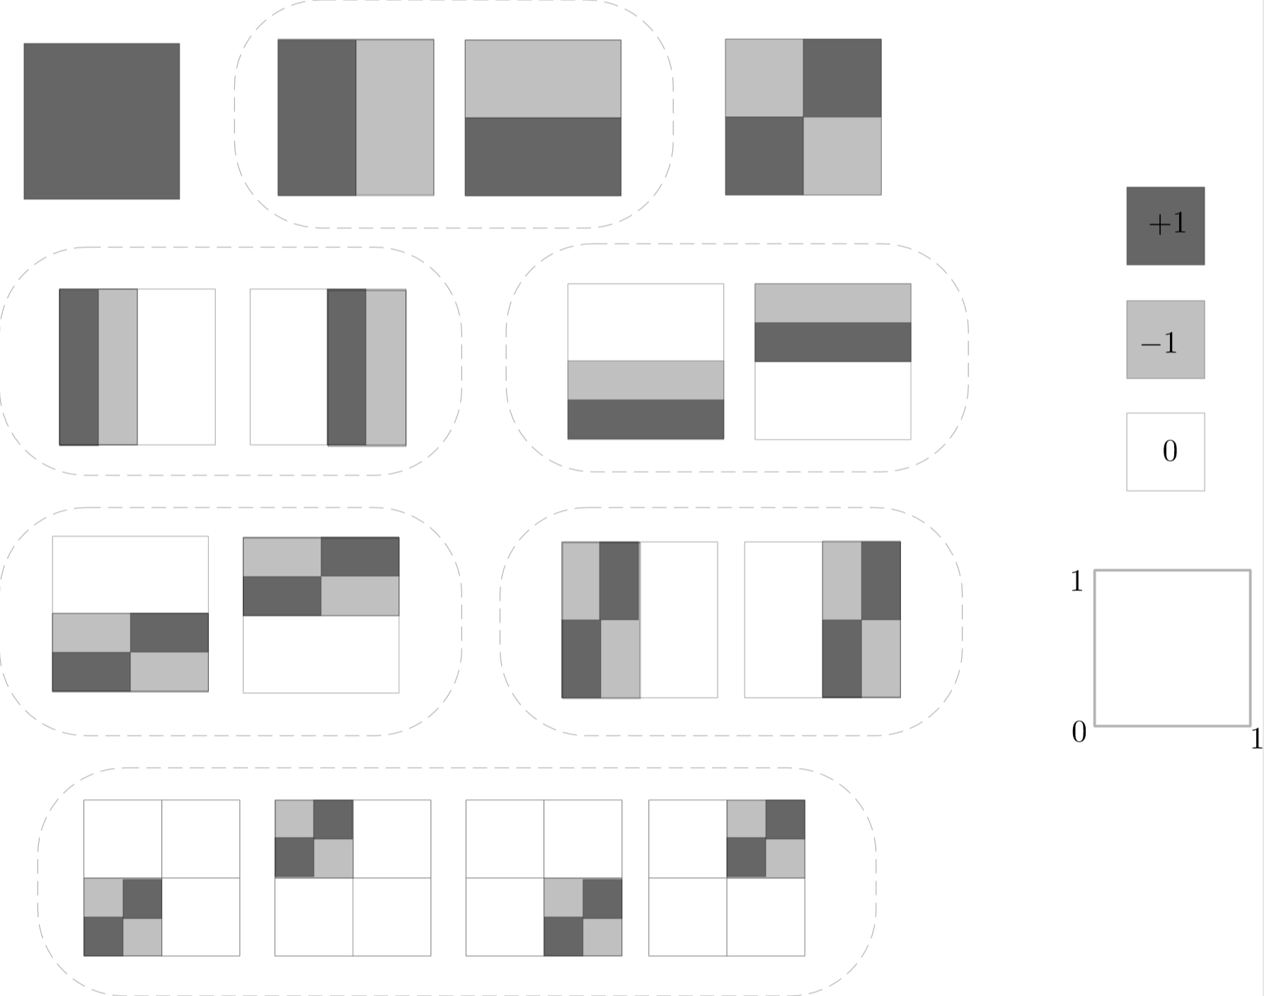
Tusnady’s Problem
Theorem : Online d-dim Tusnady’s discrep is $O(log^{2d+1} T)$
Tensor product of 1-d Haar-basis
Still gives uncorrelation
Preserves sparsity
Don’t lose while going back to the original basis

Slide 24
Conclusion
Online Stochastic Arrivals:
$poly(n\log{T})$ for vector balancing
$poly(\log^{d}{T})$ for d-dim Tusnady’s problem
Techniques:
Use $cosh⁡( )$ potential. Show Linear $≈$Quadratic
Change basis to get Uncorrelation, which implies Anti-Concentration
Eigen basis and Haar basis
Open Problems:
Extend vector balancing to oblivious adversary?
(Easier Prophet model) Independent but non-identical distributions?
Questions?

Slide 25
Further SLIDES

Slide 26
Anti-concentration for Uncorrelated R.V.s
LEMMA : For any $\left(a_{1}, …, a_{n}\right)$ and random variables $X_{1}, …,X_{n}$ that satisfy
(1) Uncorr $∀i≠j$, $E\left[X_{i}X_{j}\right]=0$ (2) Magnitude at most $1$ (3) Sparsity $s$, we have
$$E\left|\sum_{i}{a_{i}X_{i}}\right| ≥\frac{1}{s}⋅E\left[\sum_{i}{{|a}_{i}|X_{i}^{2}}\right]$$
Proof (for $s=n$):
$E\left|\sum_{i}{a_{i}X_{i}}\right|$
$≥E\left|\sum_{i}{a_{i}X_{i}}\right|⋅{|X}_{k}|$
$=E\left[|a_{k}X_{k}^{2}+\sum_{i≠k}{a_{i}X_{i}X_{k}}|\right]$
$≥E\left[sign\left(a_{k}\right)\left(a_{k}X_{k}^{2}+\sum_{i≠k}{a_{i}X_{i}X_{k}}\right)\right]$
$=E[{\left|a_{k}\right|X}_{k}^{2}]$
Now sum over all $k$.
Khintchine + Cauchy-Schwarz gives $1/\sqrt{s}$ for indep $\{1,−1\}$
Tightness:
A random row of $±$Hadamard matrix
$X_{i}$ is the $i^{th}$ coordinate of this row

Slide 27
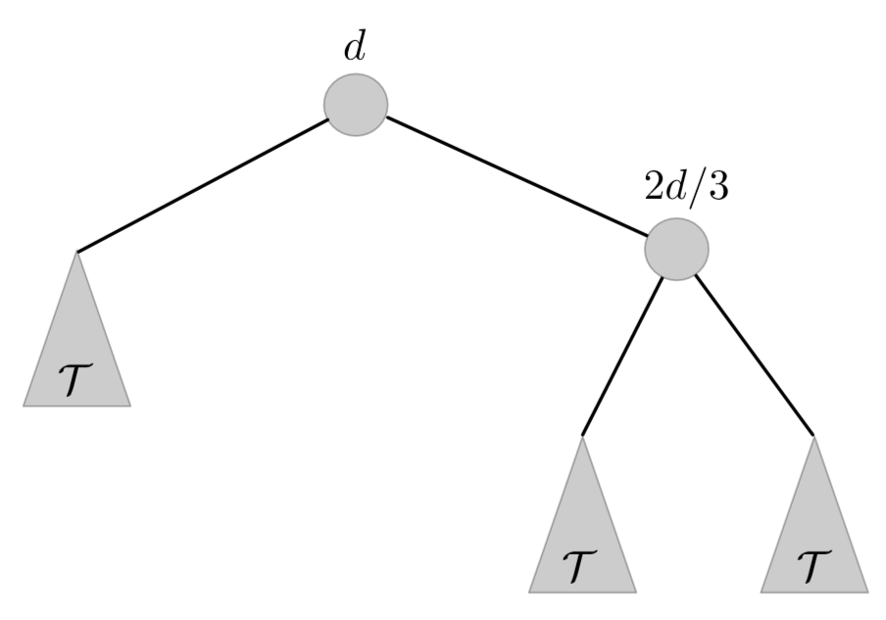
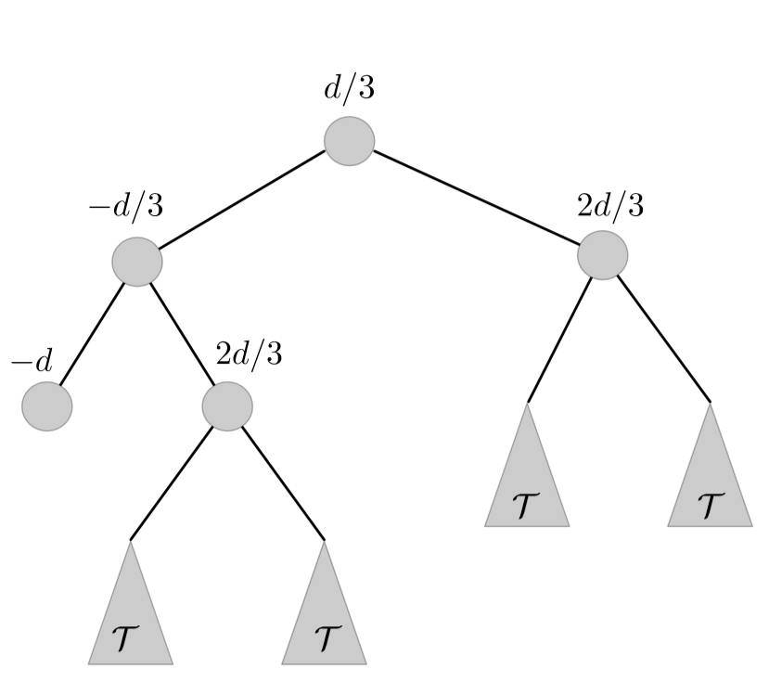
Fractal Structure
Tree
Fractal

Slide 28
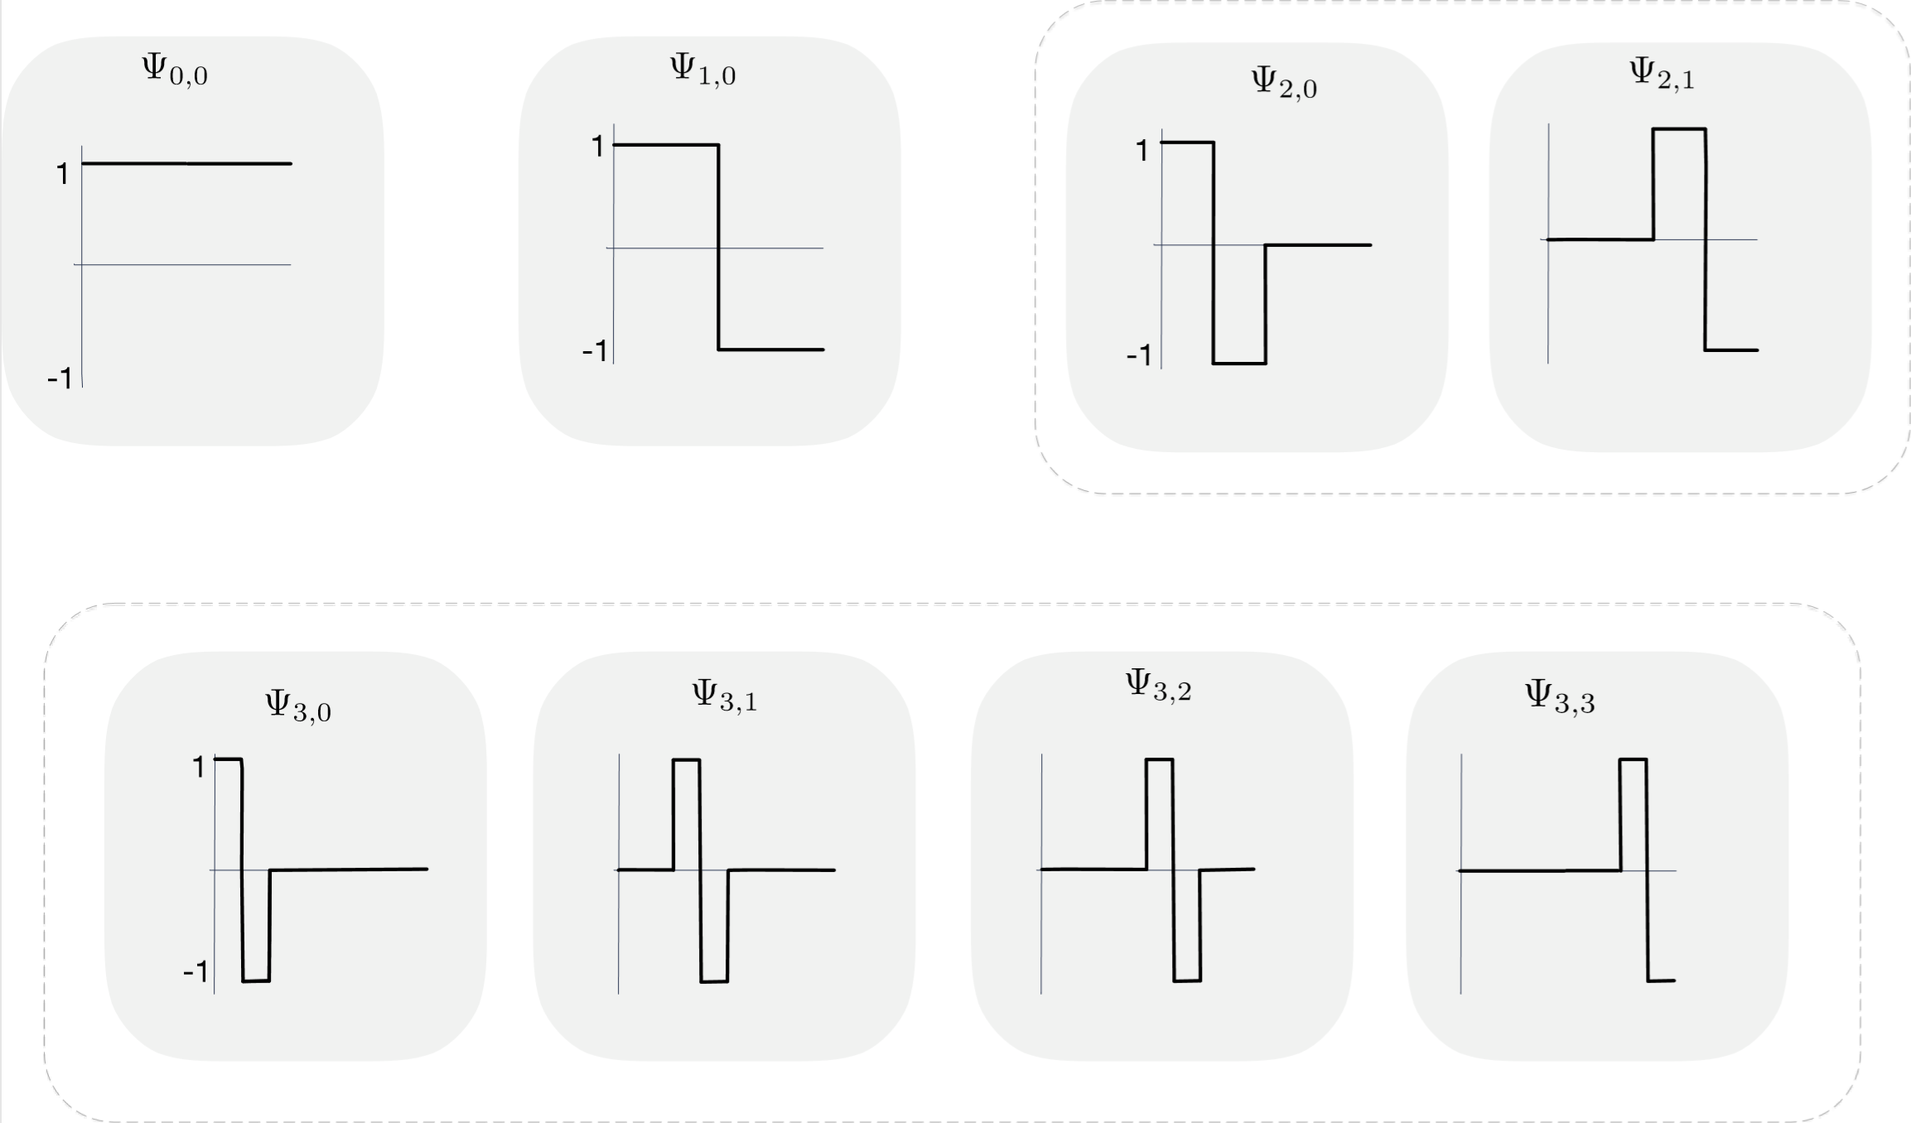
Attempt 3: Haar Basis
$Φ\left(t\right)≔cosh\left(λ d_{t}^{root}\right)+$
$\sum_{I is dyadic}{\cosh\left(λ d_{t}\left(I^{left}\right)−λ d_{t}\left(I^{right}\right)\right)}$
Orthogonal Haar Basis:
$Ψ\left(x\right)≔\left\{\begin{aligned}+1 if 0≤x<0.5 \\ −1 if 0.5≤x≤1\end{aligned}\right.$
$Ψ_{0,0}\left(x\right)=1$
$Ψ_{j,k}\left(x\right)≔Ψ(2^{j−1}x−k)$ for $j≥1$ & $0≤k≤2^{j−1}$
Use $cosh$ potential in Haar Basis:
Retains $\log{T}$ sparsity
Don’t lose while going back to original basis
Uncorrelation

Slide 29
EXTENSIONS and Lower Bounds
d-Dimensional Interval Discrepancy:
$T$ points uniformly in $\left[0,1\right]×[0,1]$
Interval Discrepancy after projection on each axis
Offline problem same as $d$-permutations problem
Use Haar Basis for each Axis:
At most $O(d log^{3} T)$
At least $Ω(\sqrt{d log (T/d)})$
Main Idea for Lower Bounds:
Use uncorrelation to imply potential “somewhat” rises
Thus, discrepancy is at least something
$$1$$
$$x_{1}$$
$$x_{2}$$
$$x_{4}$$
$$x_{3}$$
$$0$$
$$1$$

